Slide 1
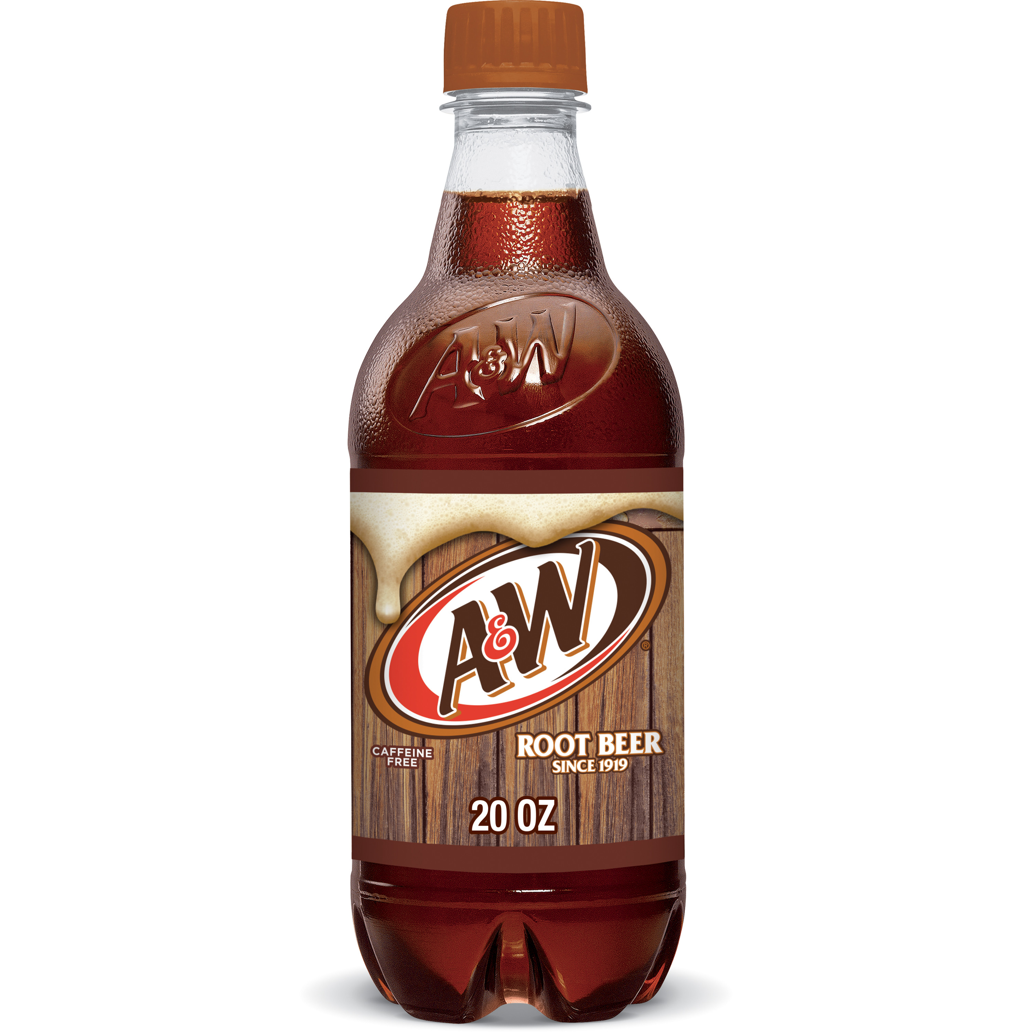
A&W Root Beer Soda Pop Bottle

Slide 2
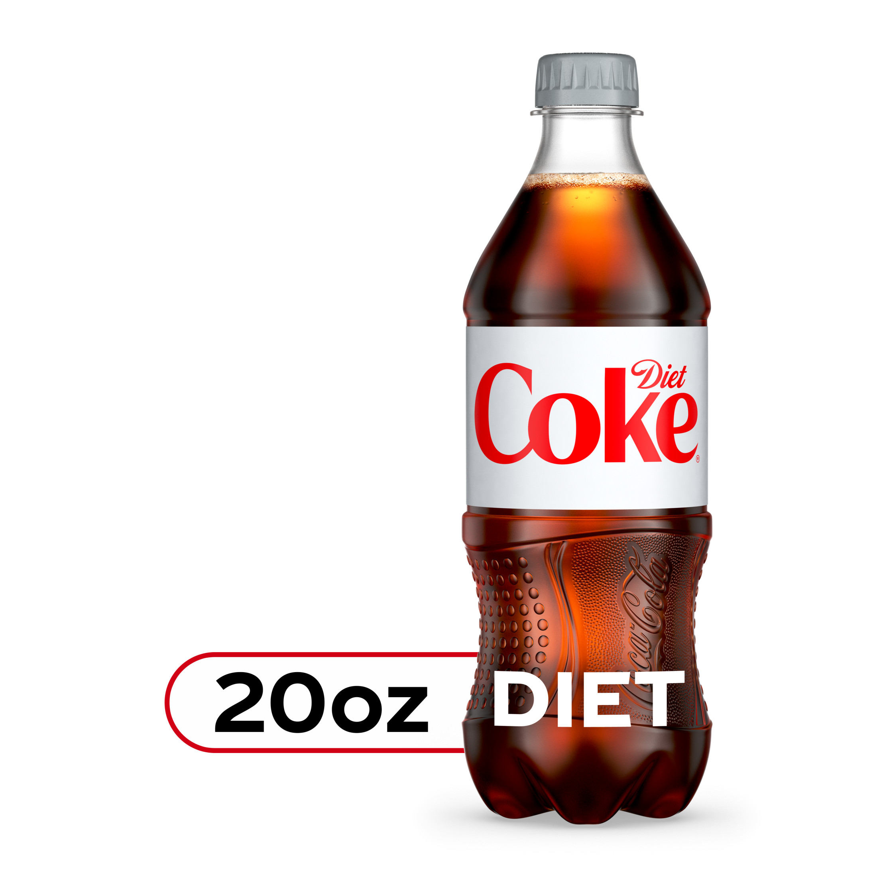
Coca-Cola Soda Diet Pop Bottle

Slide 3
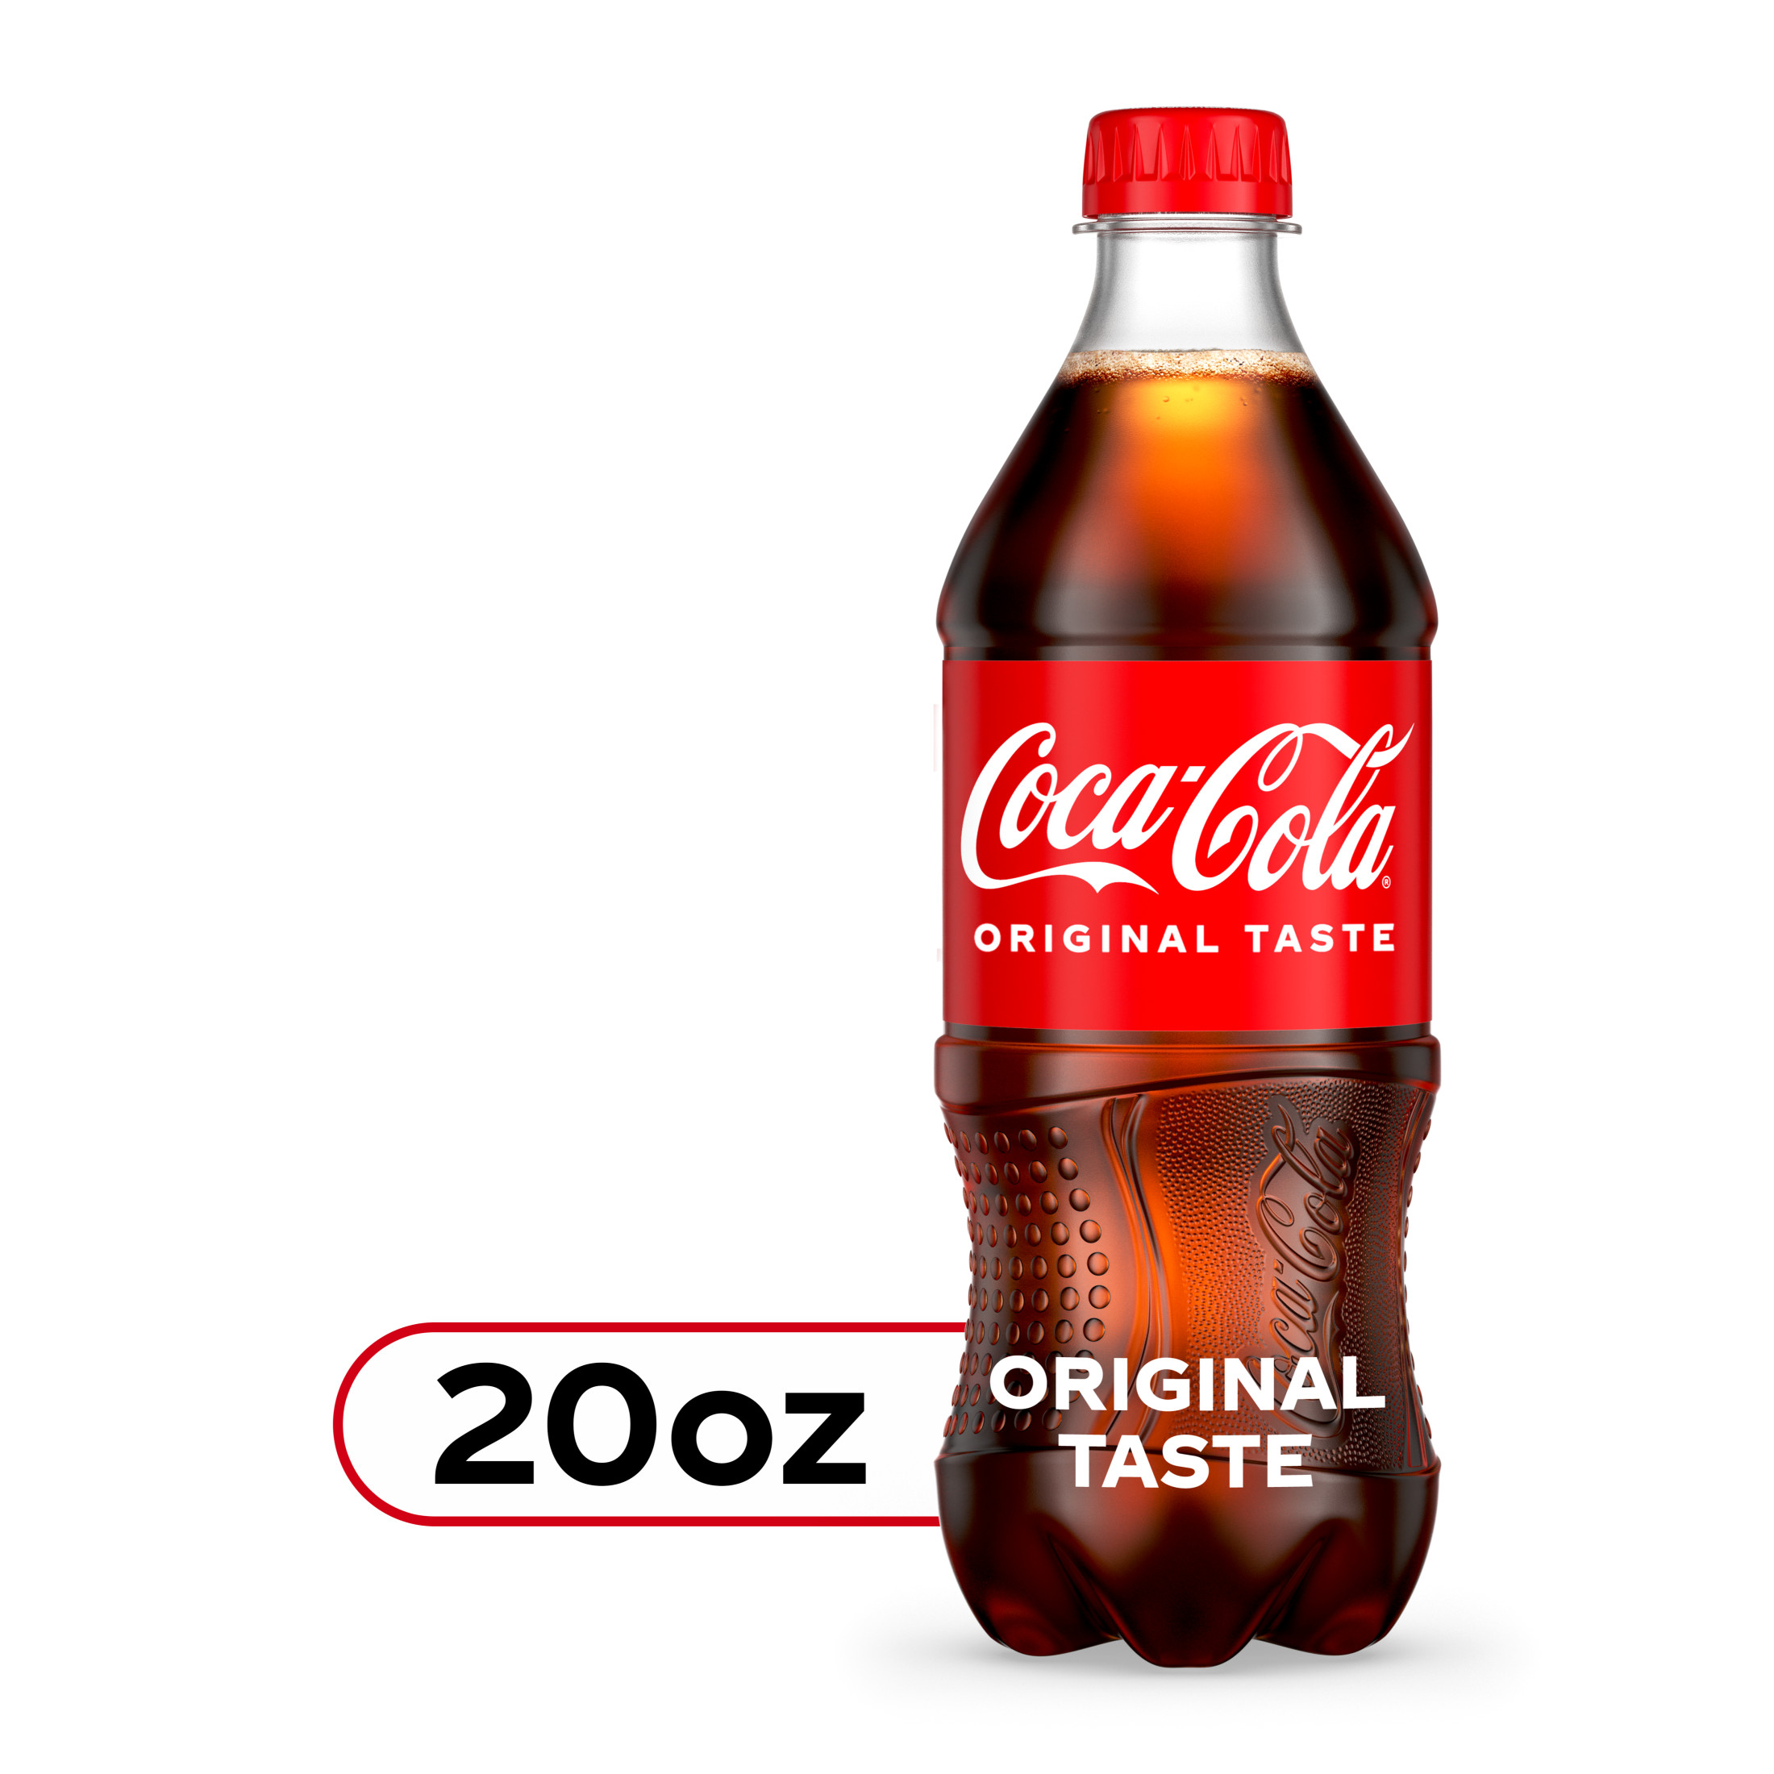
Coca-Cola Soda Original Pop Bottle

Slide 4
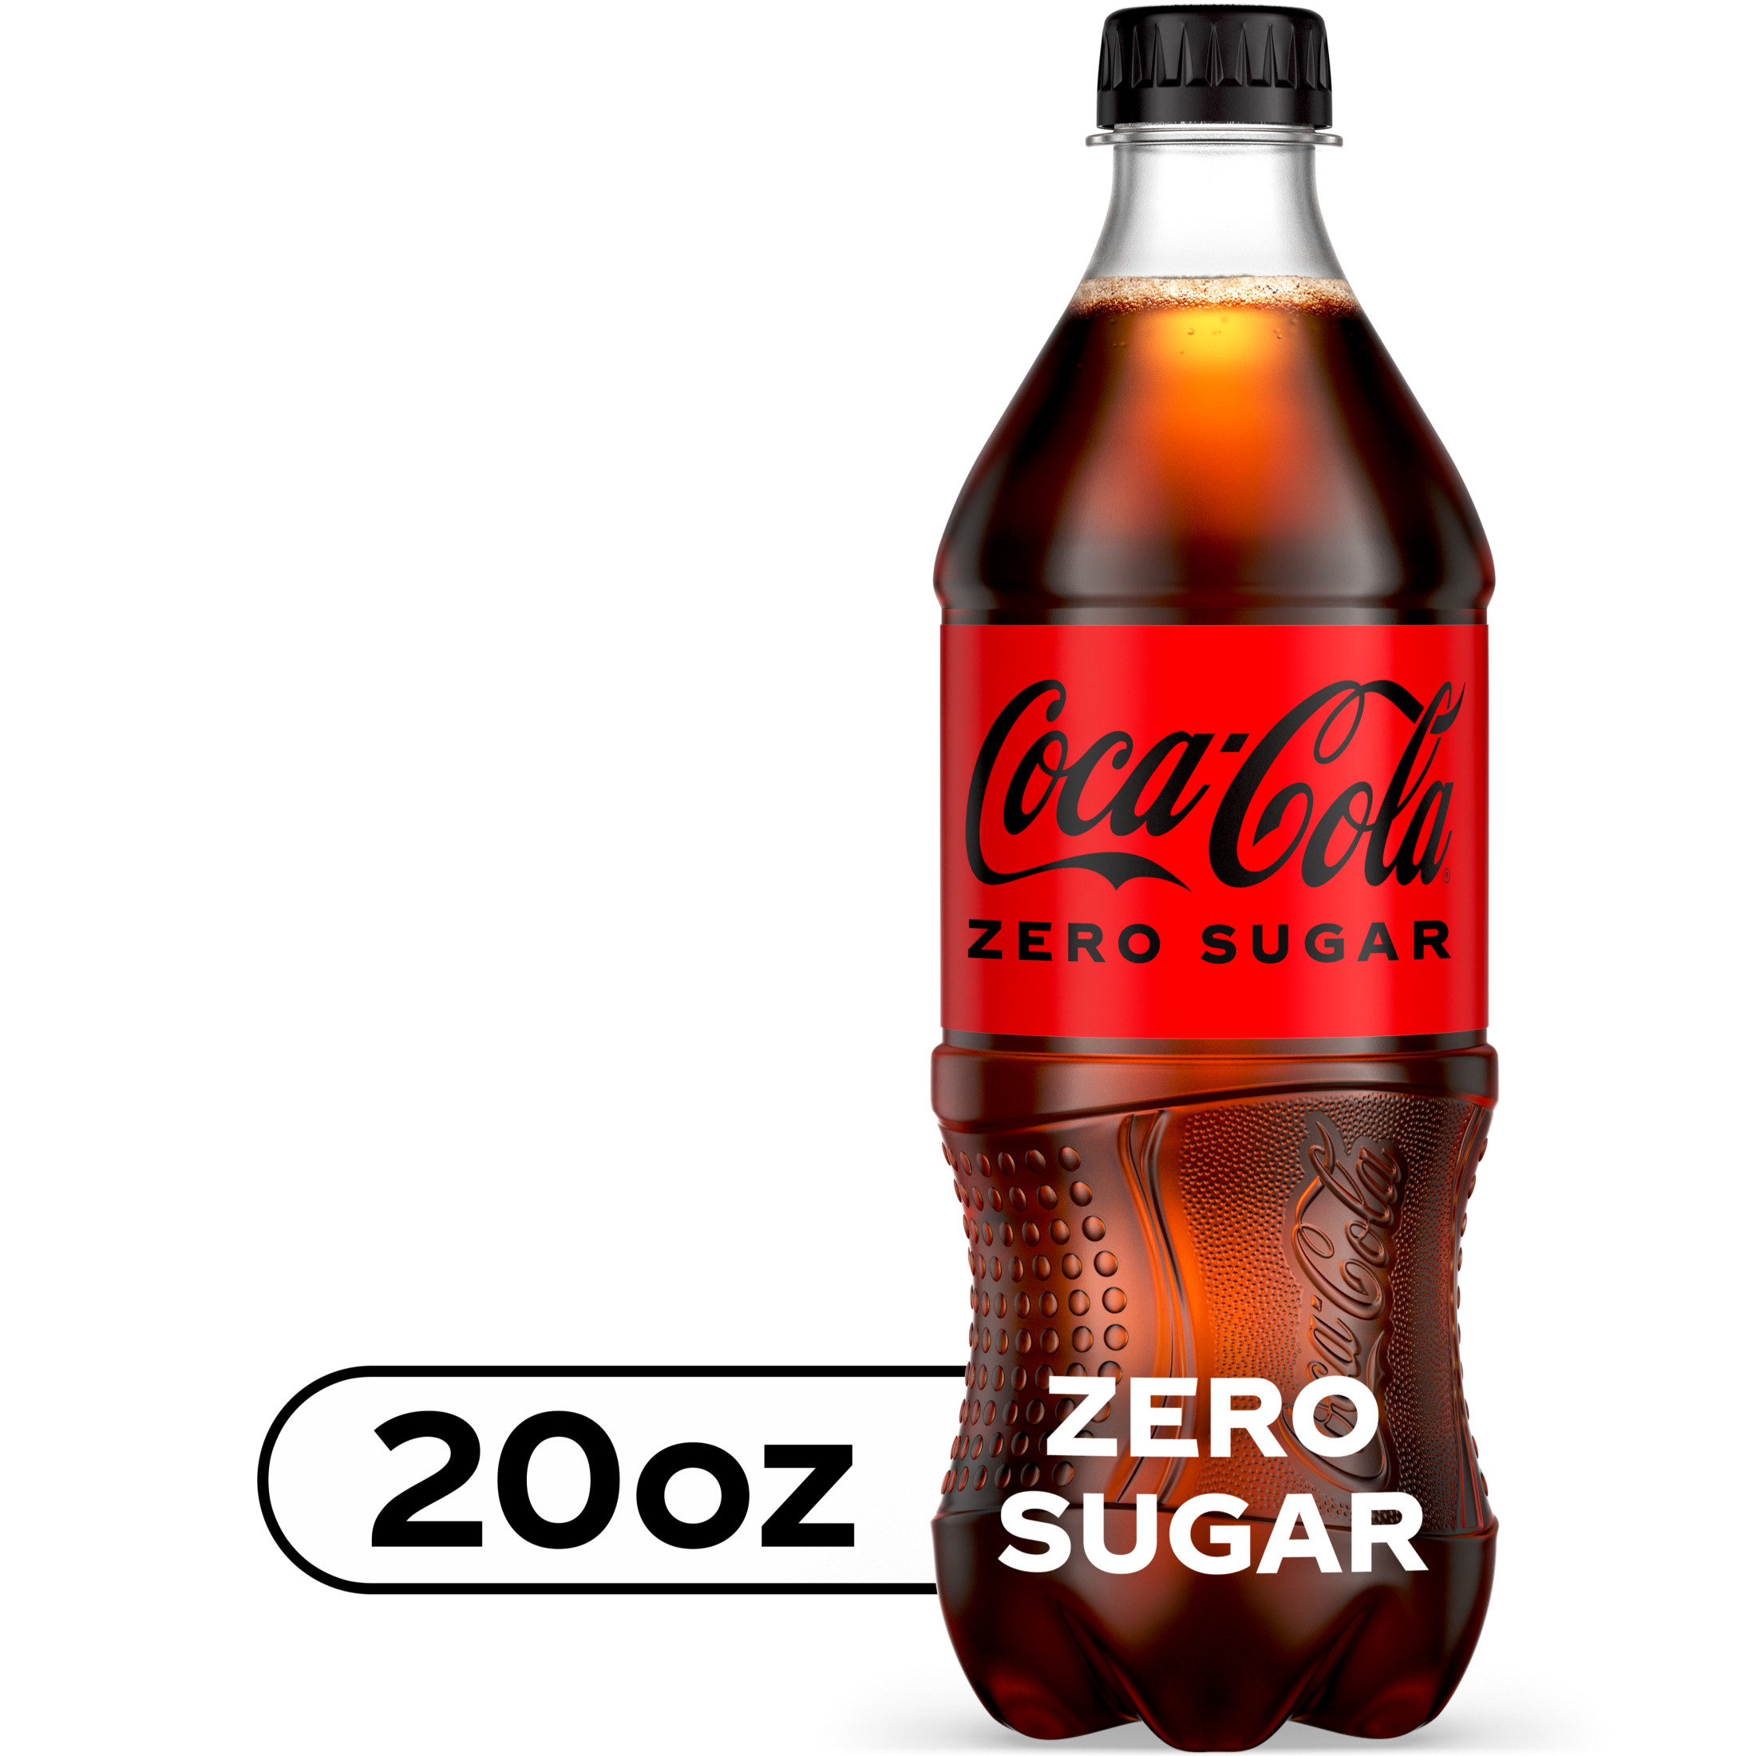
Coca-Cola Soda Zero Pop Bottle

Slide 5
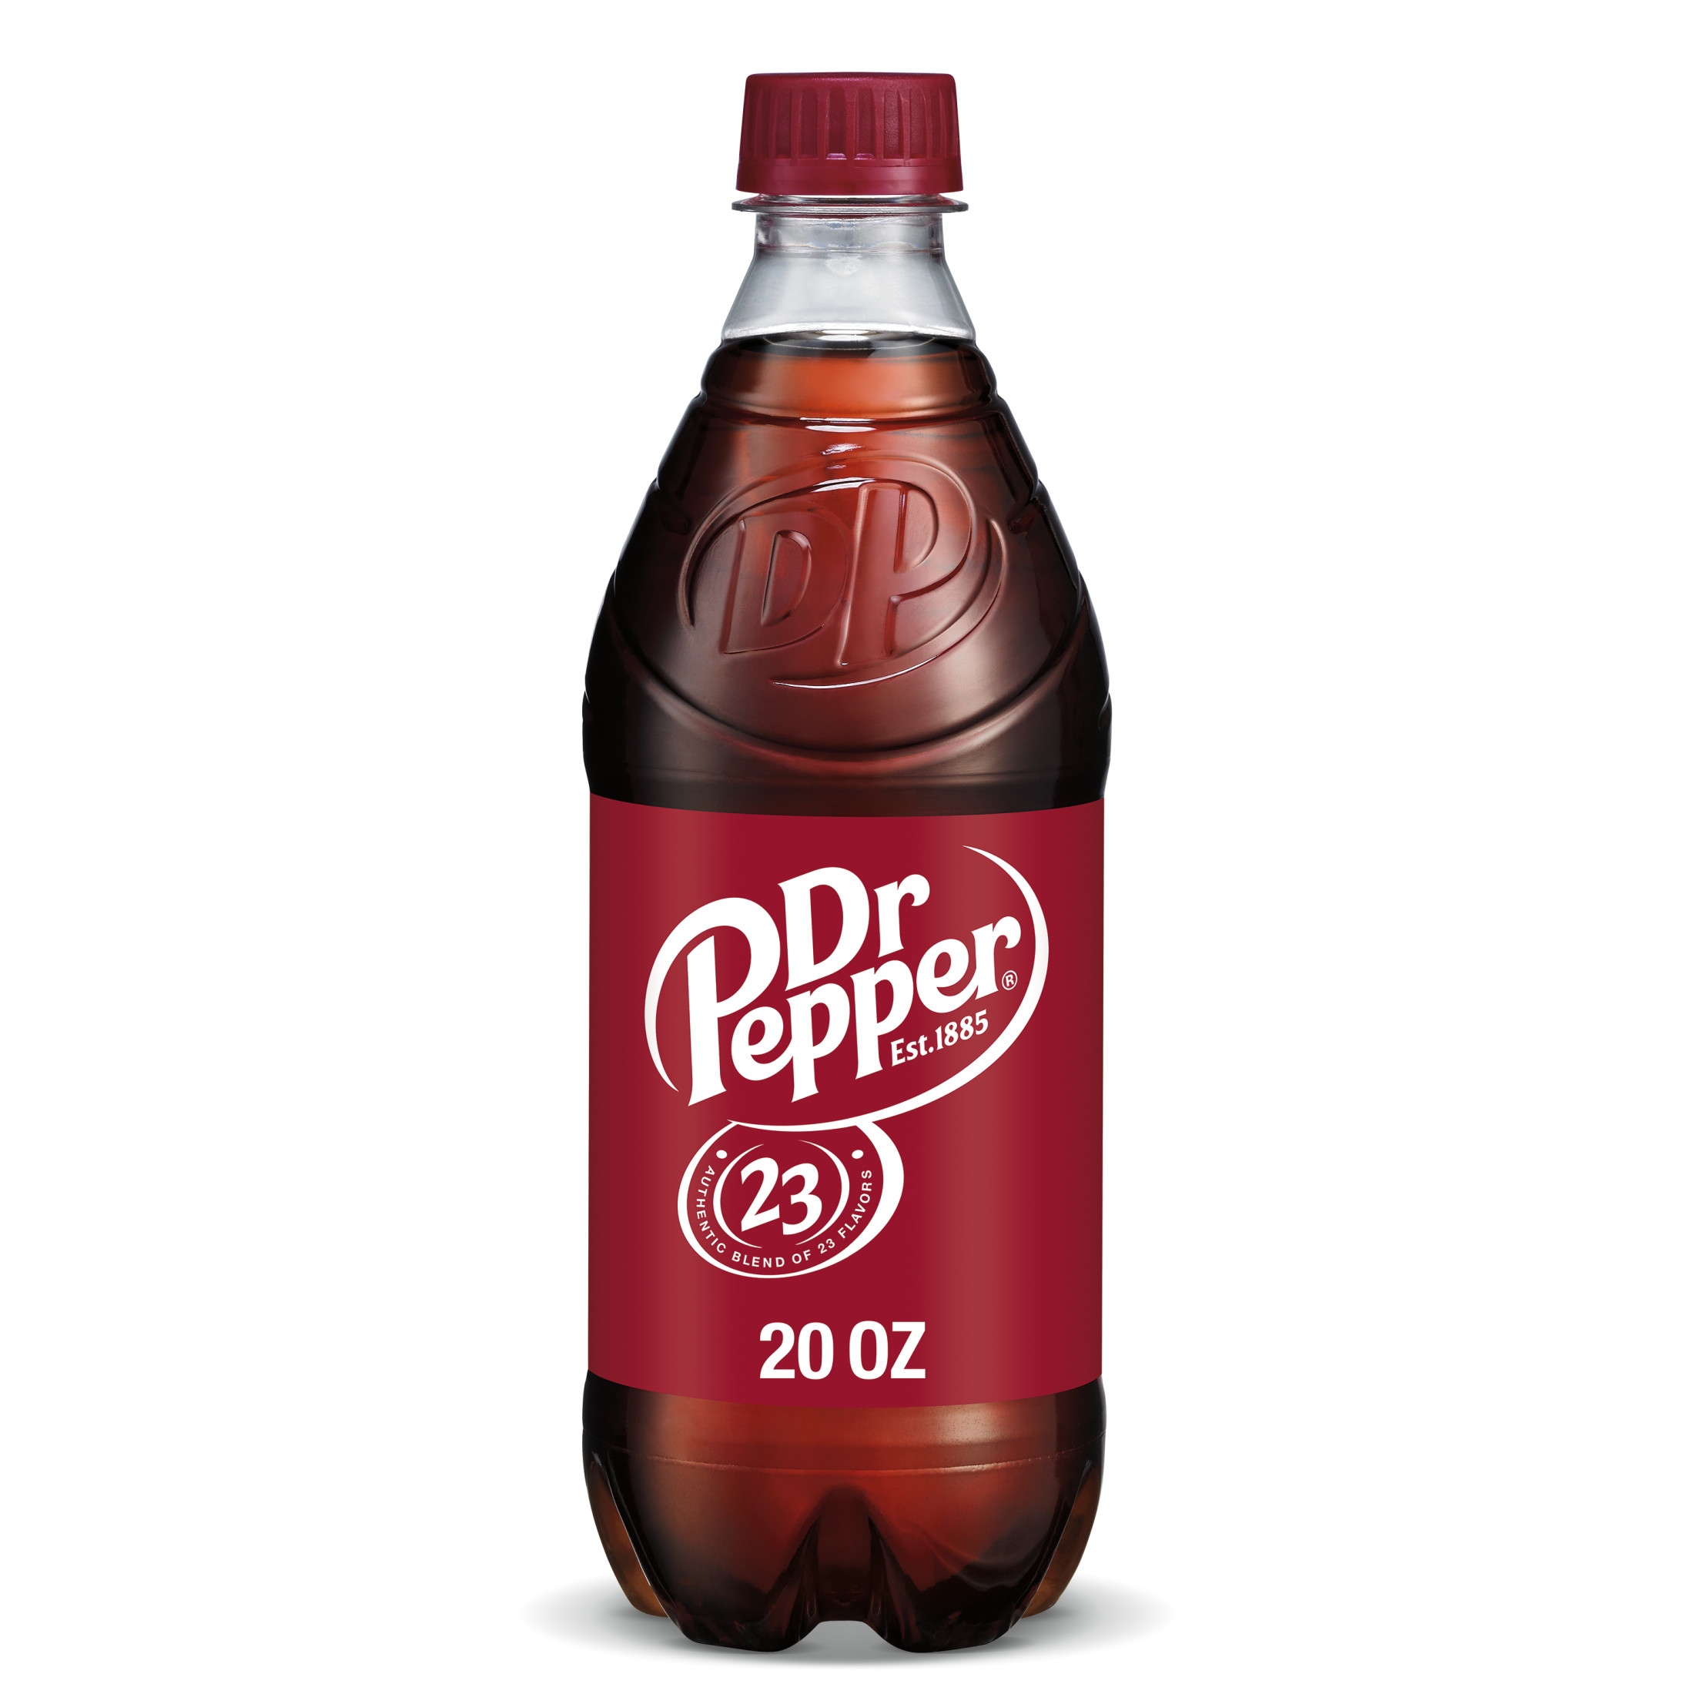
Dr Pepper Soda Pop Bottle

Slide 6
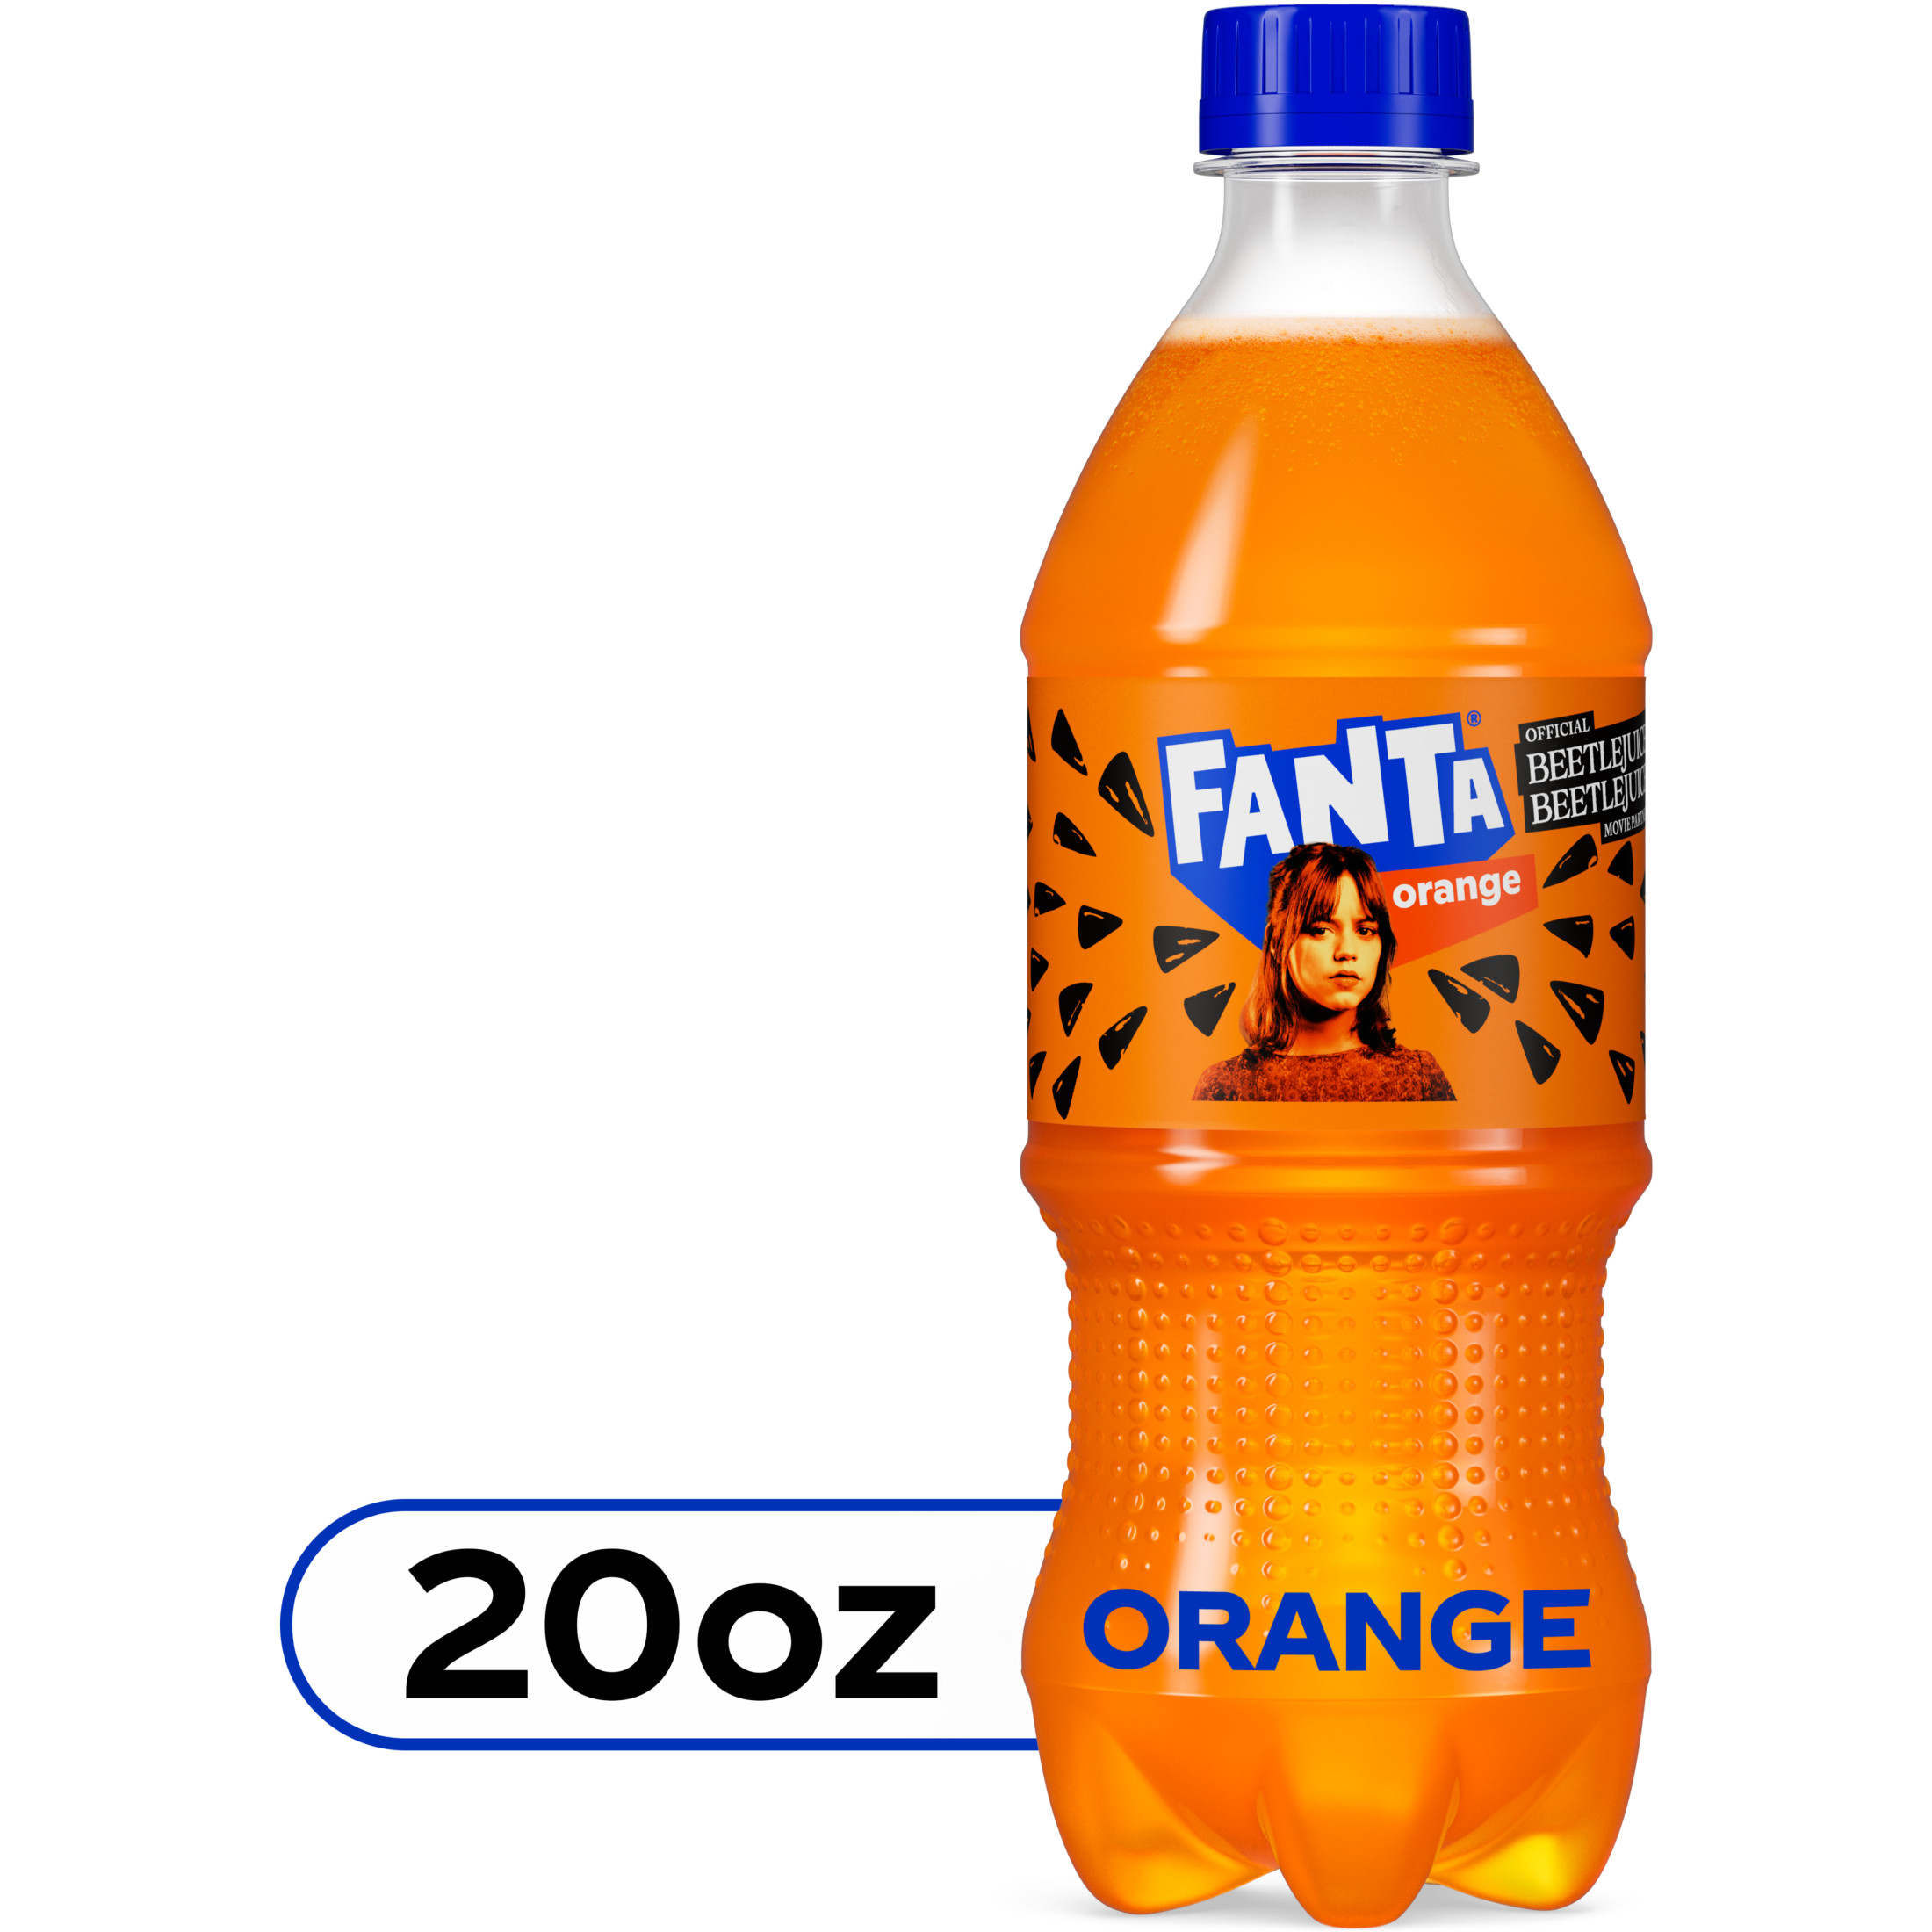
Fanta Orange Fruit Soda Pop Bottle

Slide 7
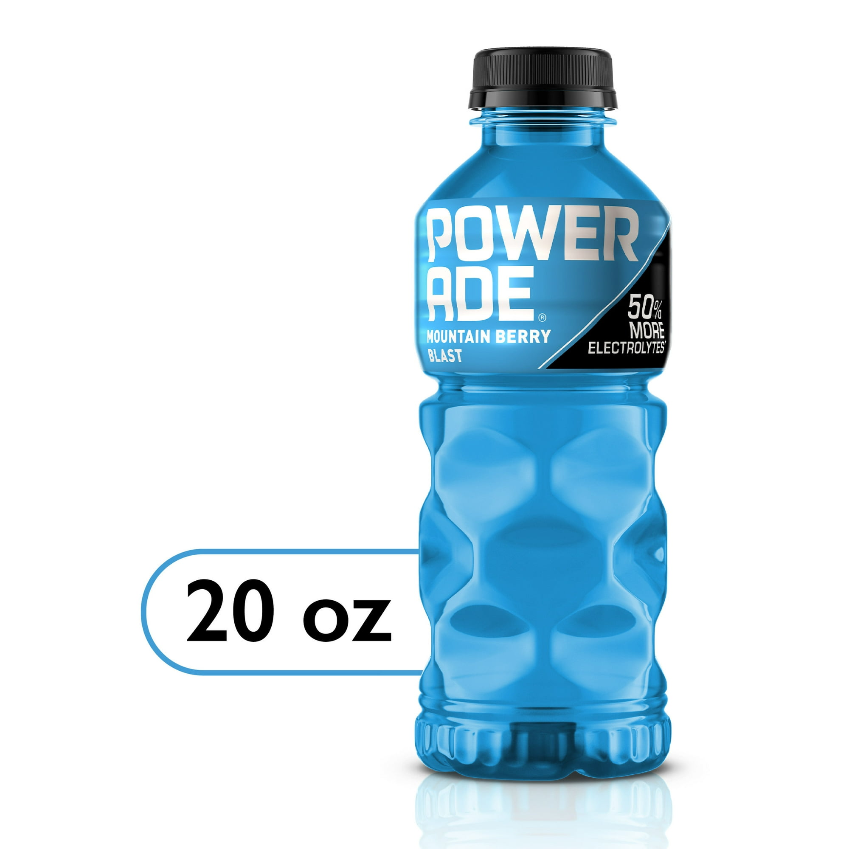
POWERADE Mountain Berry Blast

Slide 8
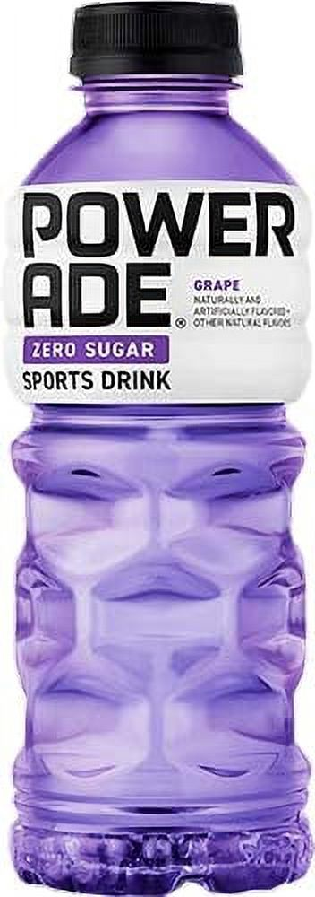
Powerade Zero Purple Grape

Slide 9
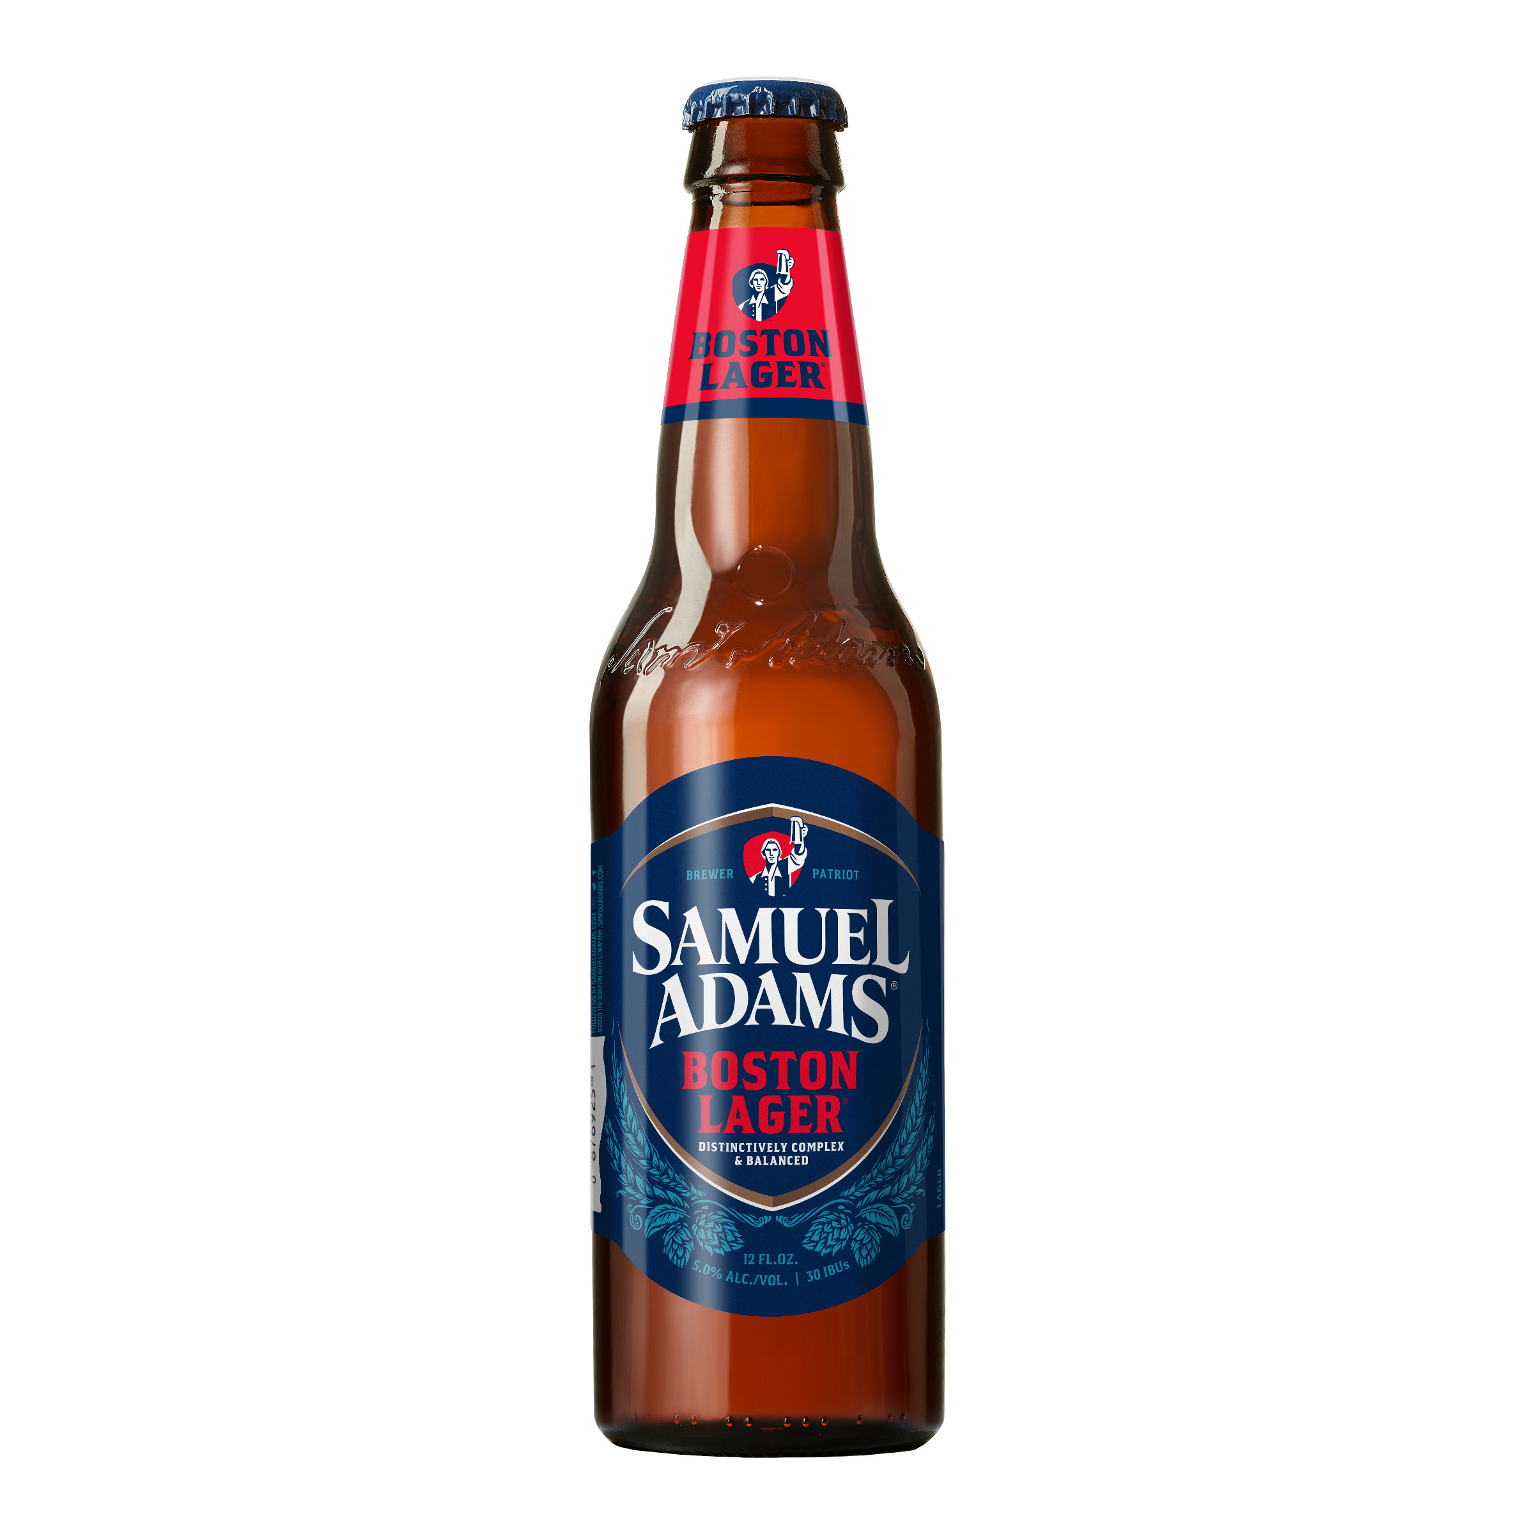
Samuel Adams Boston Lager Craft Beer

Slide 10
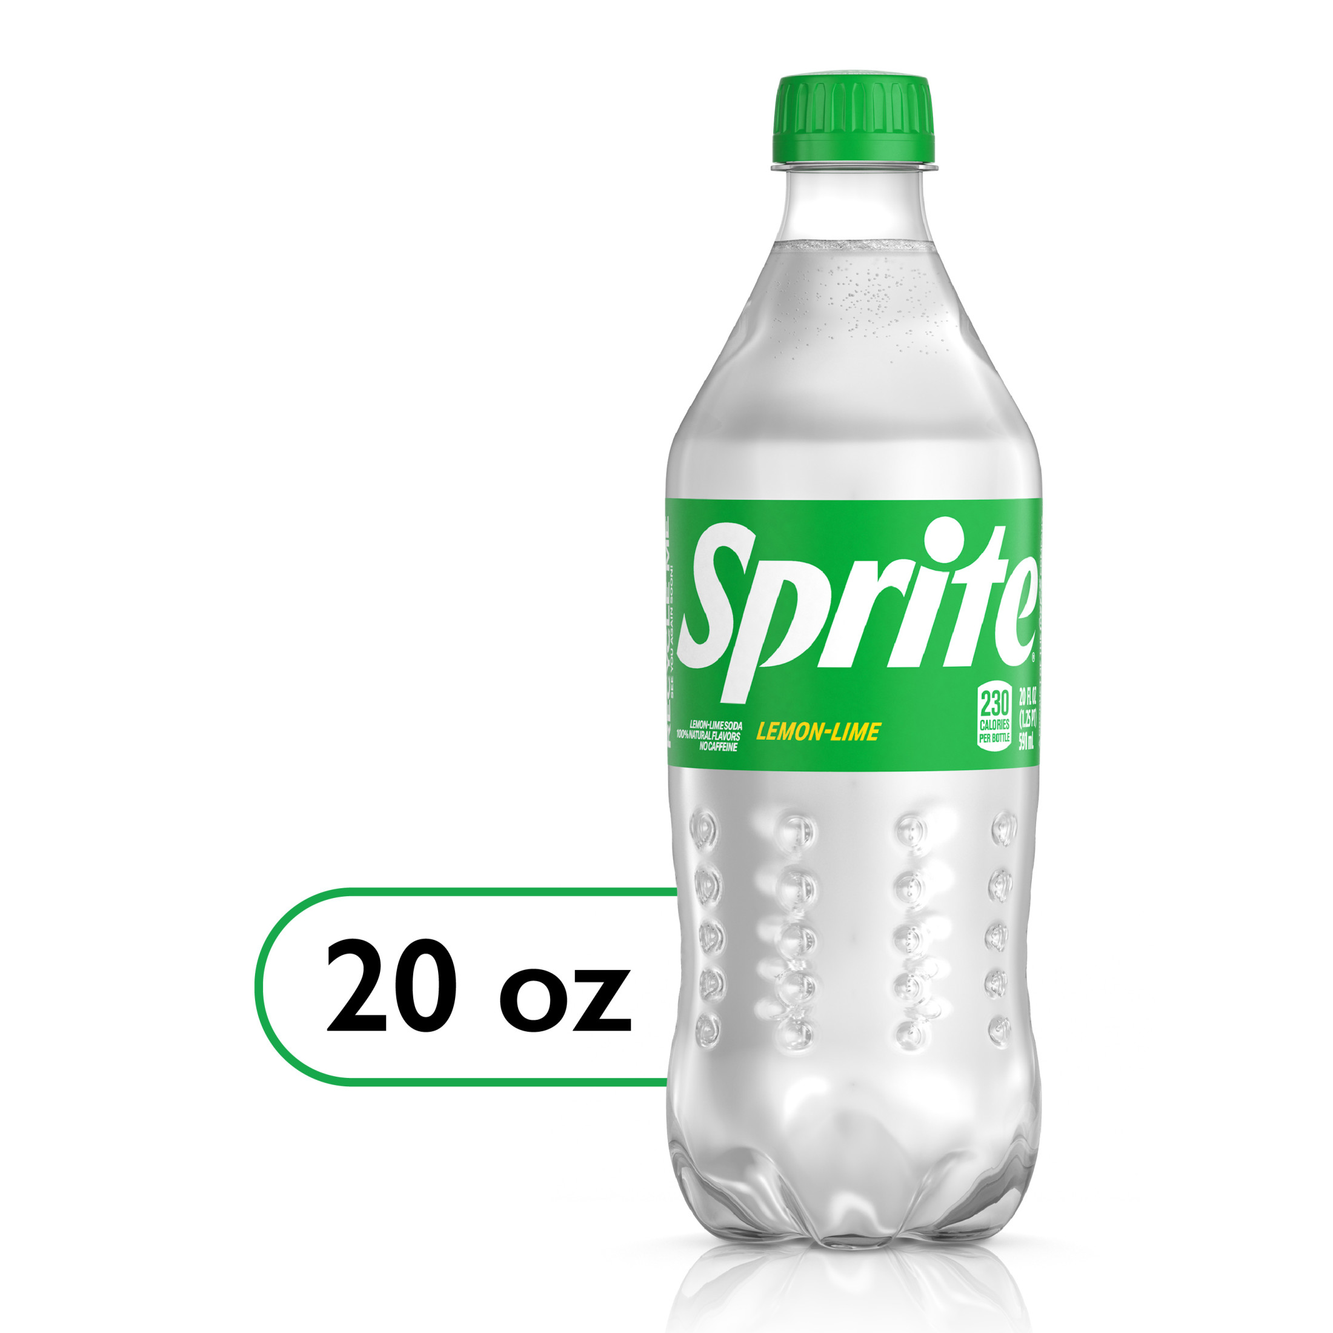
Sprite Lemon Lime Soda Pop Bottle

Slide 11
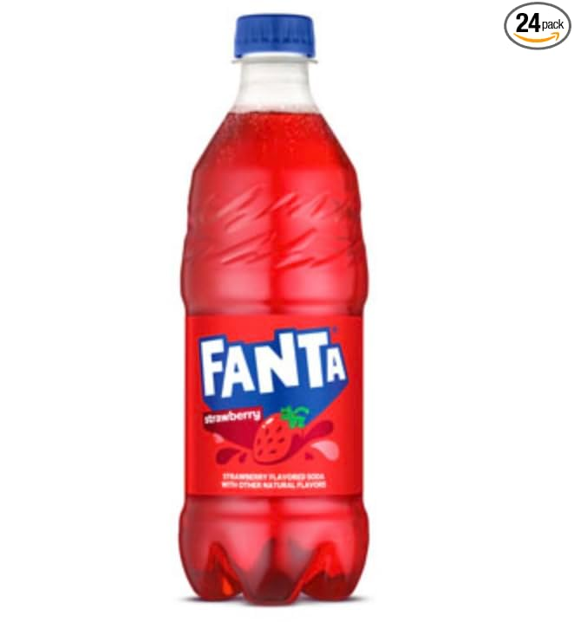
Fanta Strawberry Soda Bottle

Slide 12
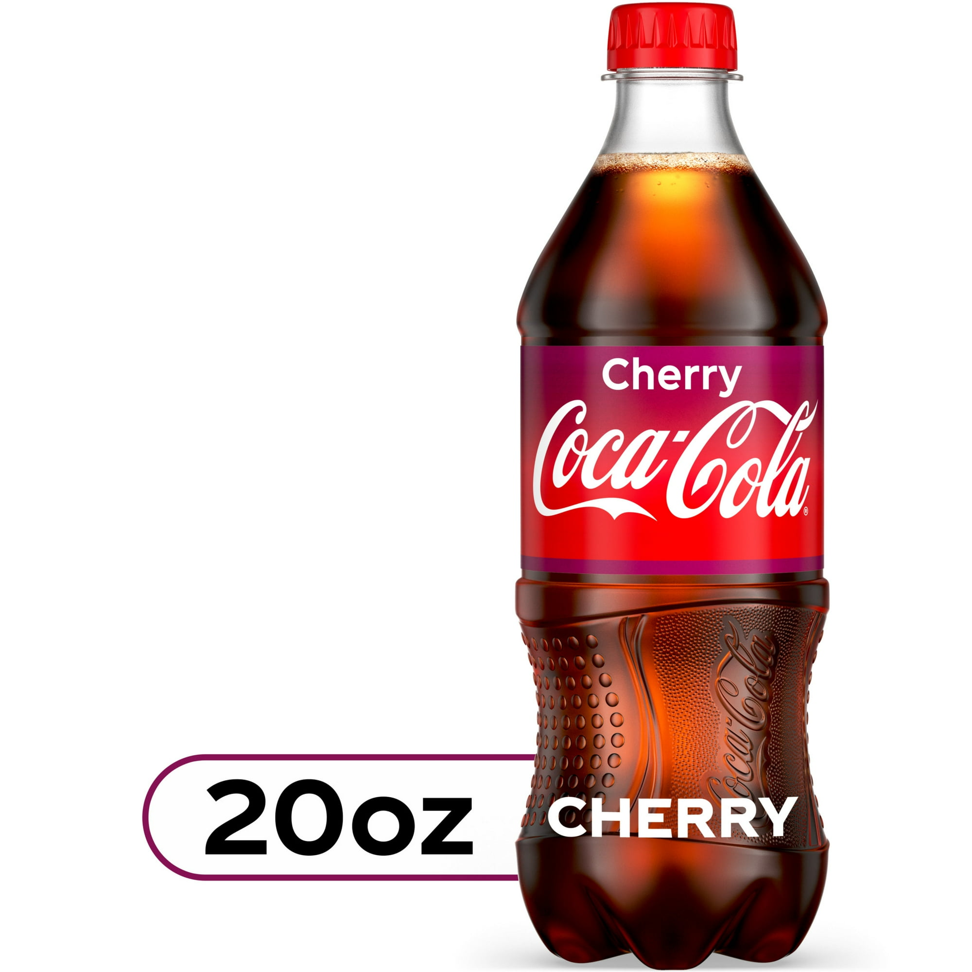
Coca-Cola Cherry Soda Pop Bottle

Slide 13
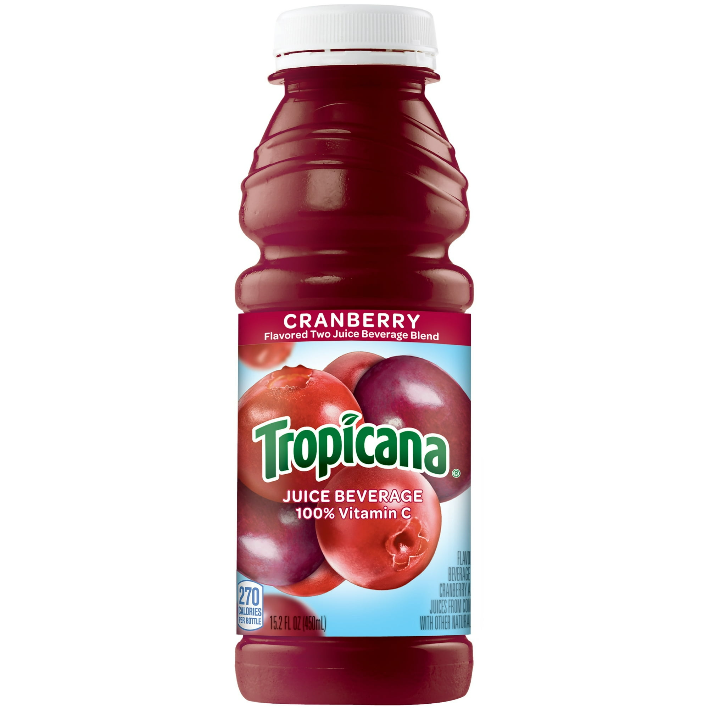
Tropicana Cranberry Juice

Slide 14
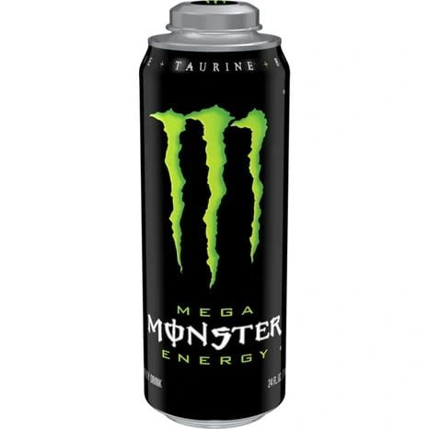
Monster Energy Mega Can

Slide 15
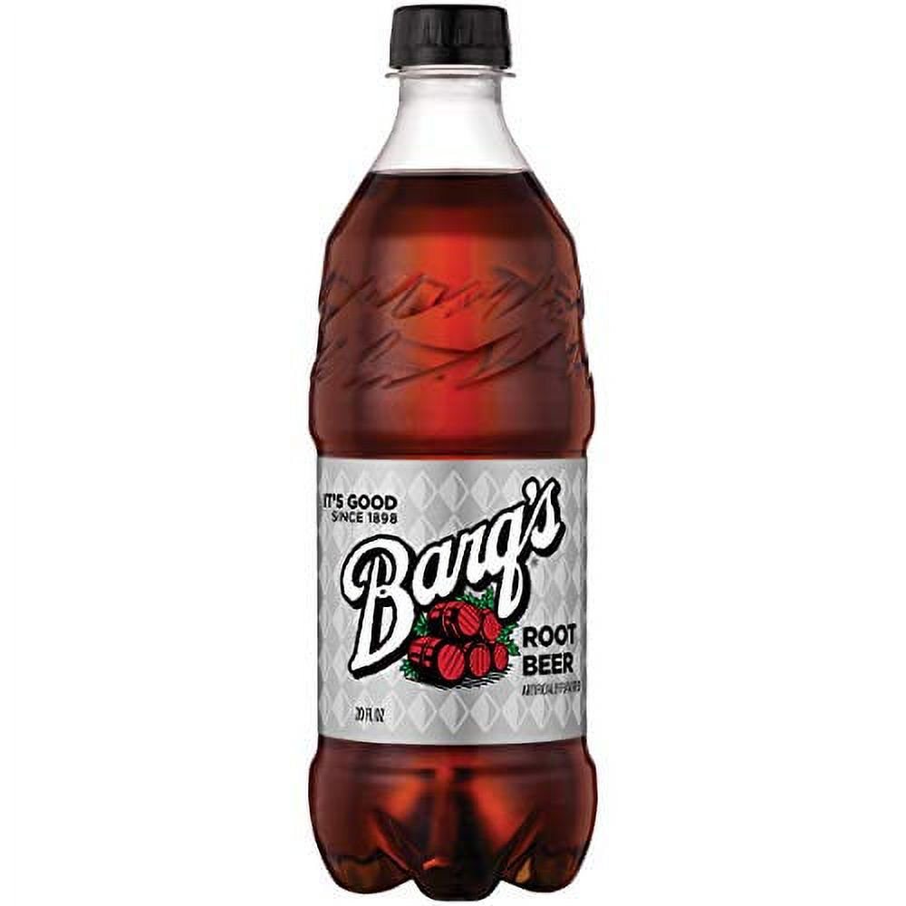
Barq's Root Beer Soda Bottle

Slide 16
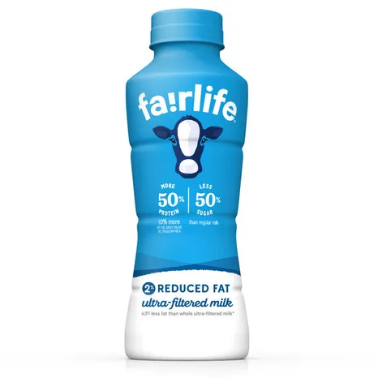
Fairlife Reduced Fat Milk

Slide 17
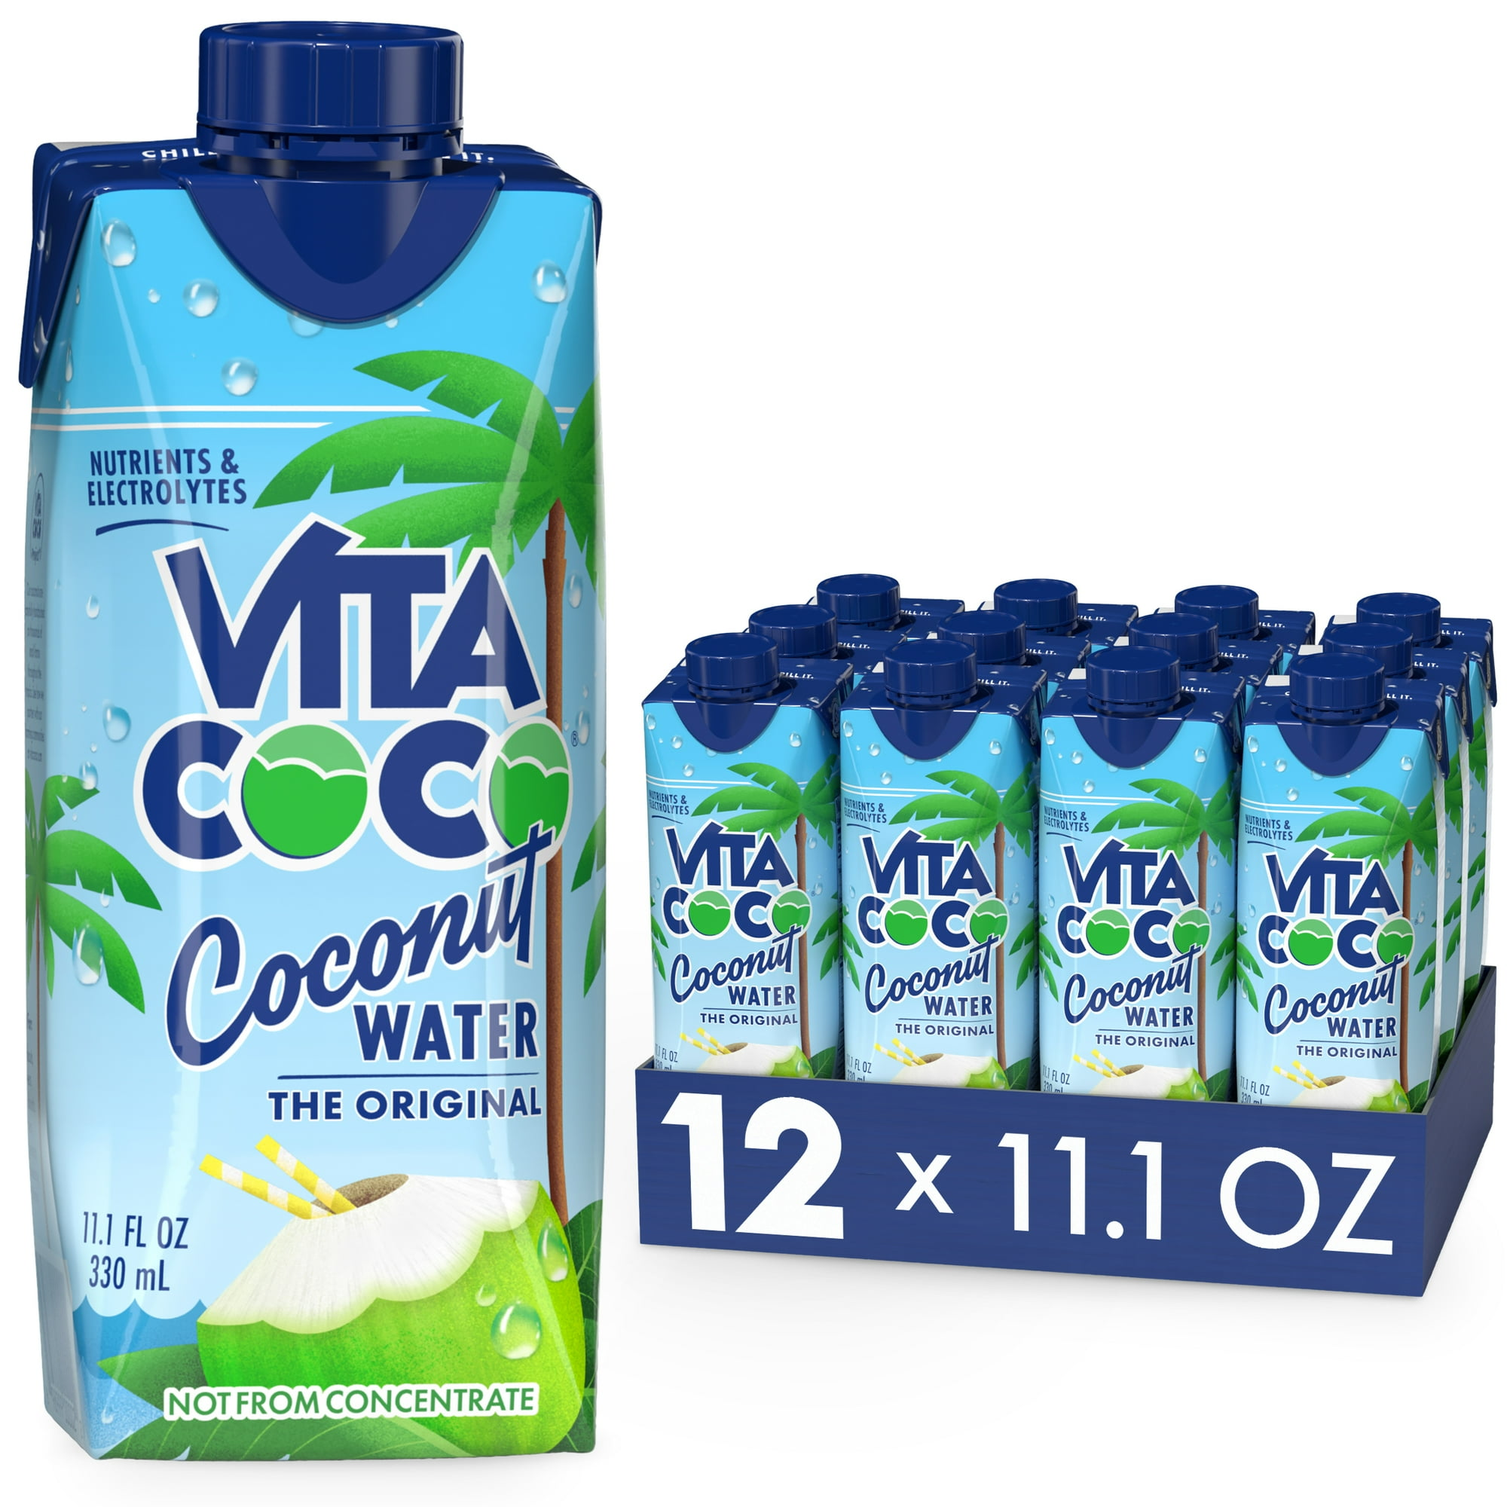
Vita Coco The Original Coconut Water

Slide 18
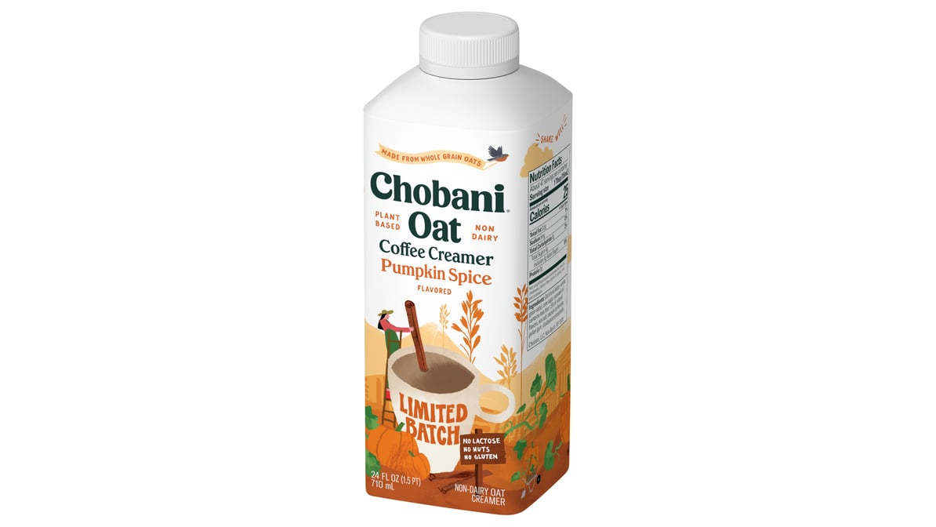
Chobani Pumpkin Spice Oat Coffee Creamer

Slide 19
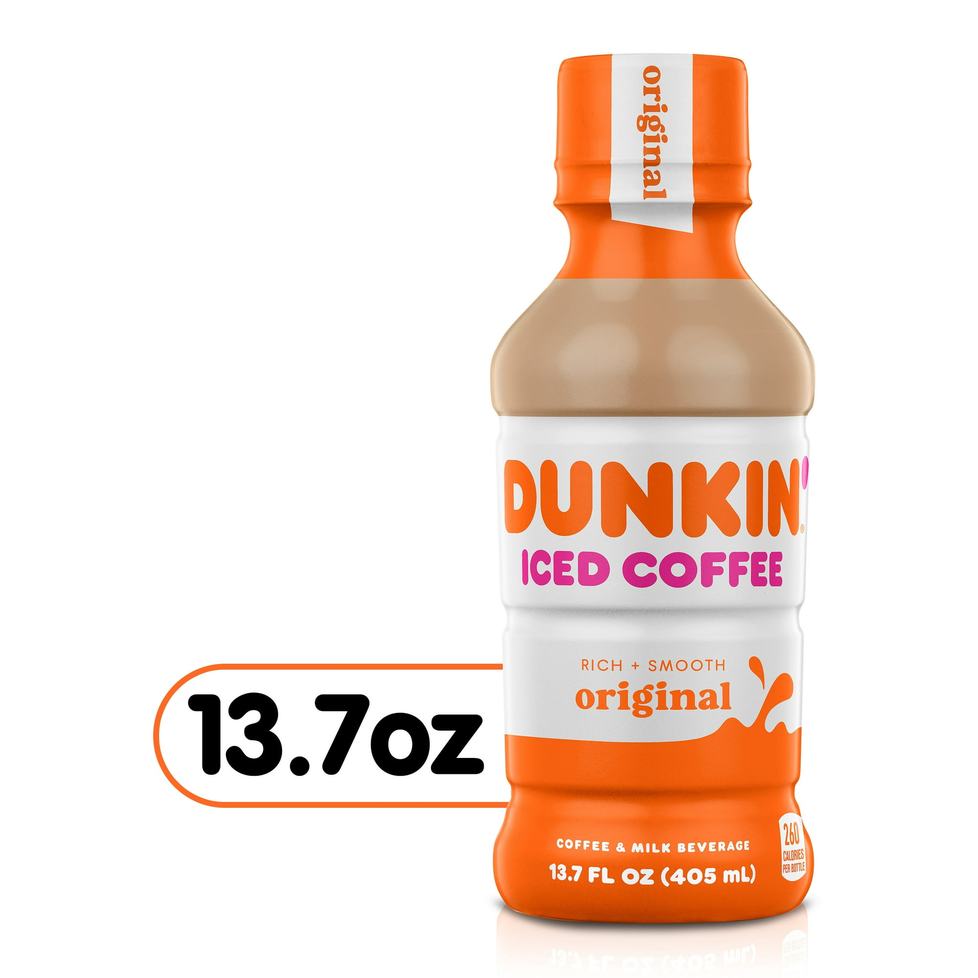
Dunkin' Original Iced Coffee

Slide 20
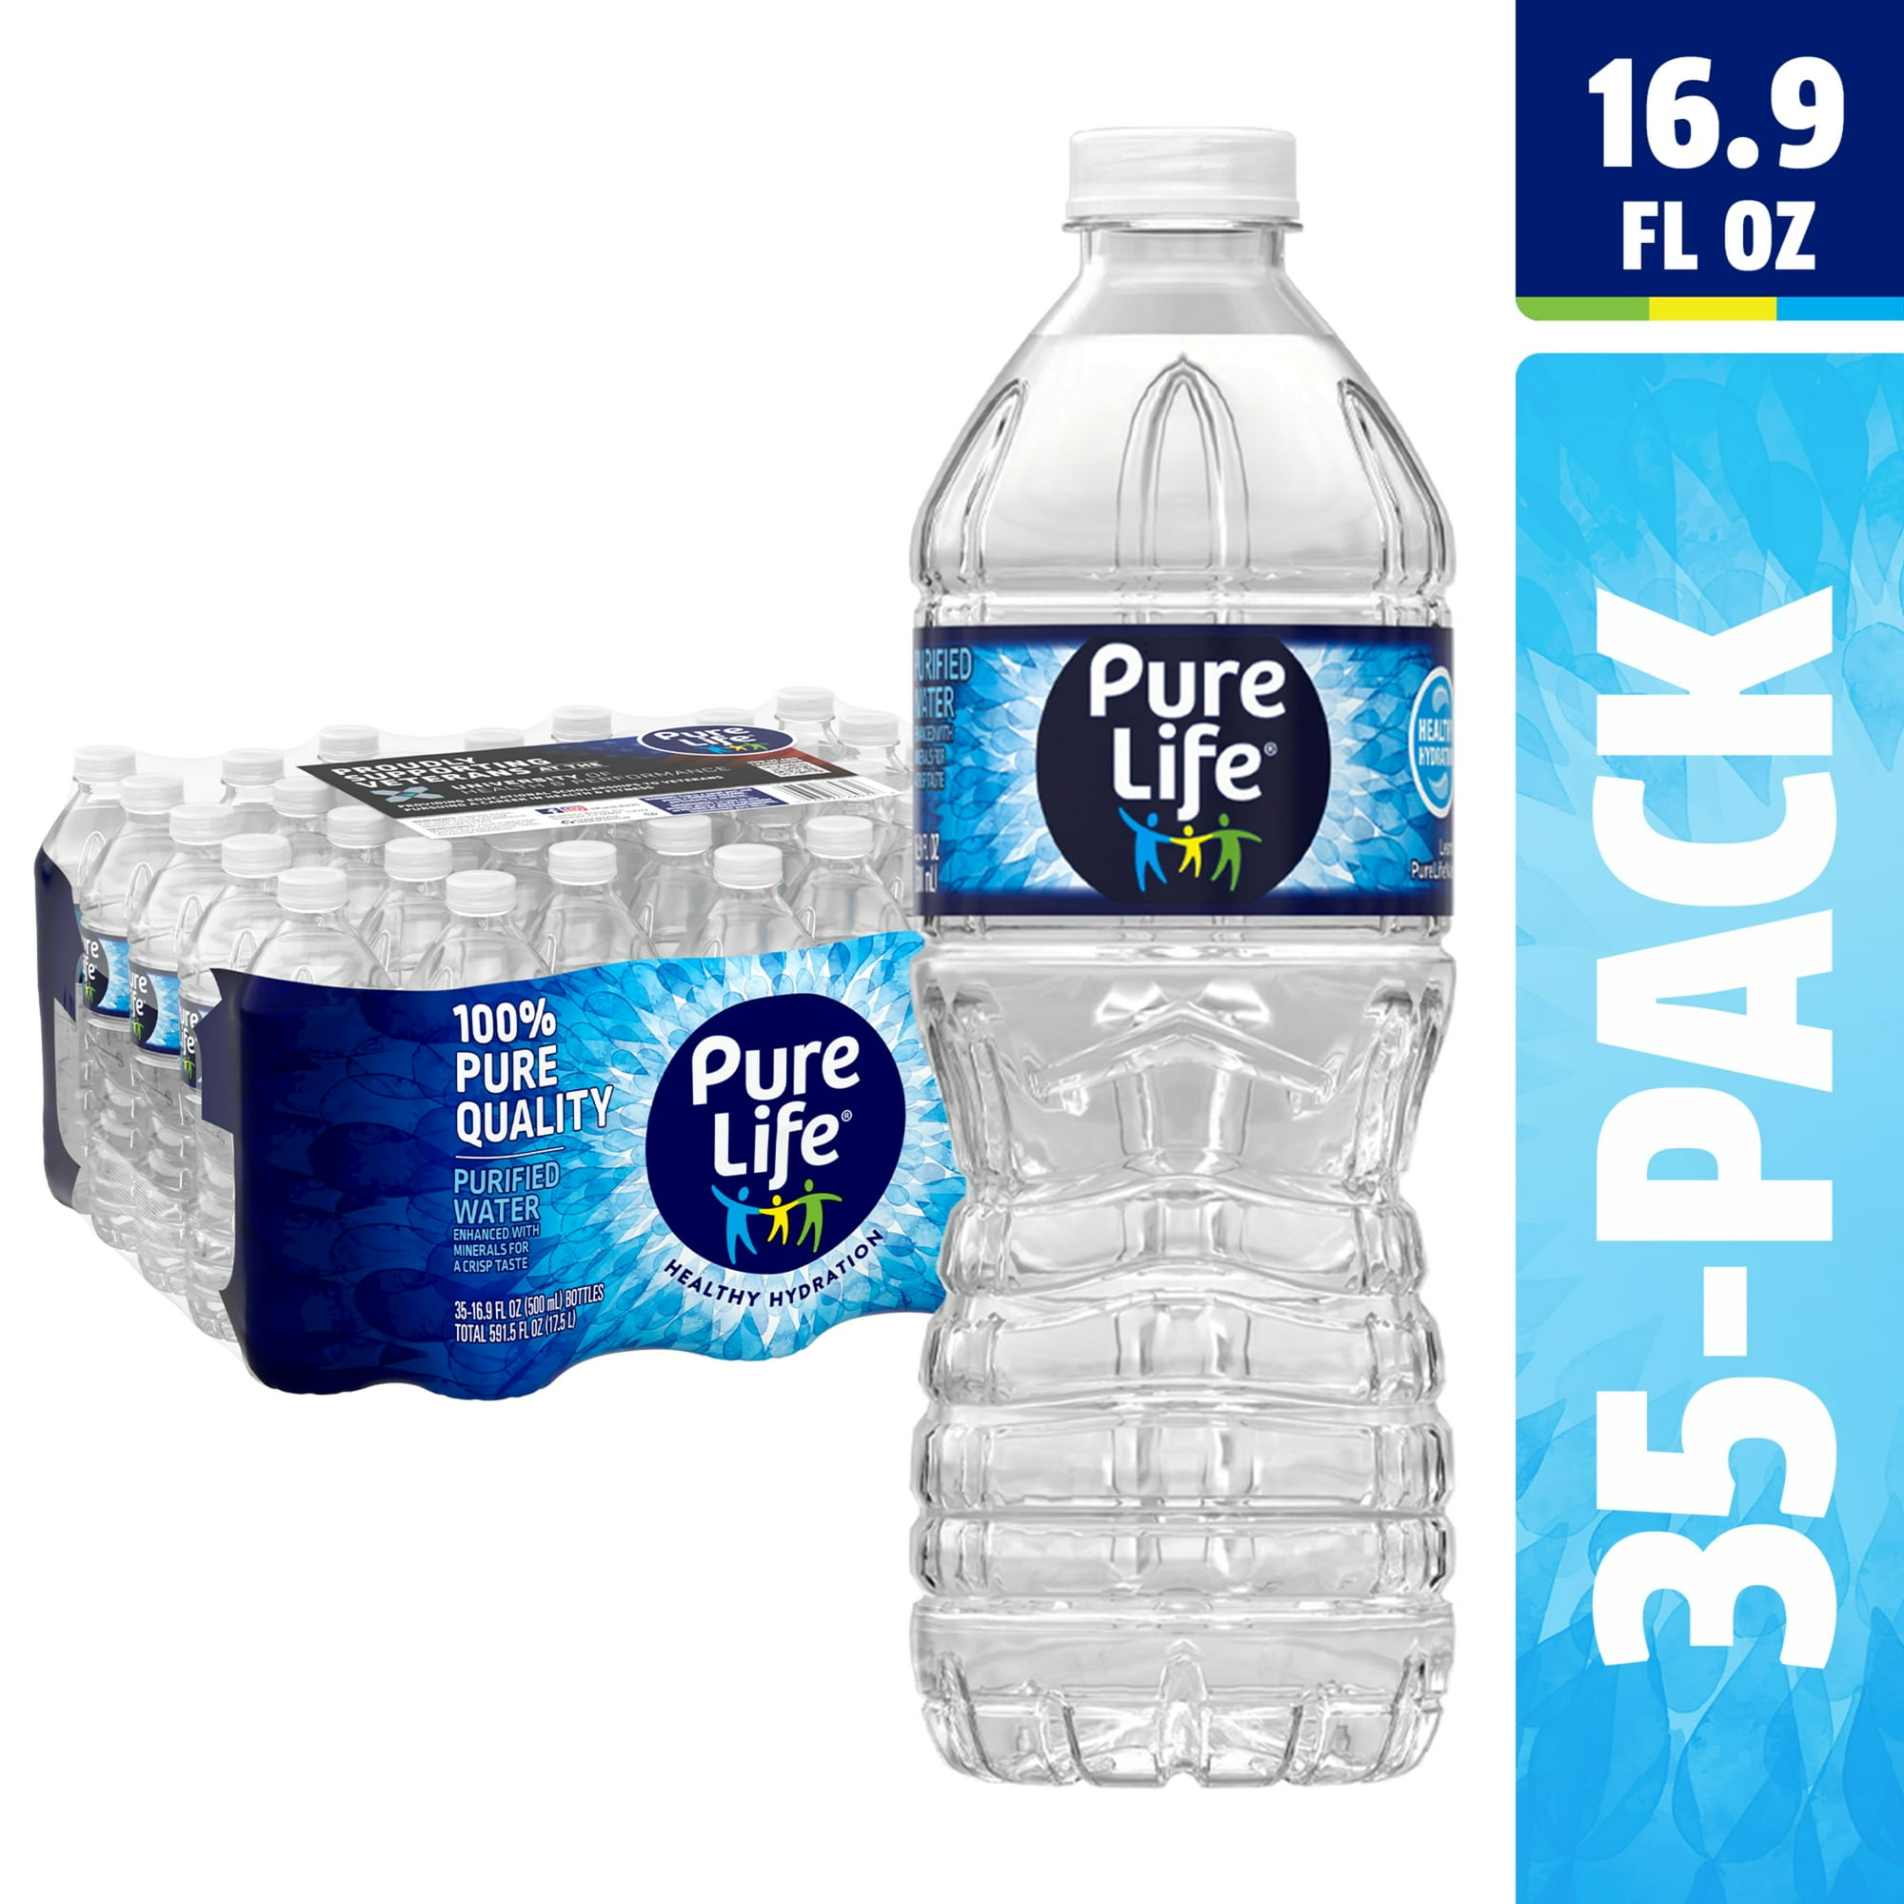
Pure Life Purified Water

Slide 21
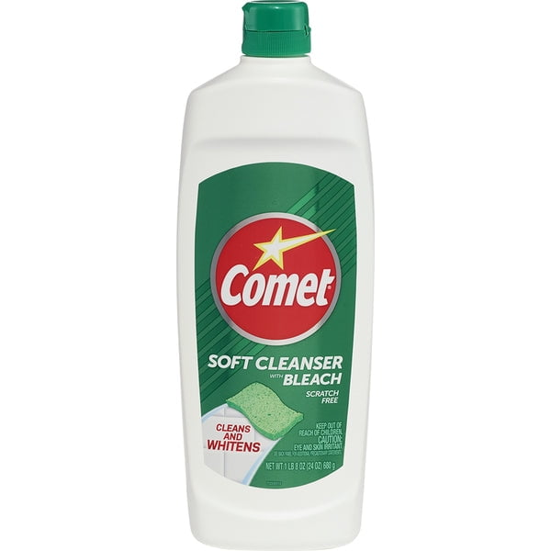
Comet No Scent Soft Cleaner with Bleach

Slide 22
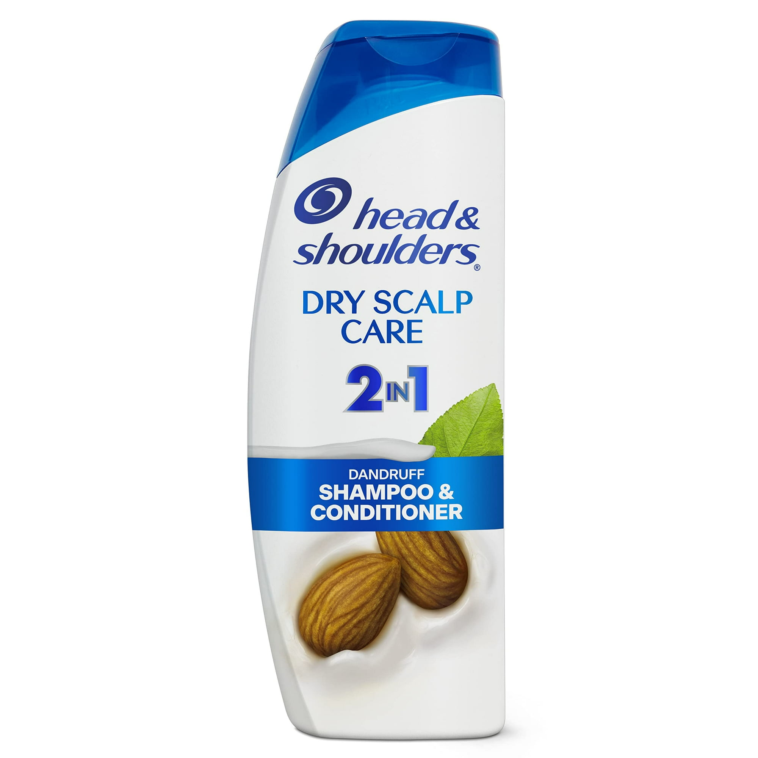
Head and Shoulders Shampoo and Conditioner

Slide 23
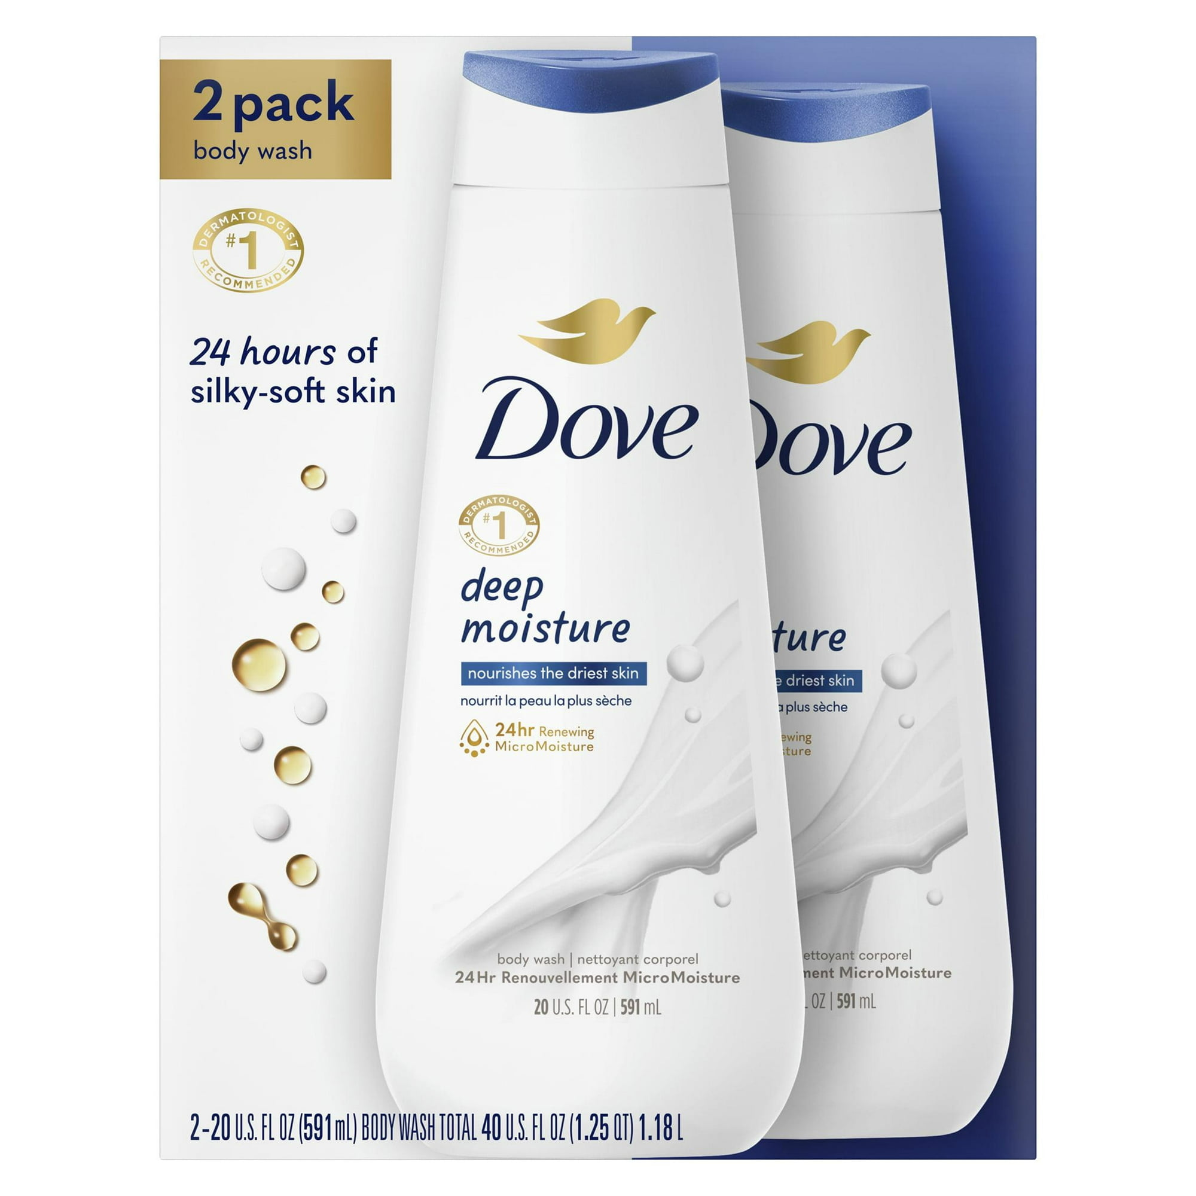
Dove Deep Body Wash

Slide 24
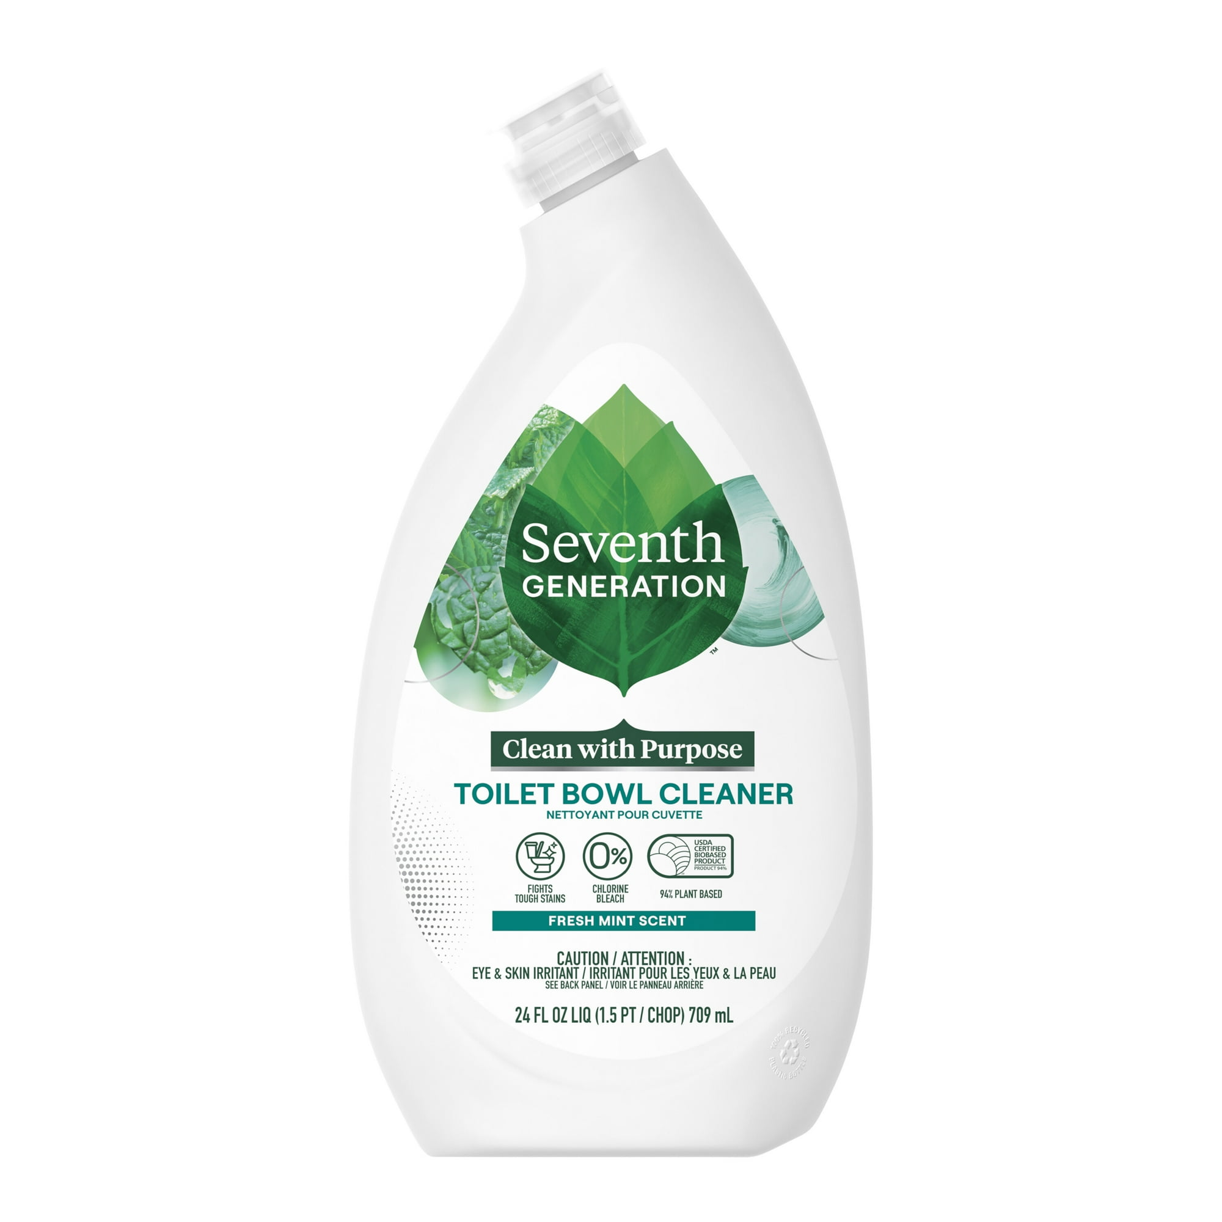
Seventh Generation Toilet Bowl Cleaner

Slide 25
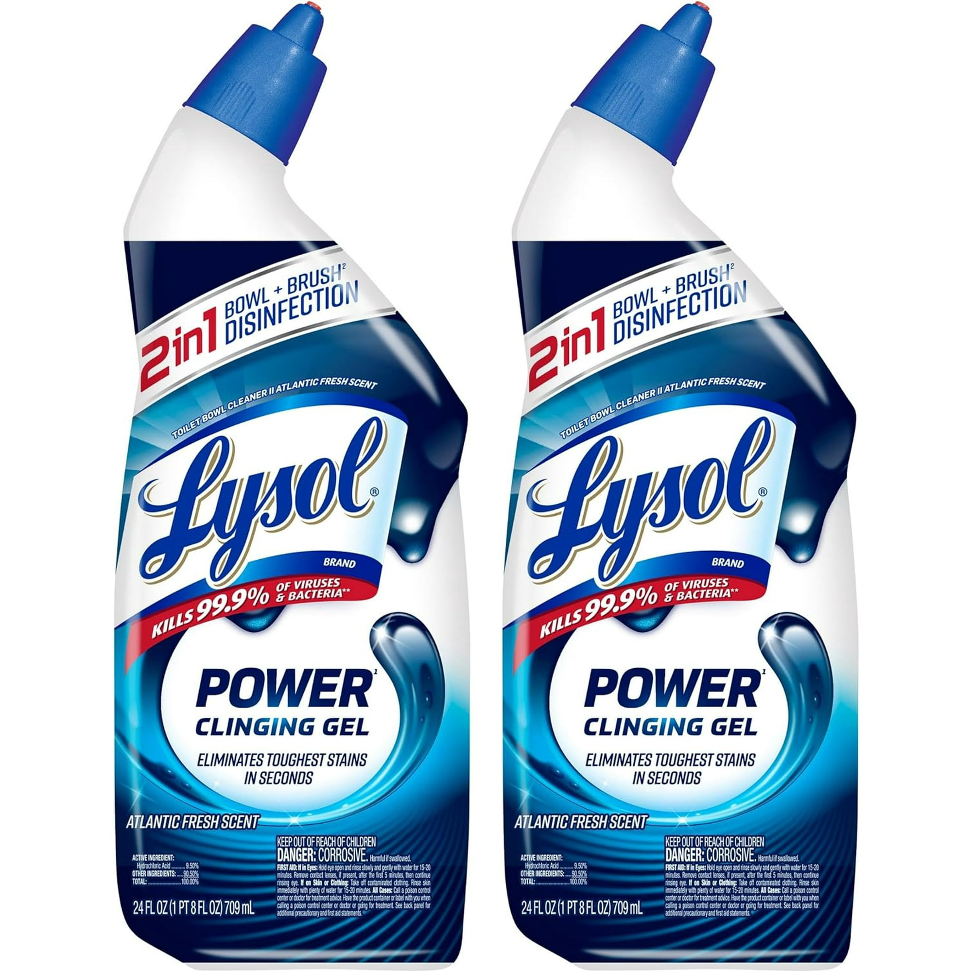
Lysol Power Toilet Bowl Cleaner Gel

Slide 26
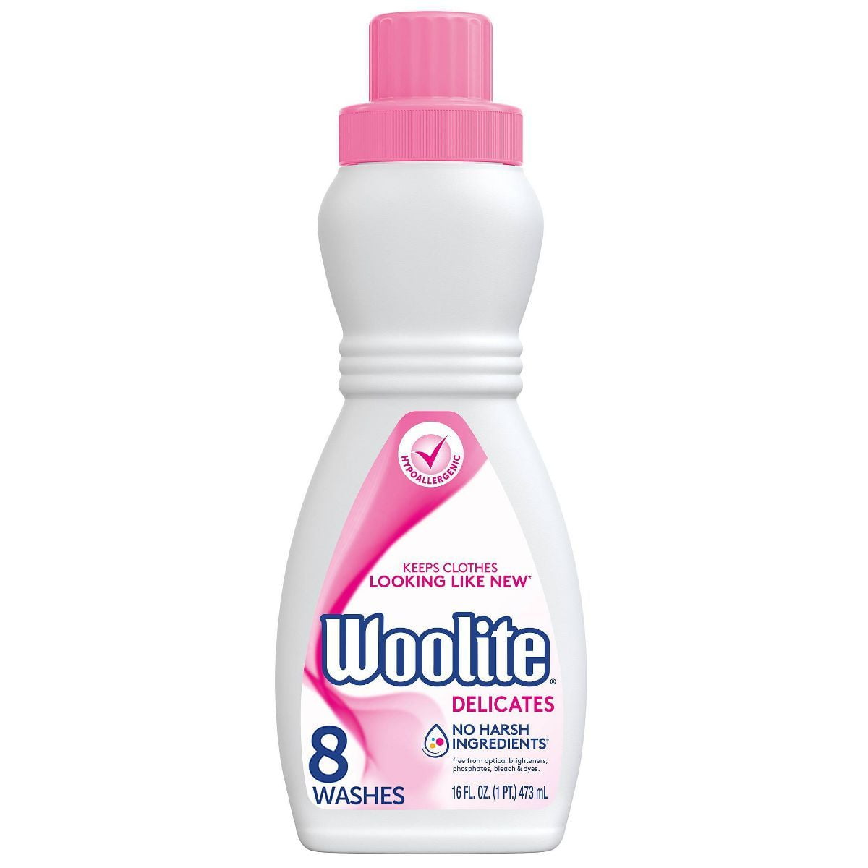
Woolite Extra Delicates Laundry Detergent

Slide 27
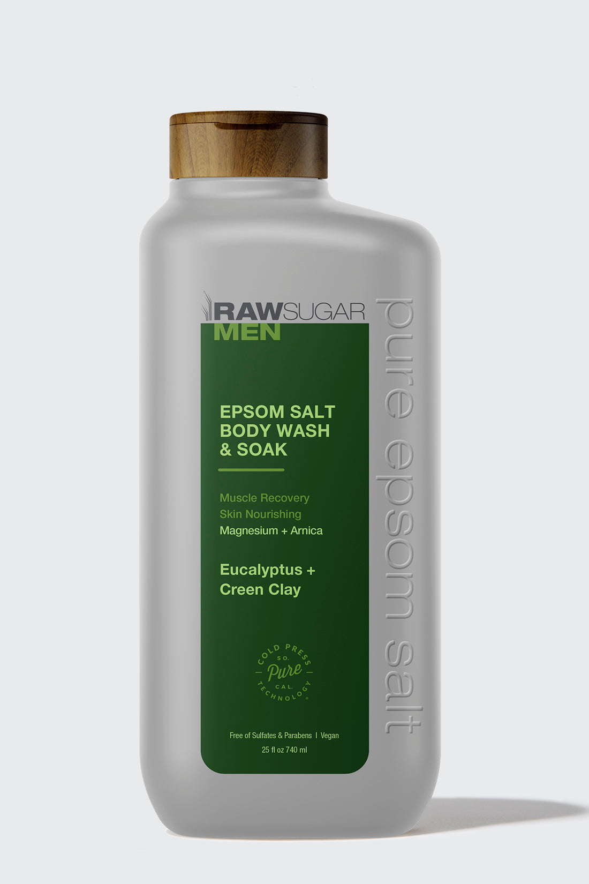
Raw Sugar Men's Body Wash

Slide 28
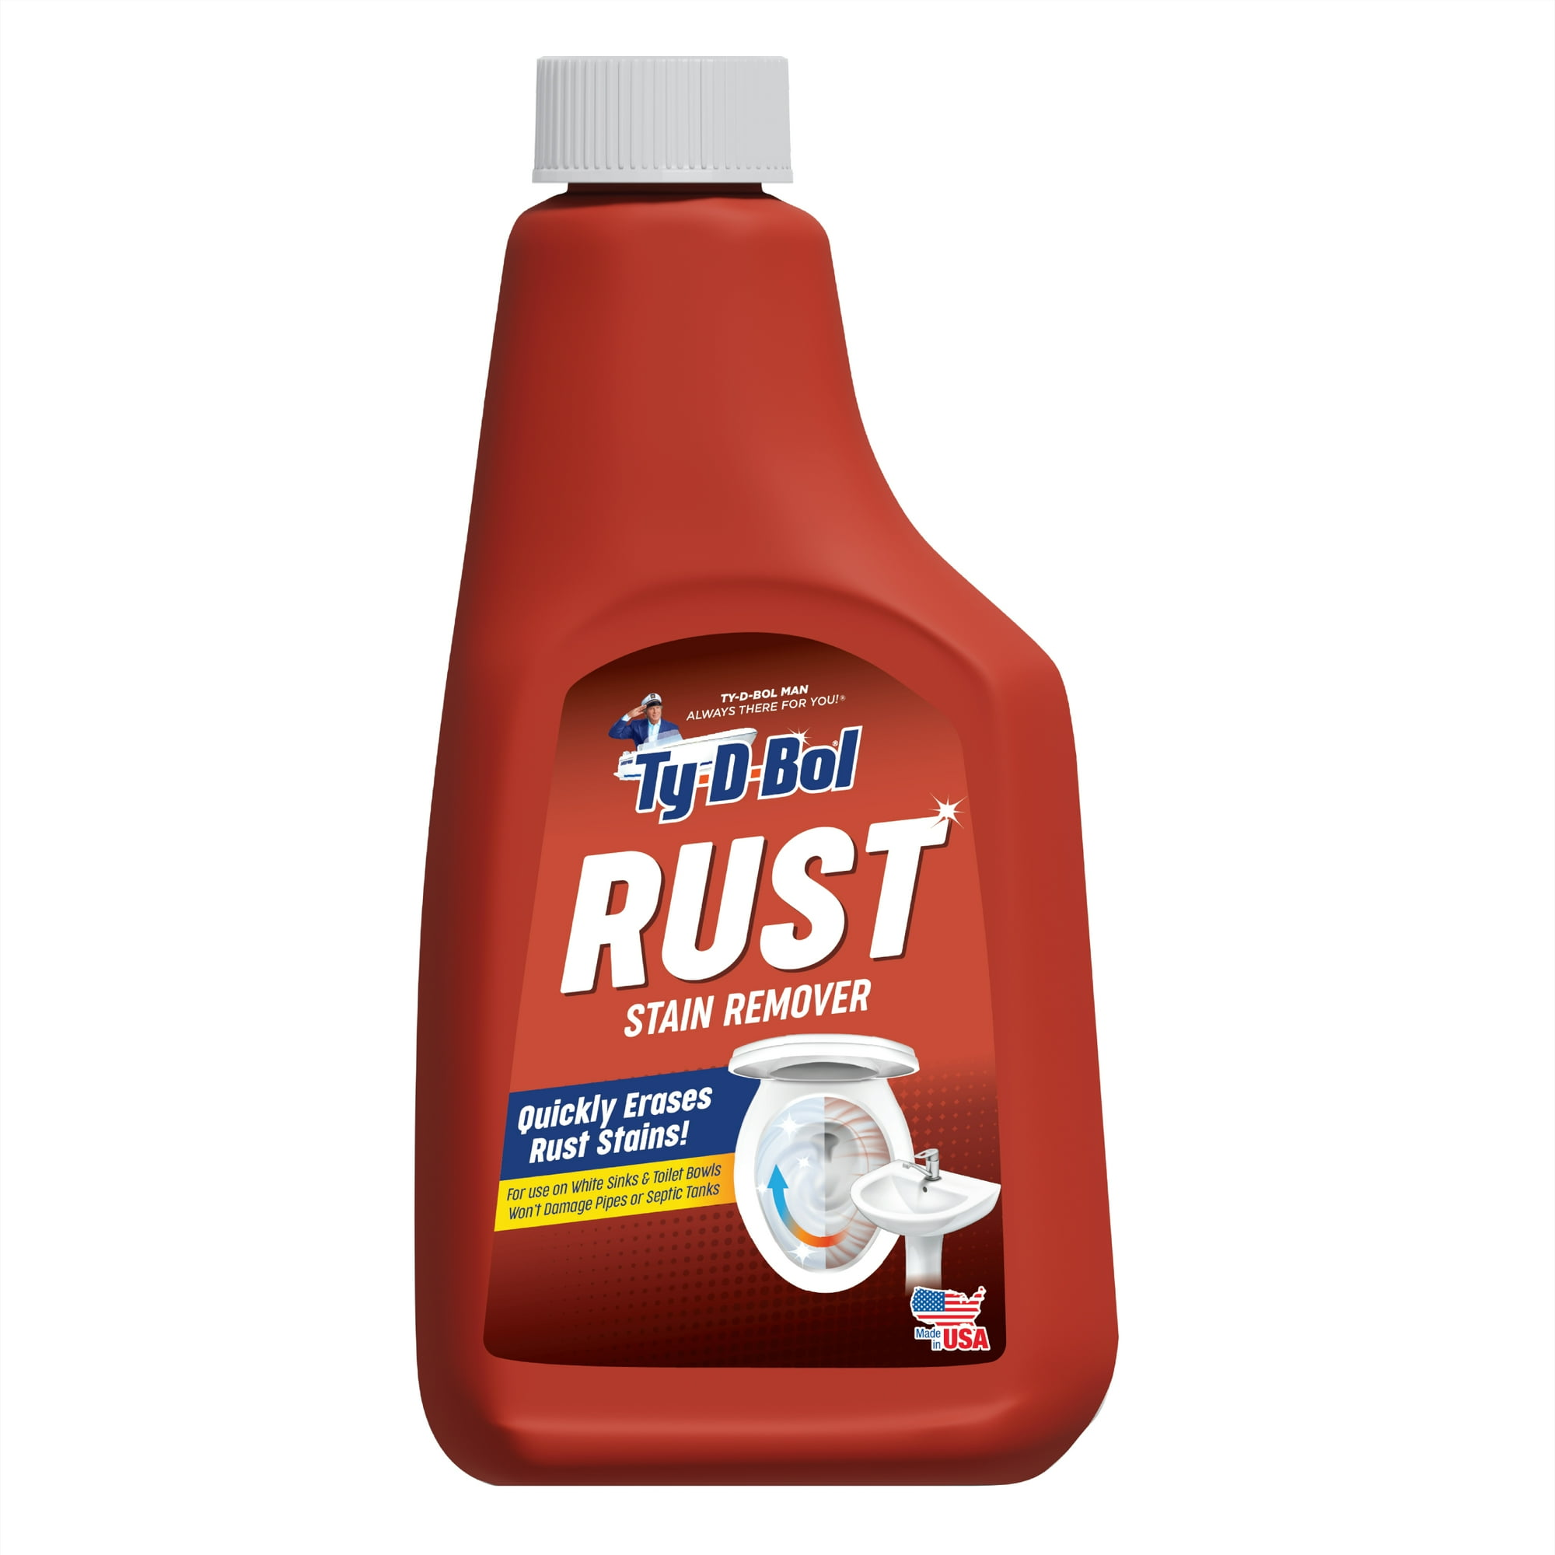
Ty-D-Bol Rust Stain Remover

Slide 29
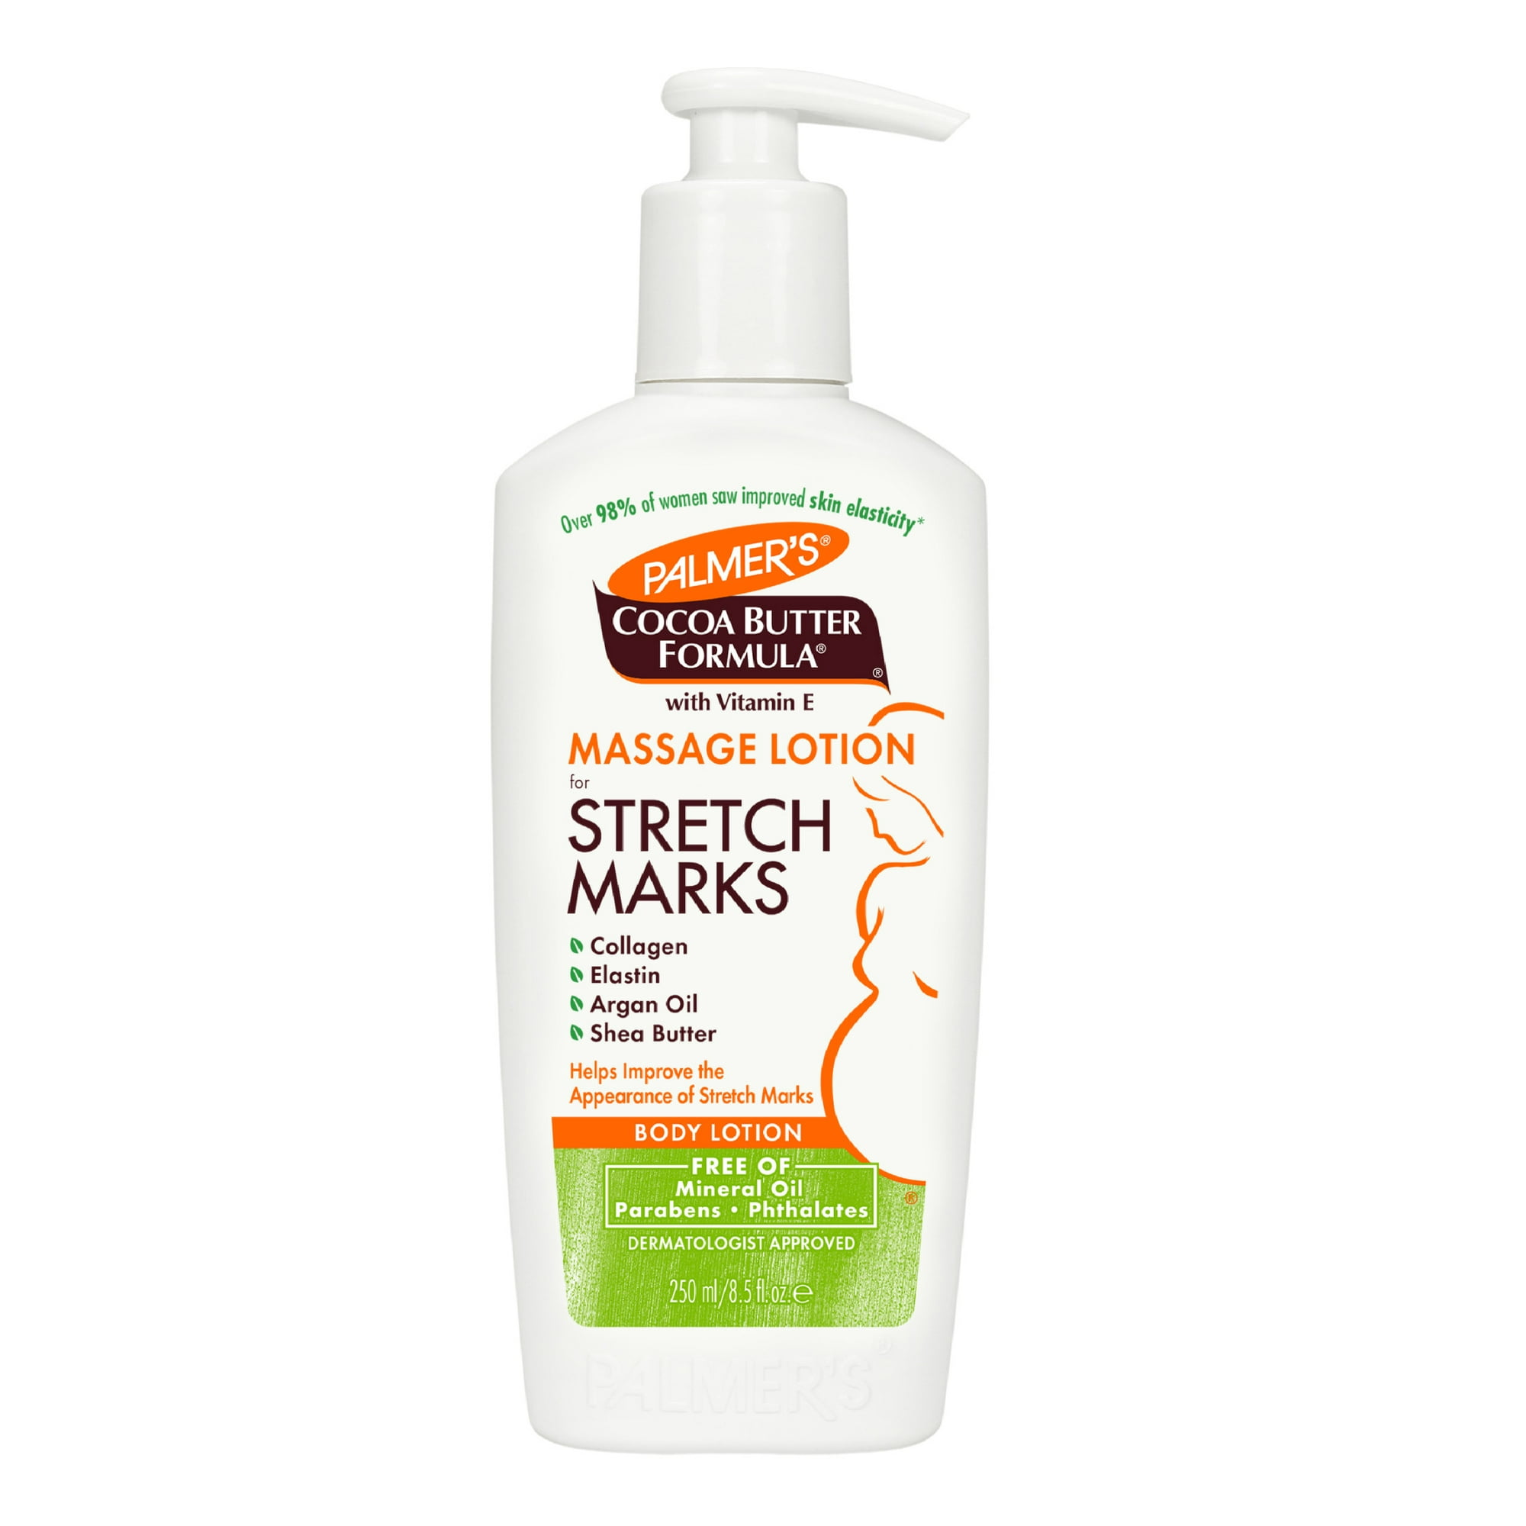
Palmer's Cocoa Butter Formula Massage Lotion

Slide 30
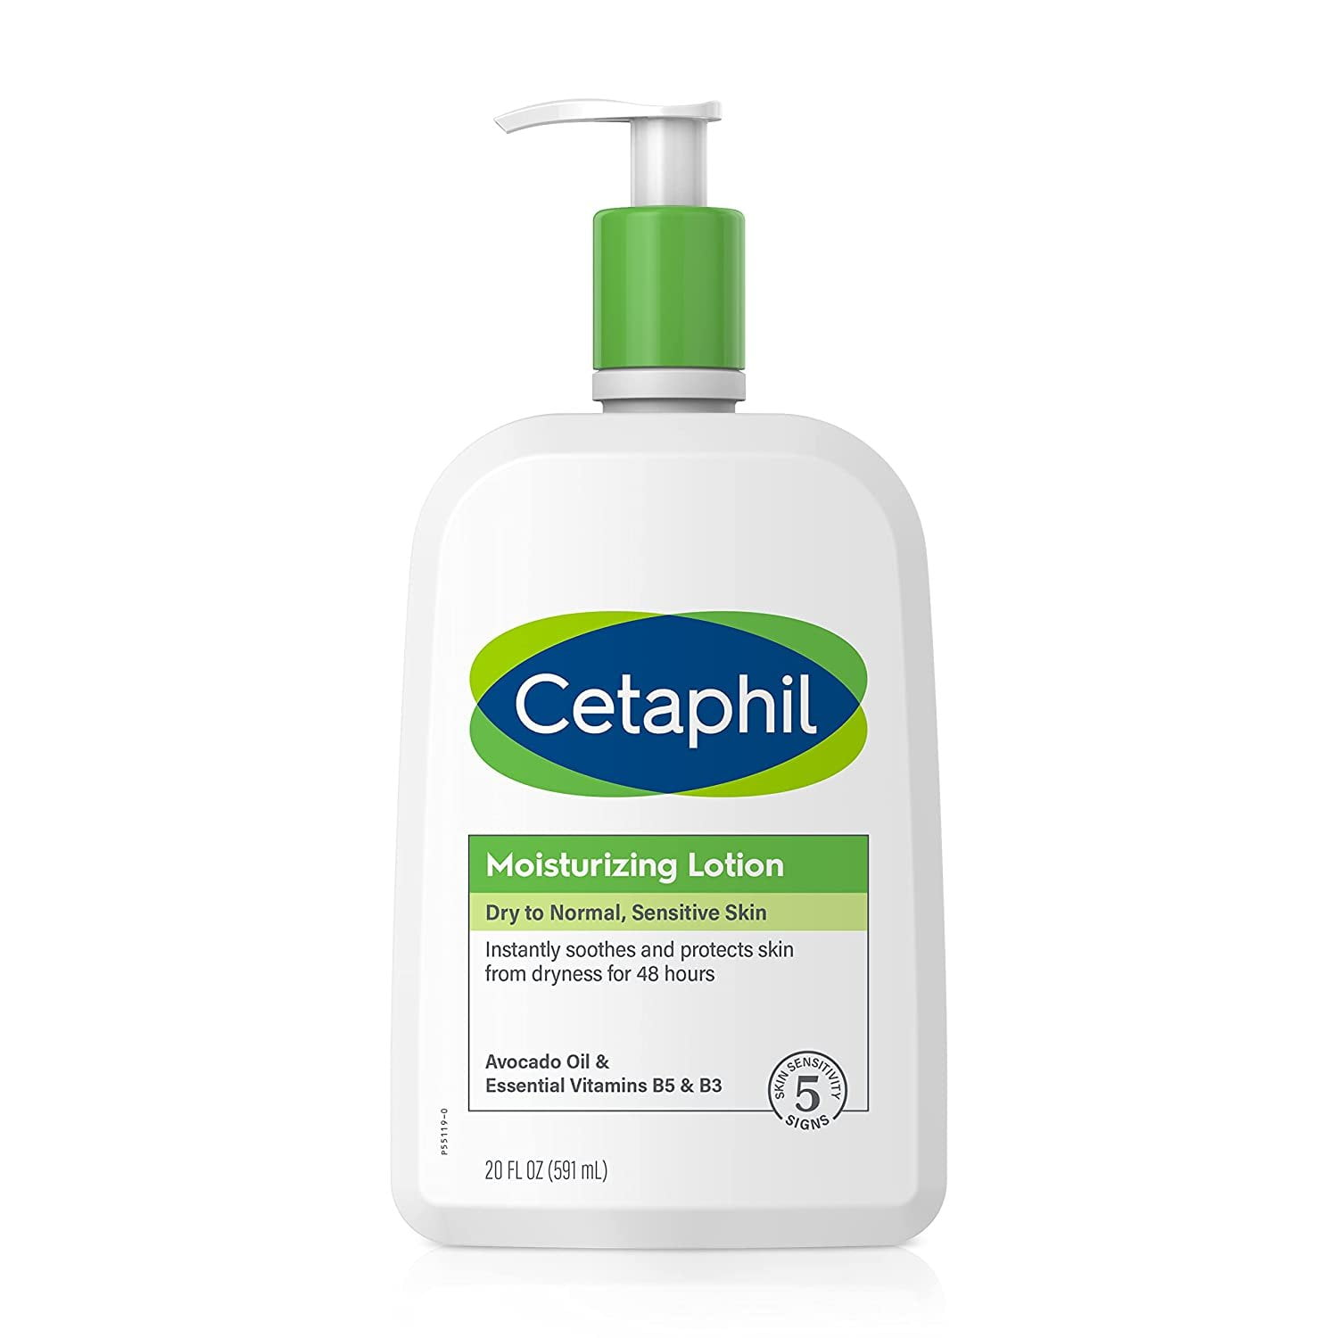
Body Moisturizer by CETAPHIL

Slide 31
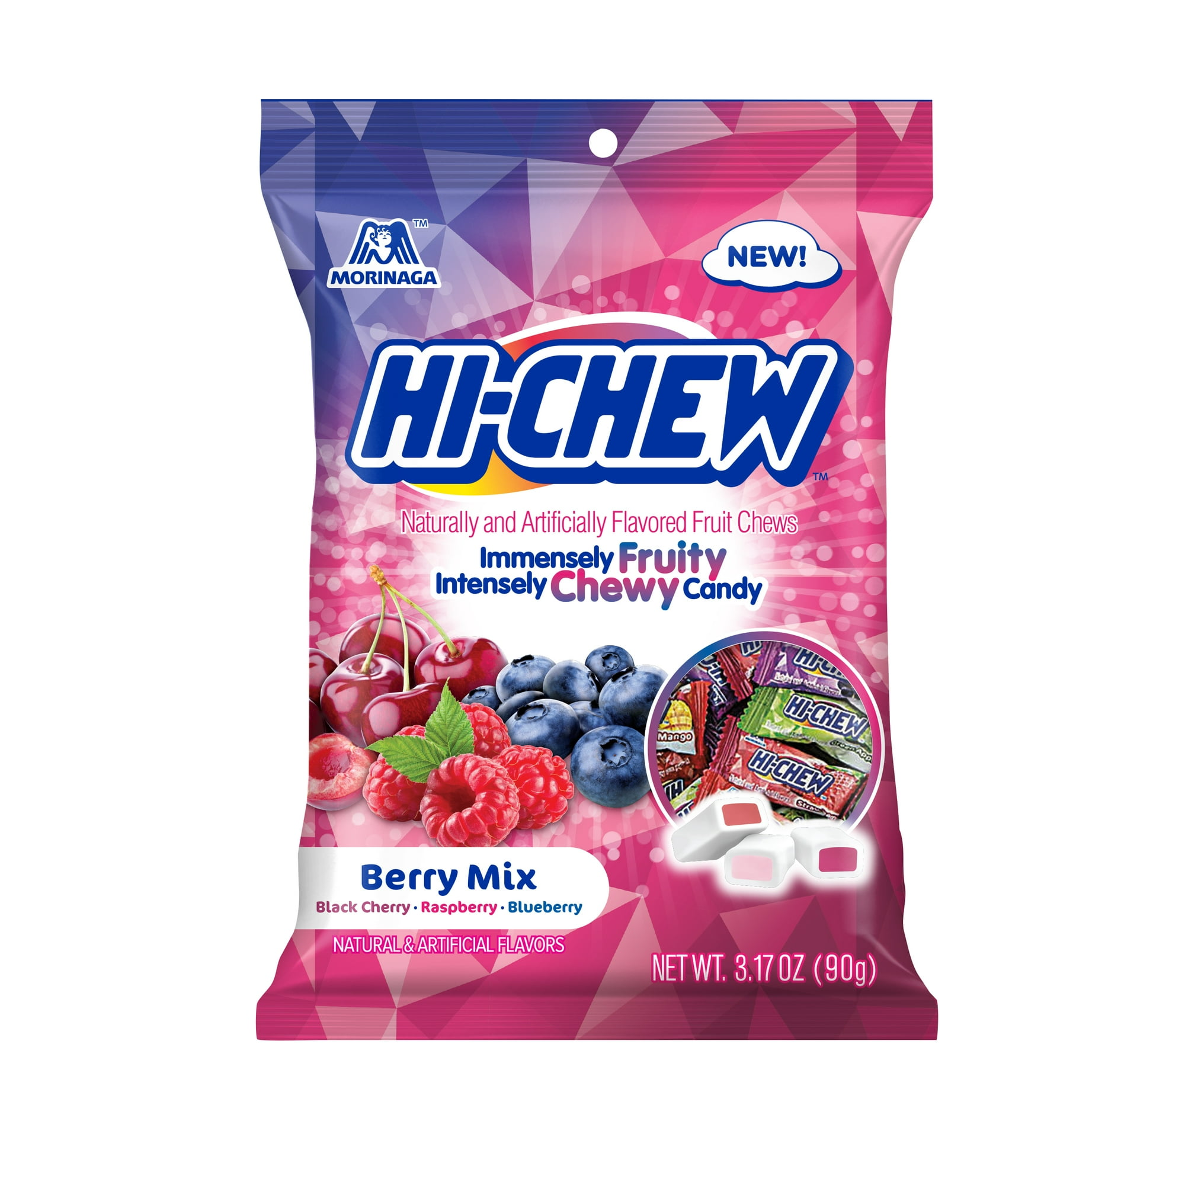
HI-CHEW Berry Mix Peg Bag

Slide 32
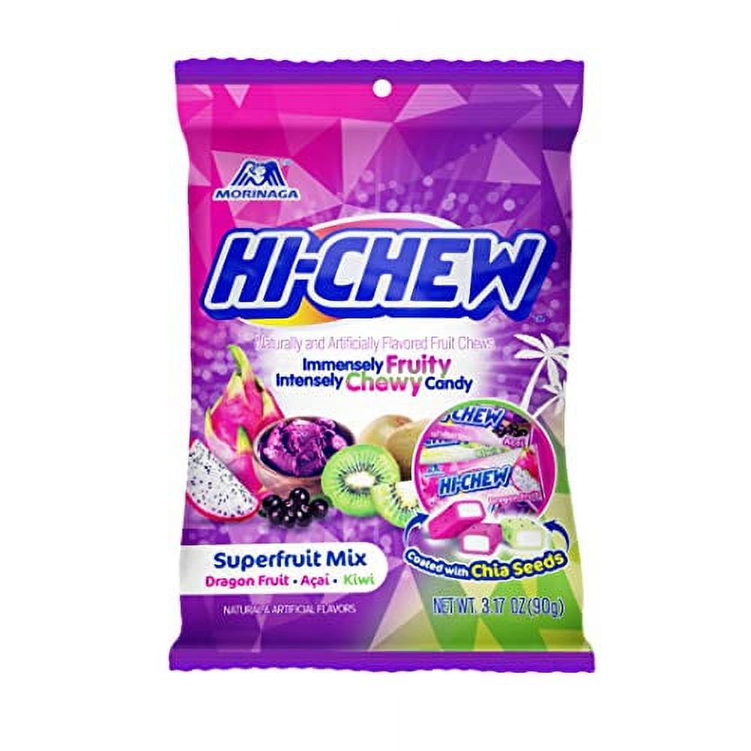
HI-CHEW Superfruit Mix Peg Bag

Slide 33
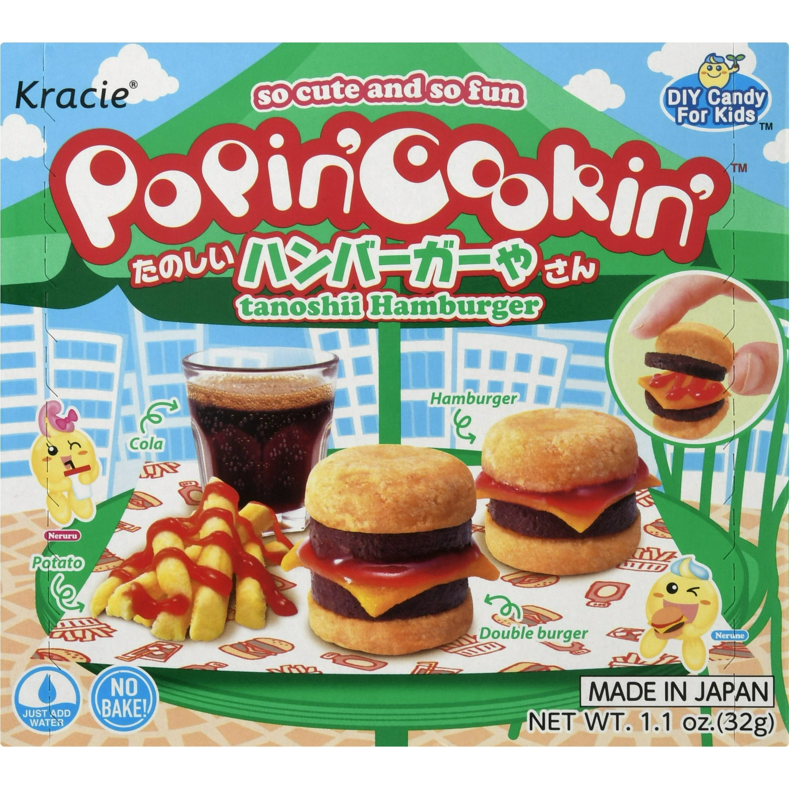
Popin Cookin Tanoshii Hamburger DIY Candy

Slide 34
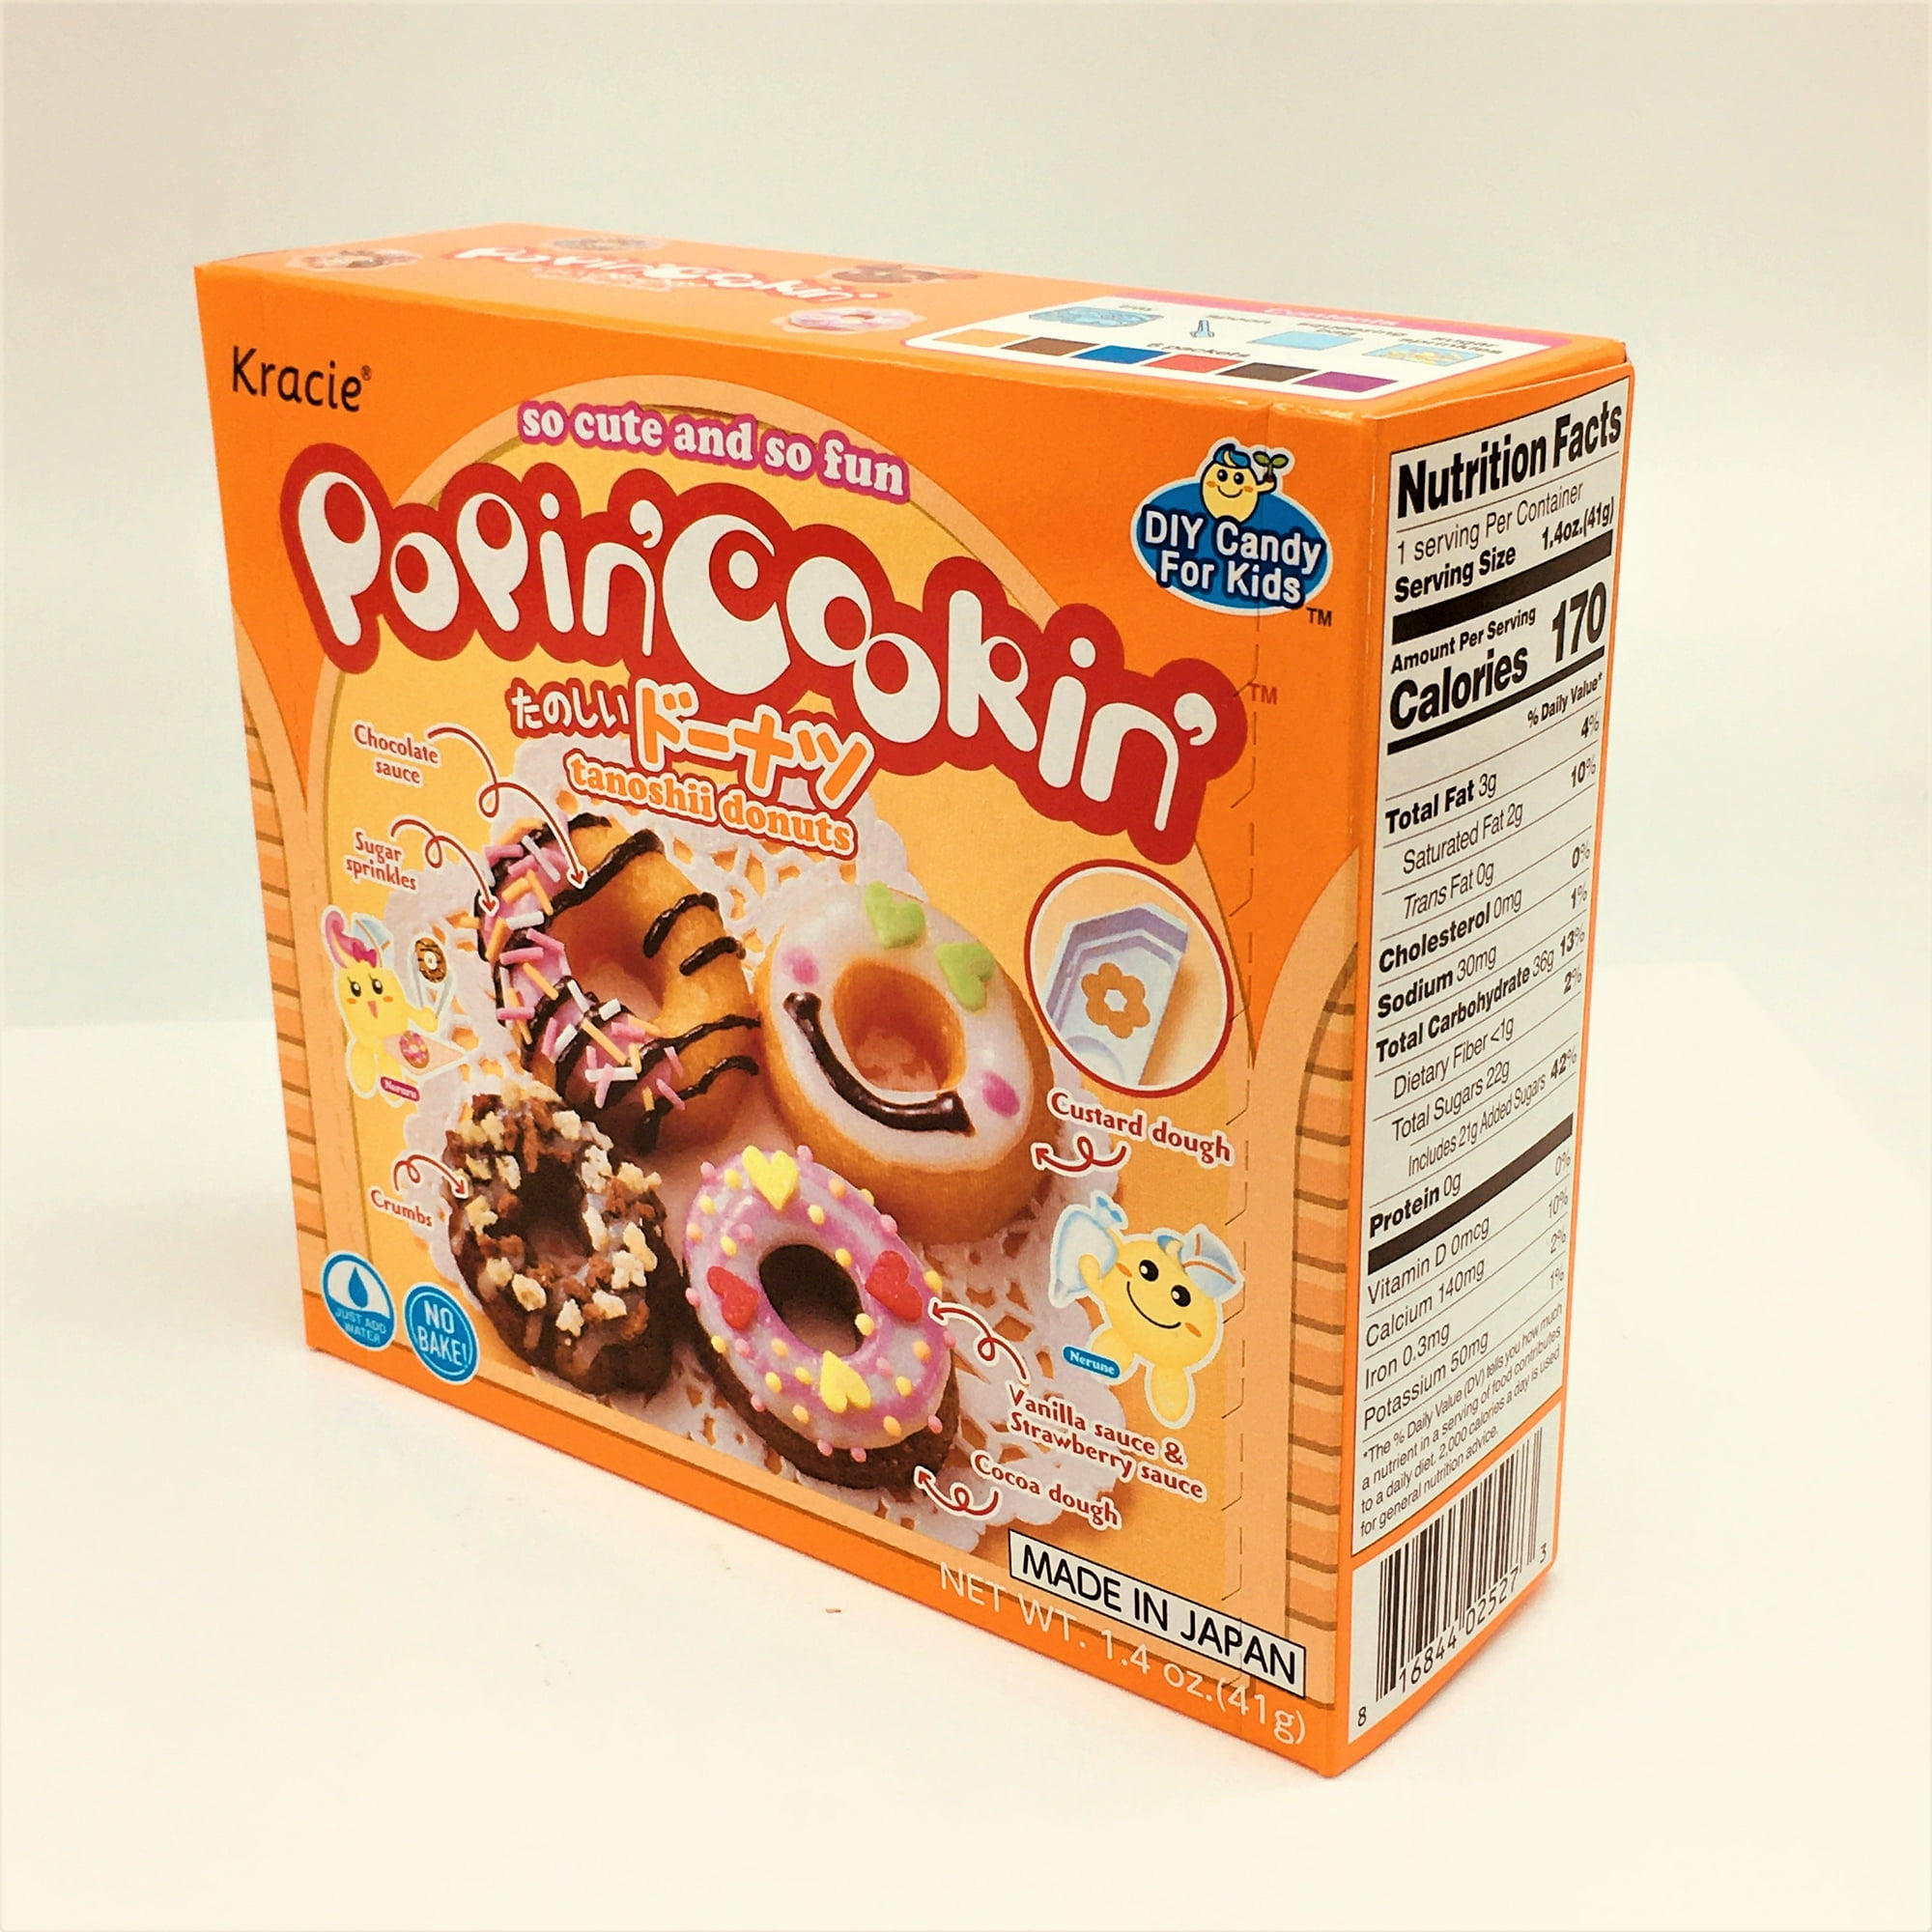
Popin Cookin Tanoshii Donuts DIY Candy

Slide 35
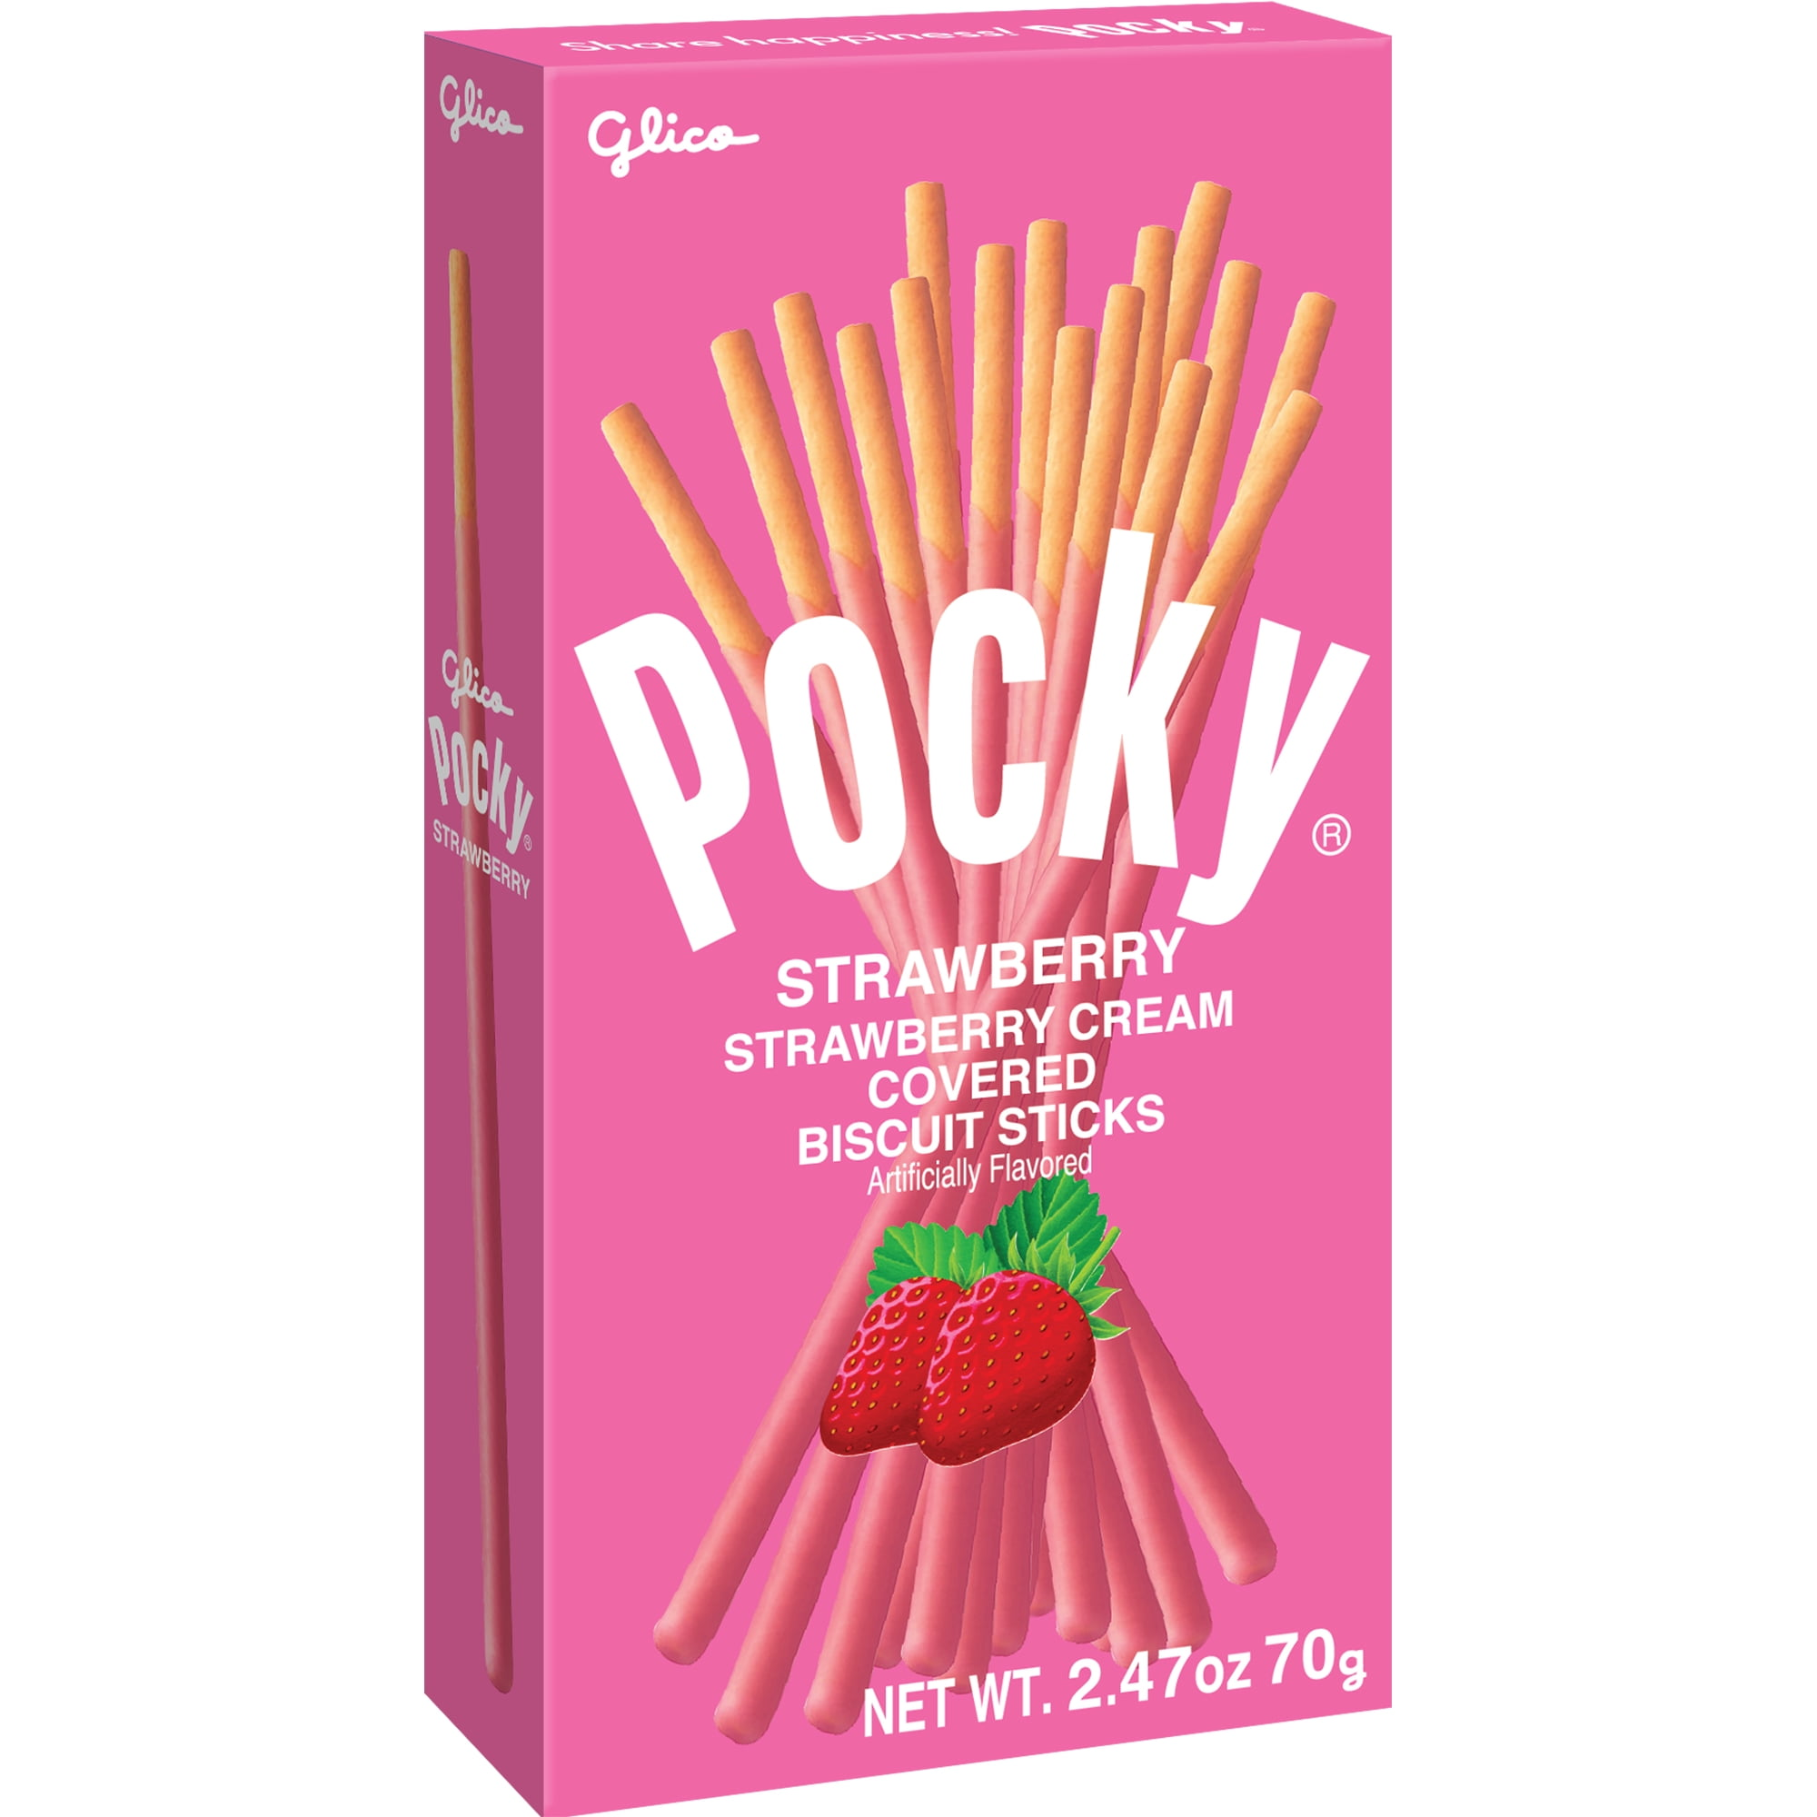
Pocky Strawberry Cream Sticks

Slide 36
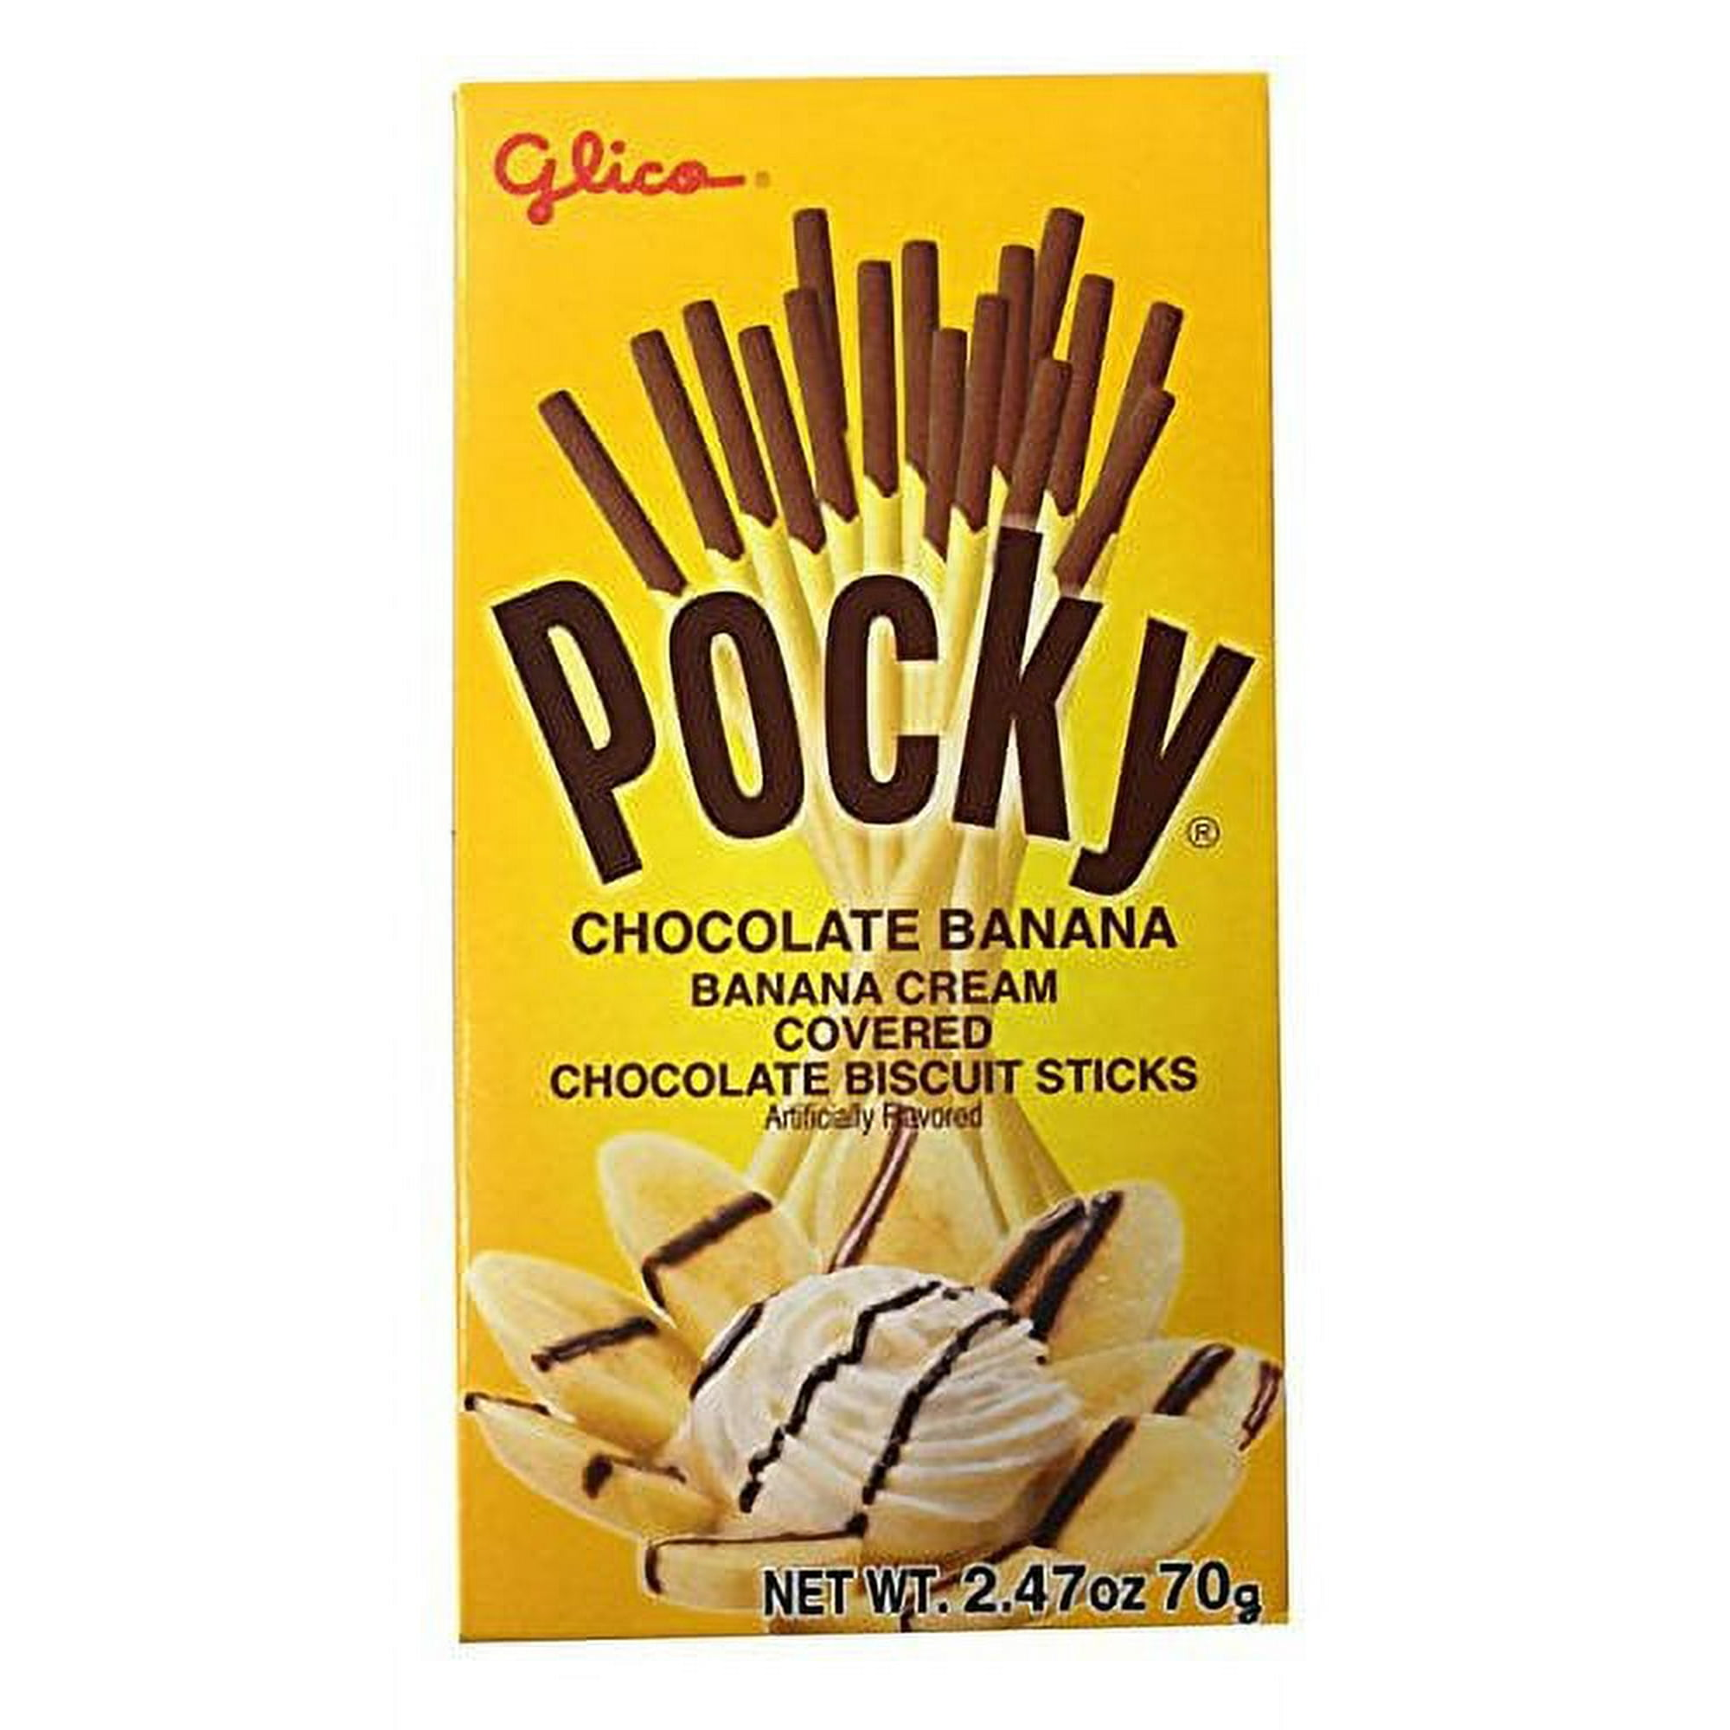
Pocky Banana Cream Sticks

Slide 37
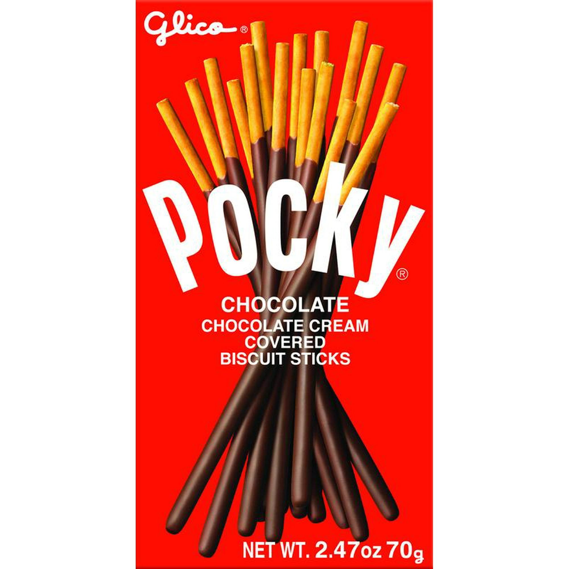
Pocky Chocolate Cream Sticks

Slide 38
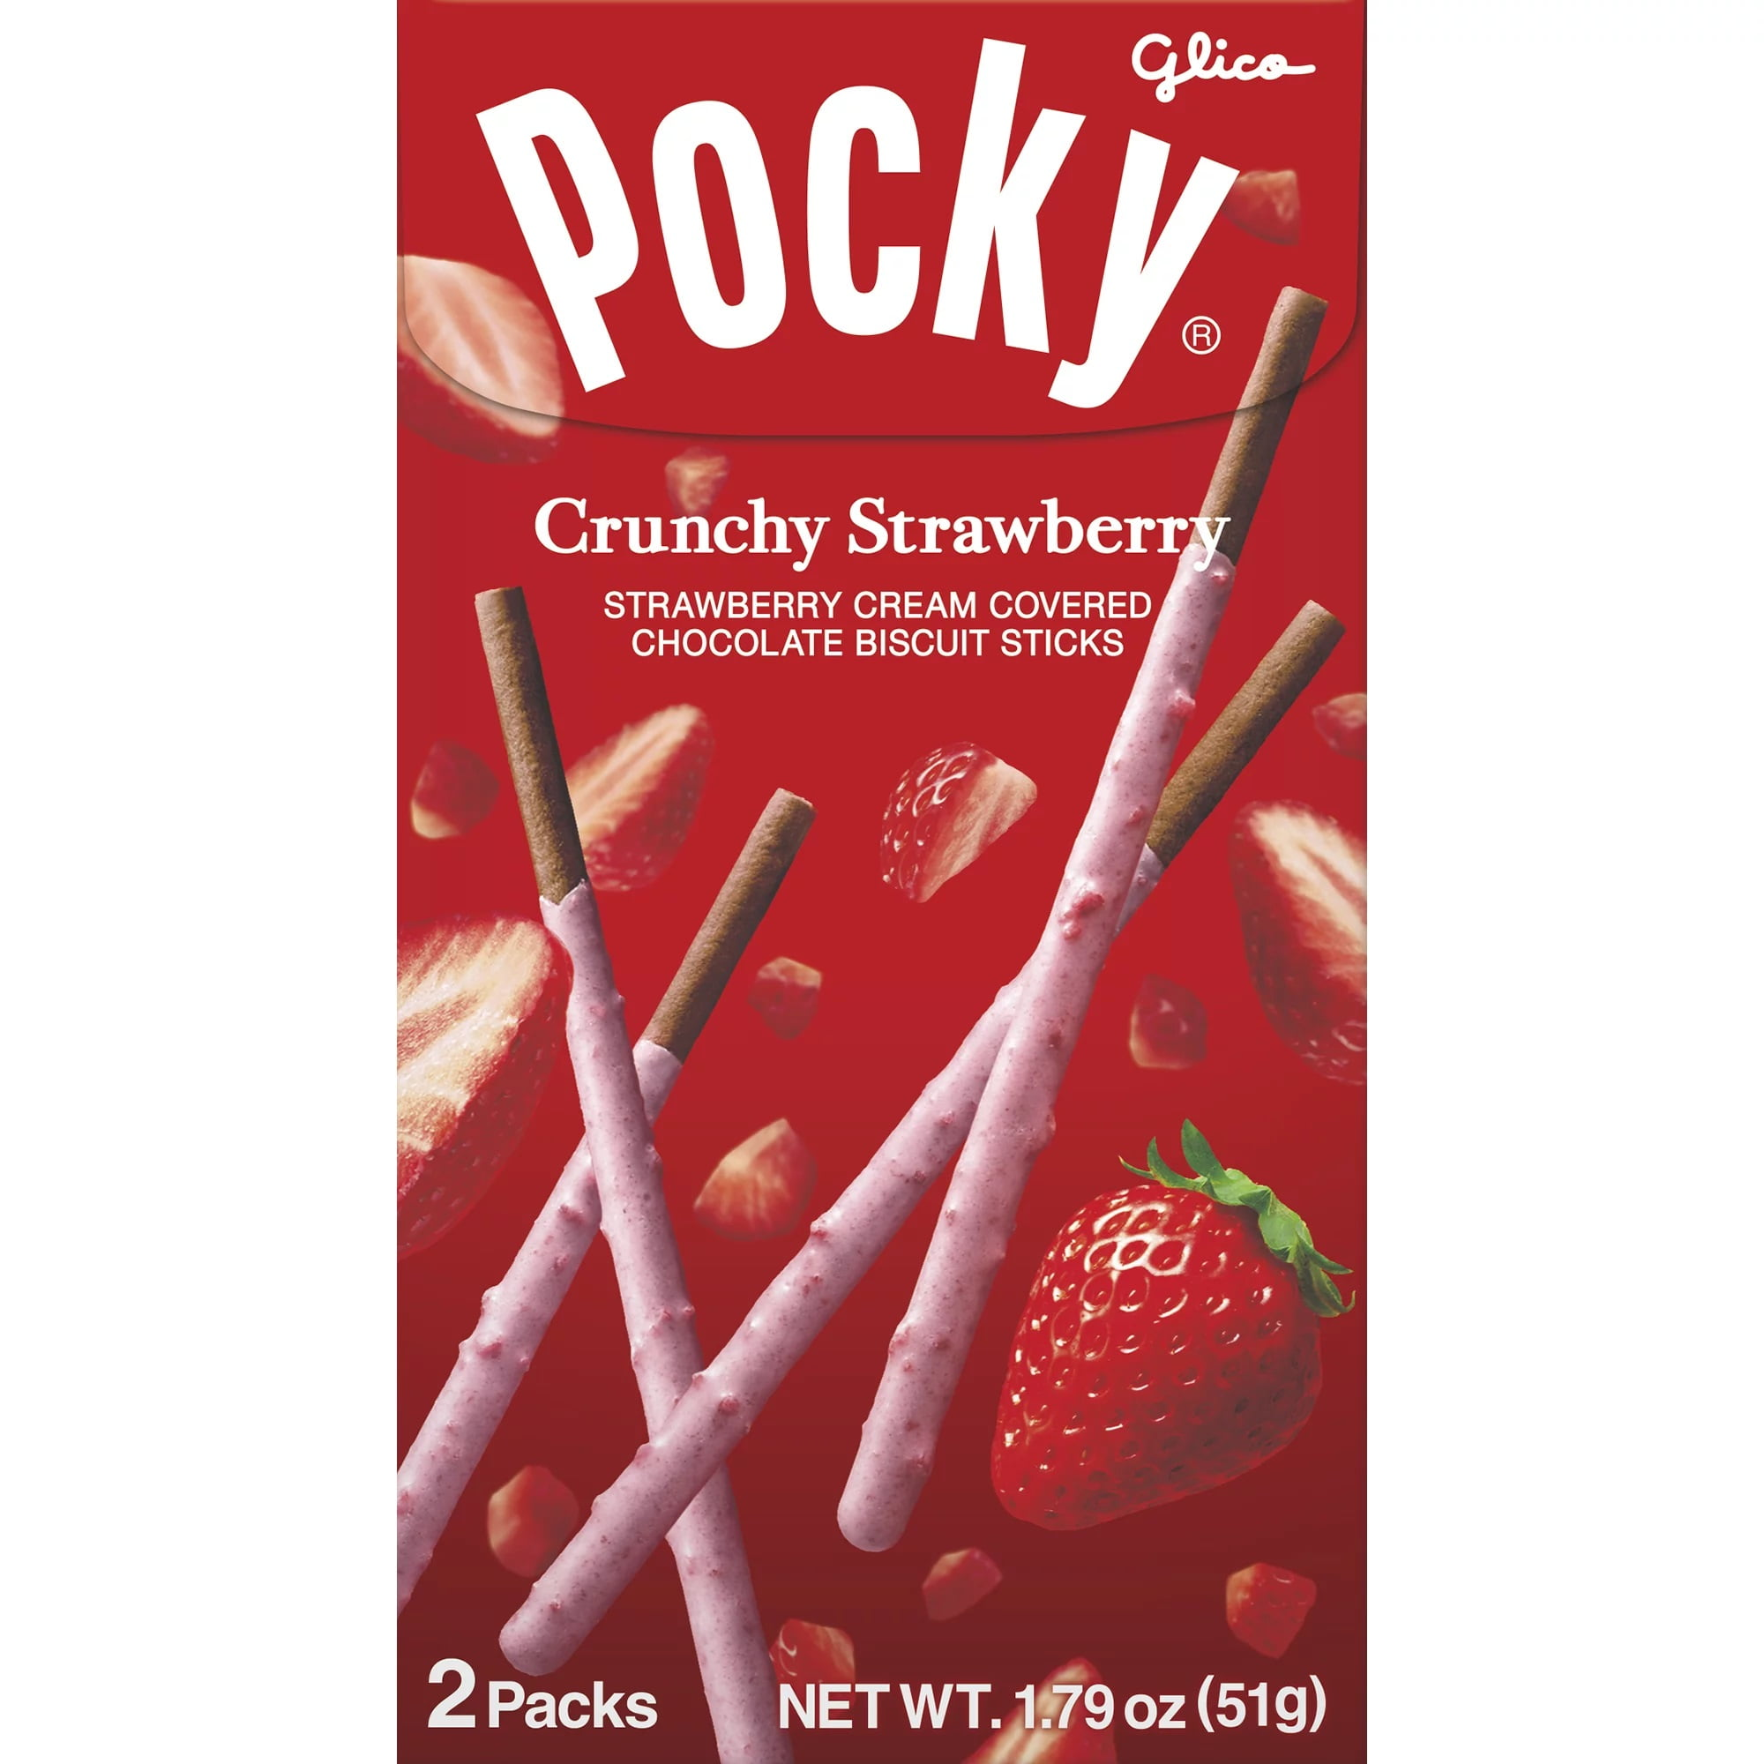
Pocky Crunchy Strawberry Cream Sticks

Slide 39
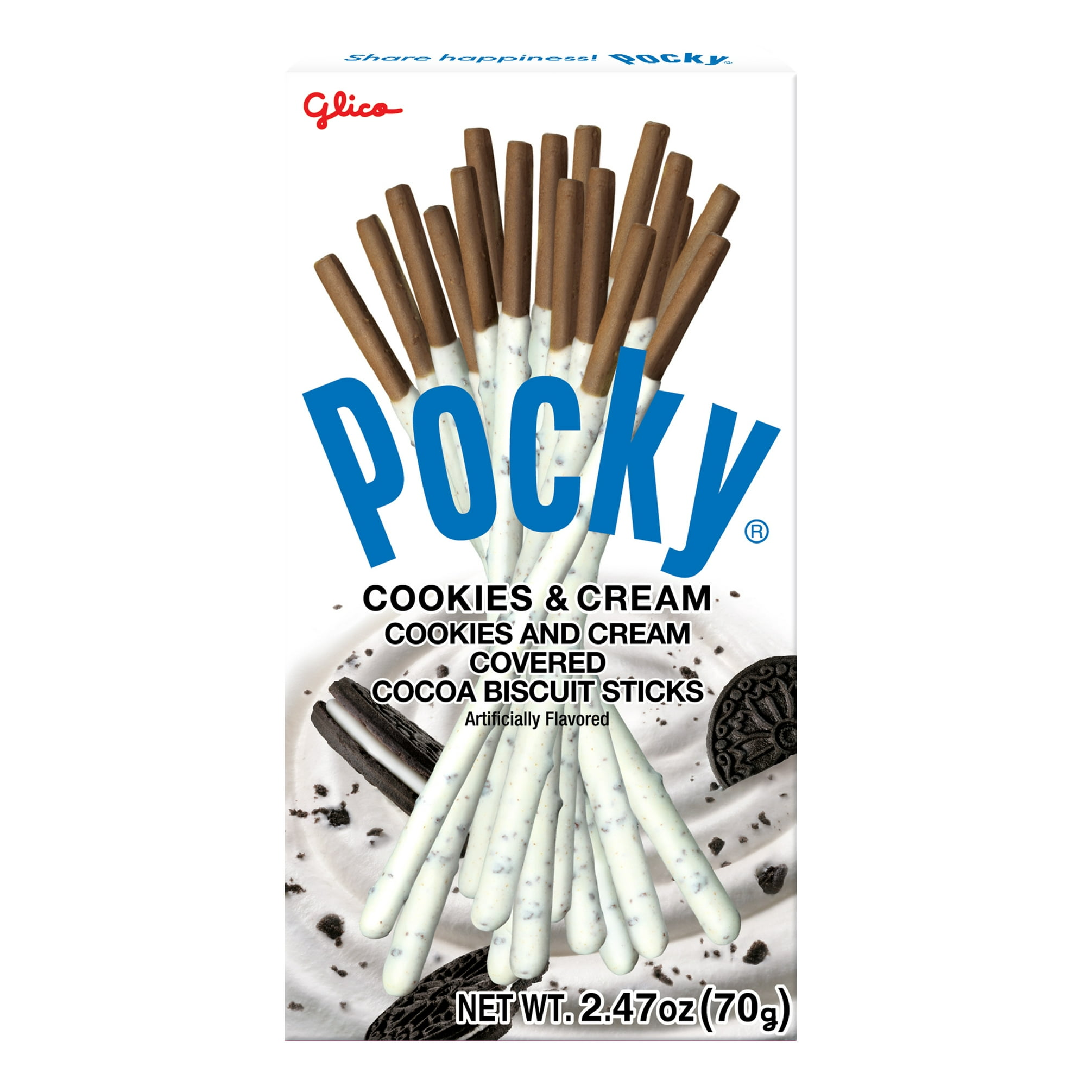
Pocky Cookies and Cream Sticks

Slide 40
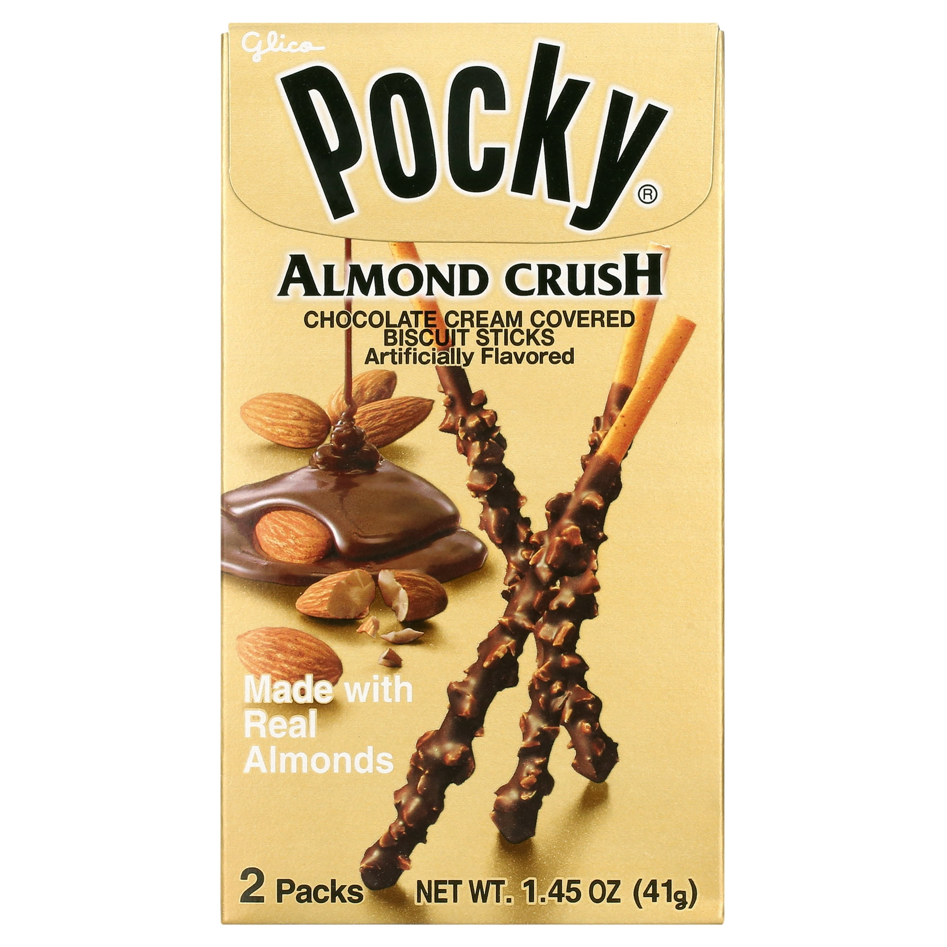
Pocky Almond Crush Chocolate Cream Sticks

Slide 41
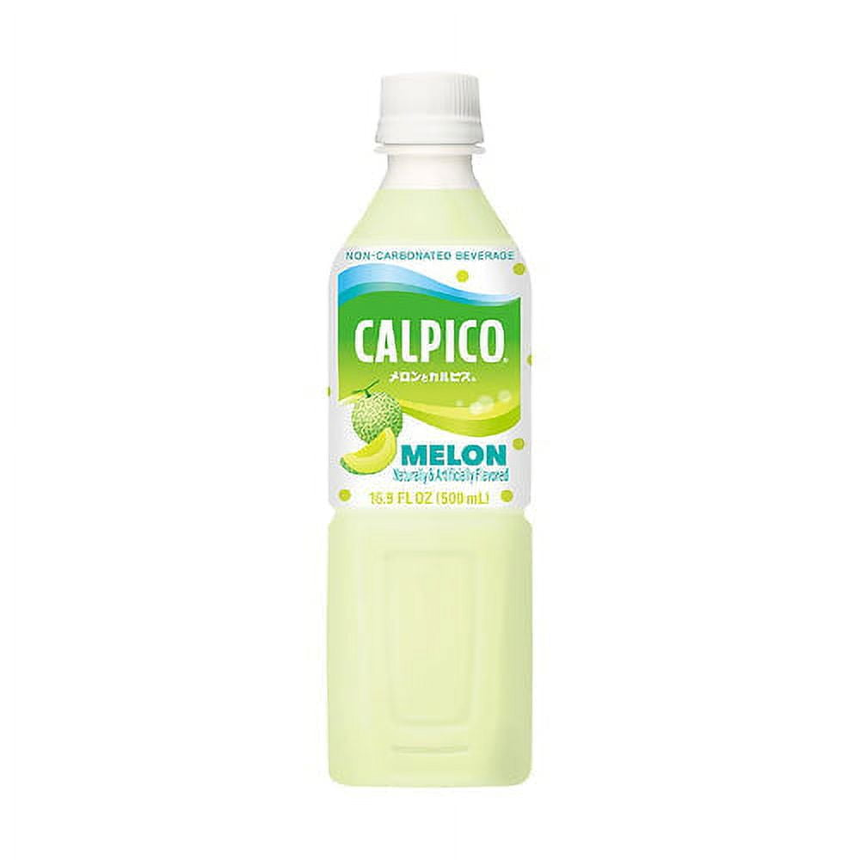
CALPICO Melon Drink

Slide 42
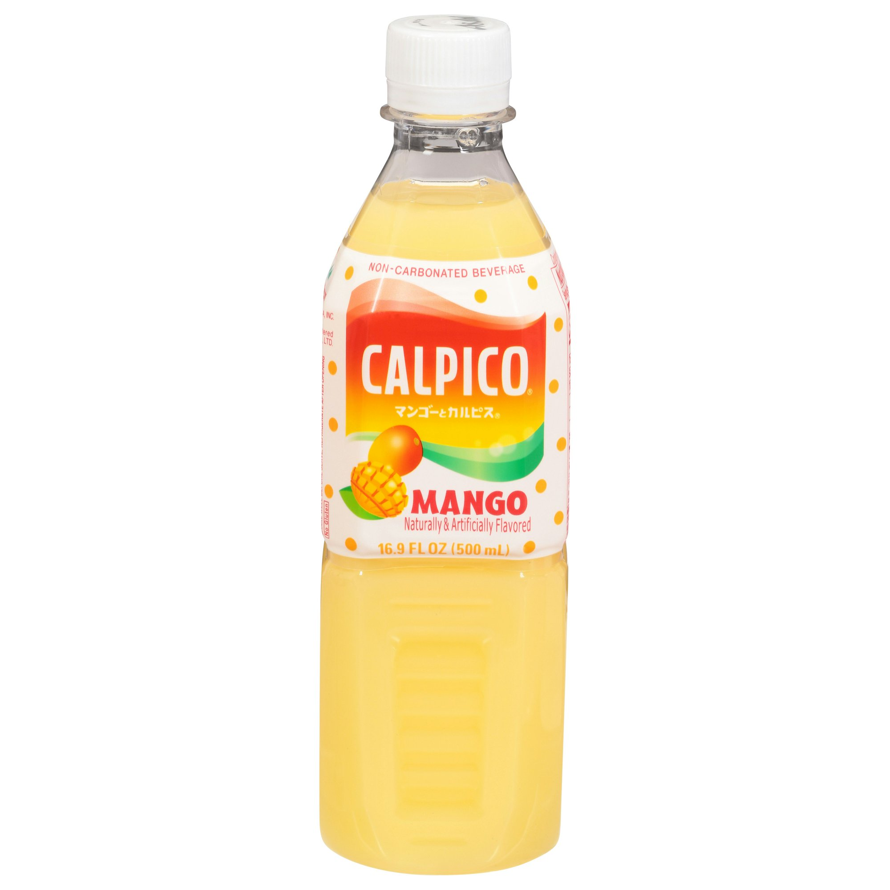
CALPICO Mango Drink

Slide 43
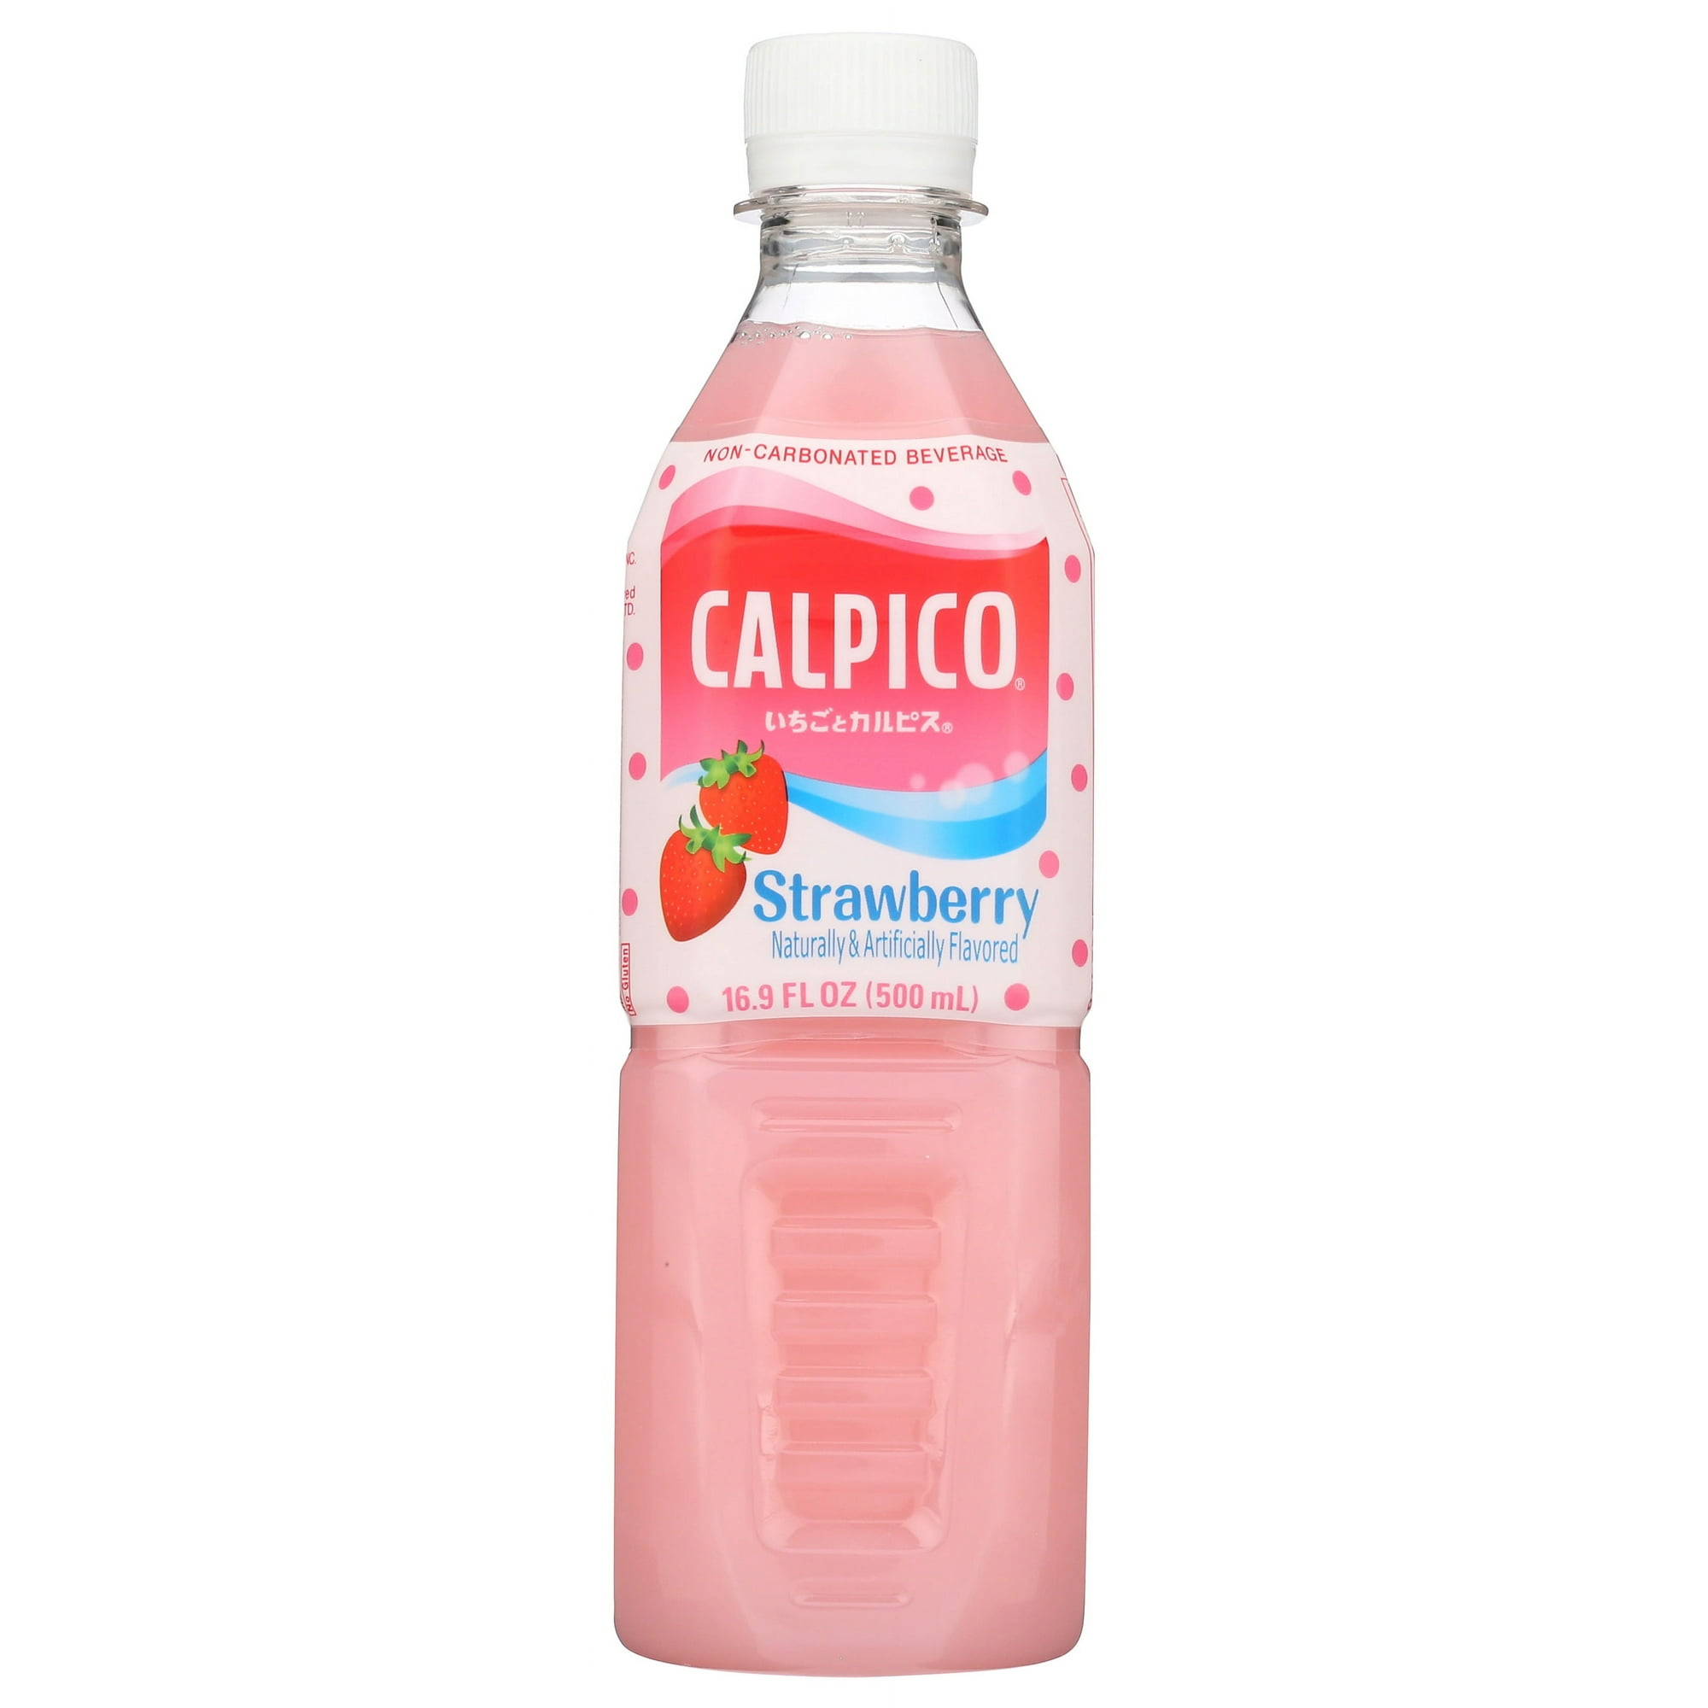
CALPICO Strawberry Drink

Slide 44
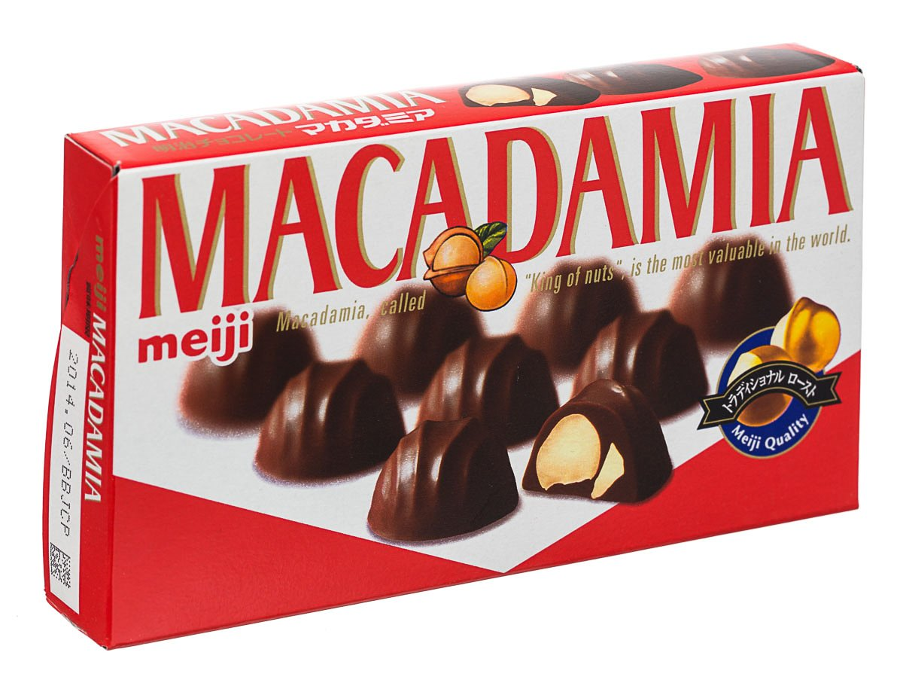
Meiji Choco Macadamia

Slide 45
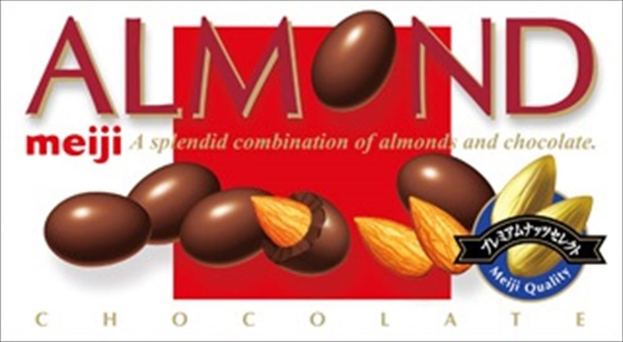
Meiji Choco Almond

Slide 46
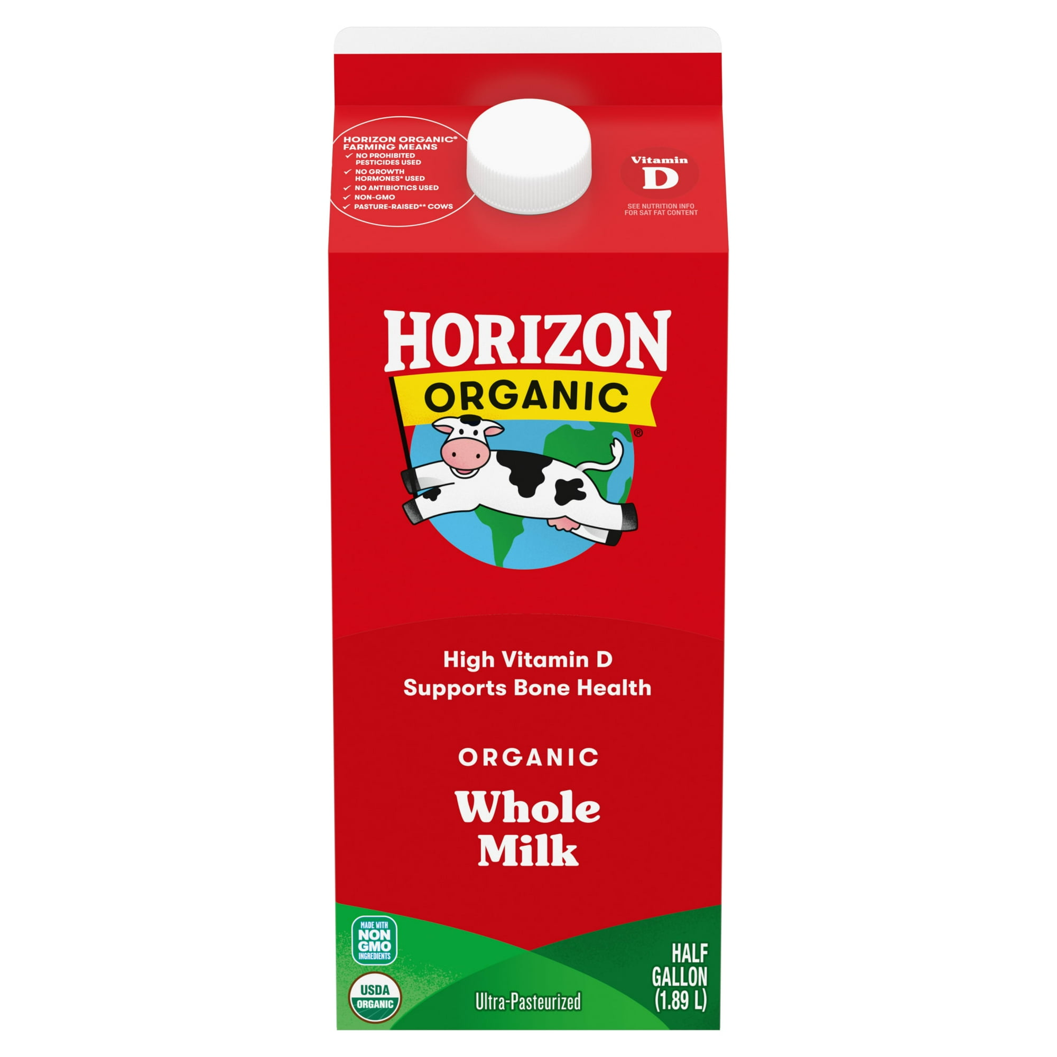
Horizon Organic Whole Milk

Slide 47
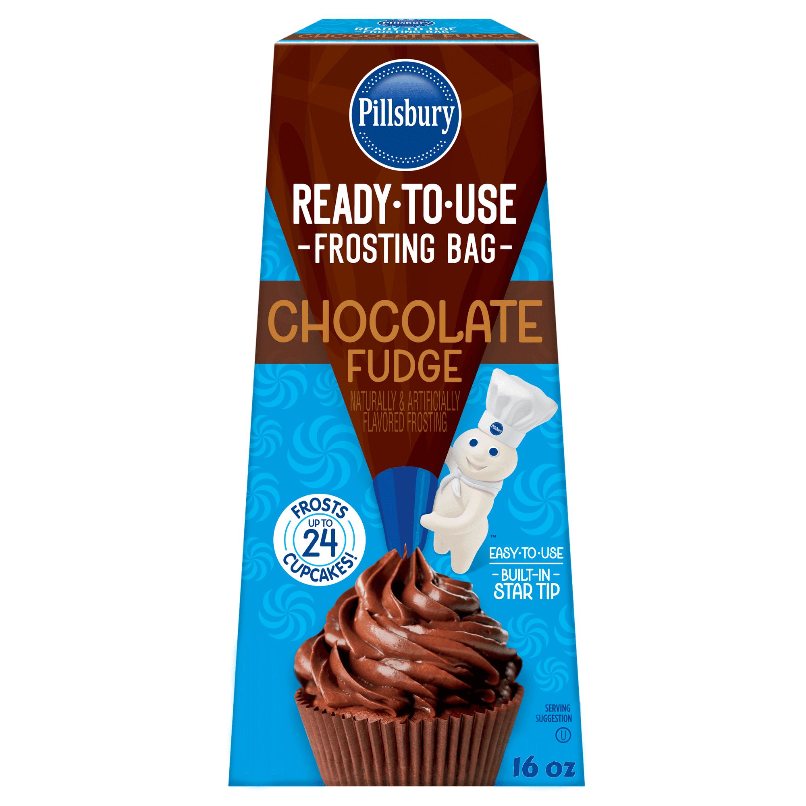
Pillsbury Chocolate Fudge

Slide 48
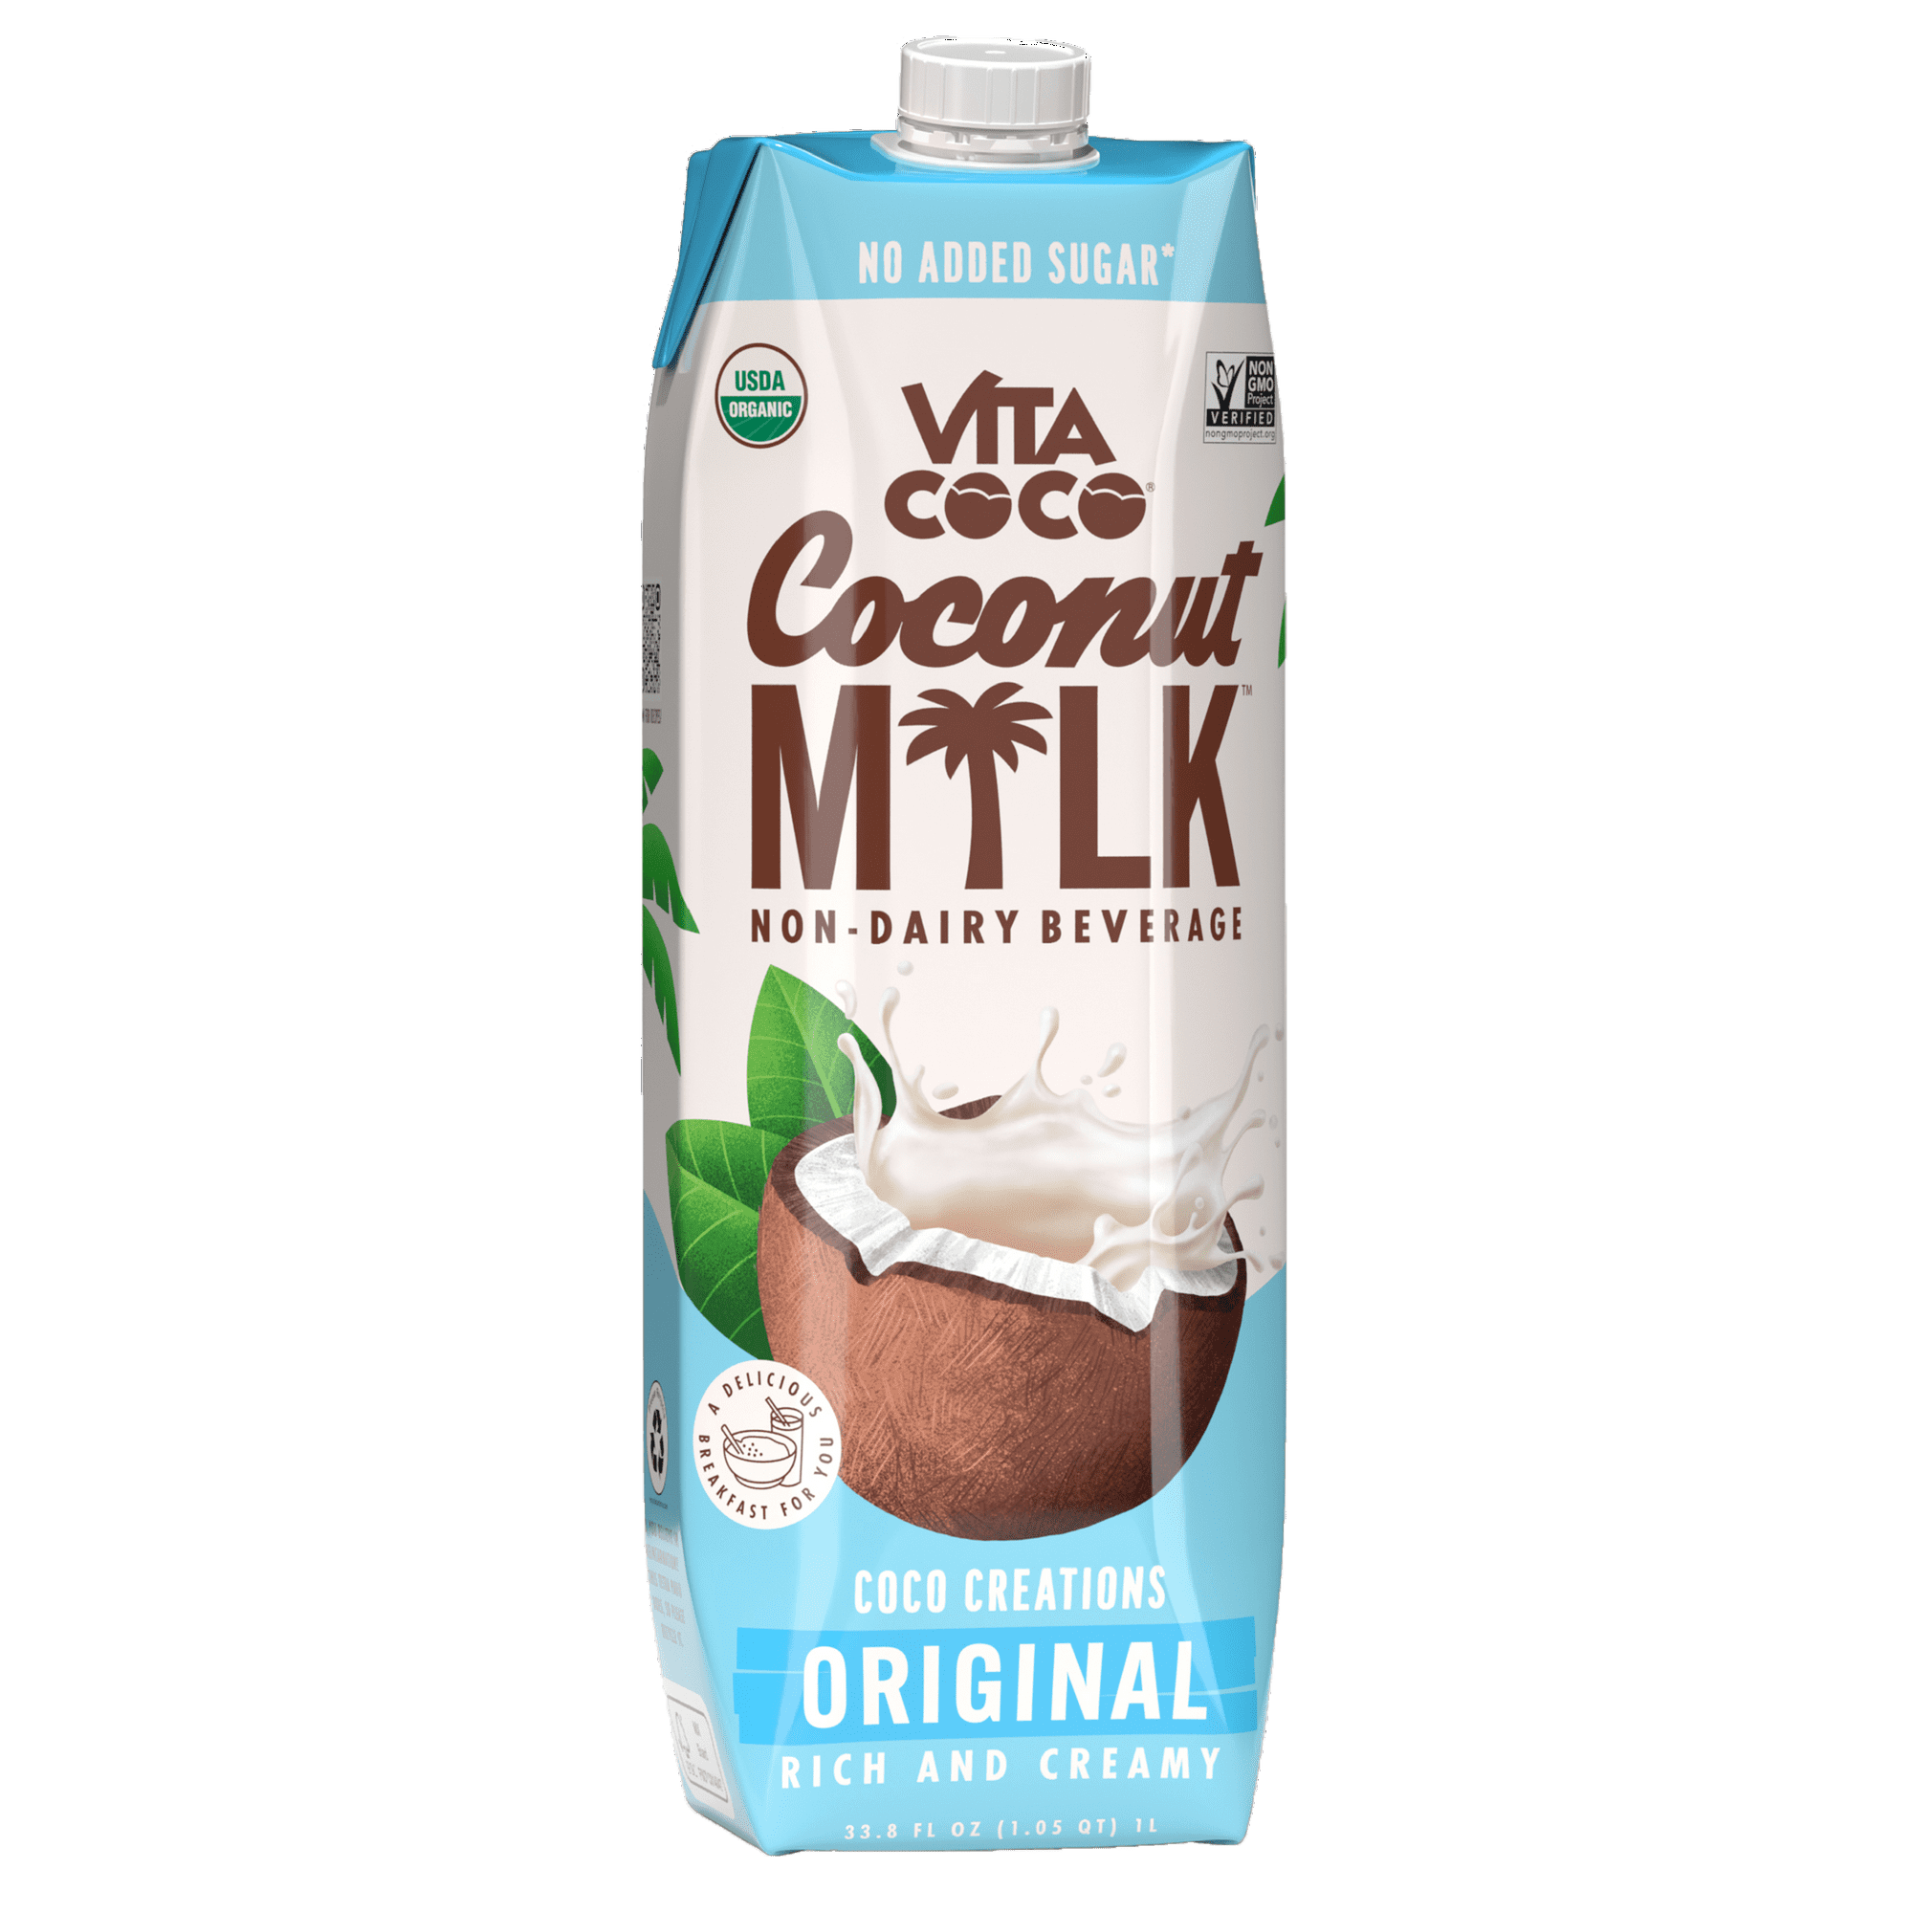
Vita Coco Coconut Milk

Slide 49
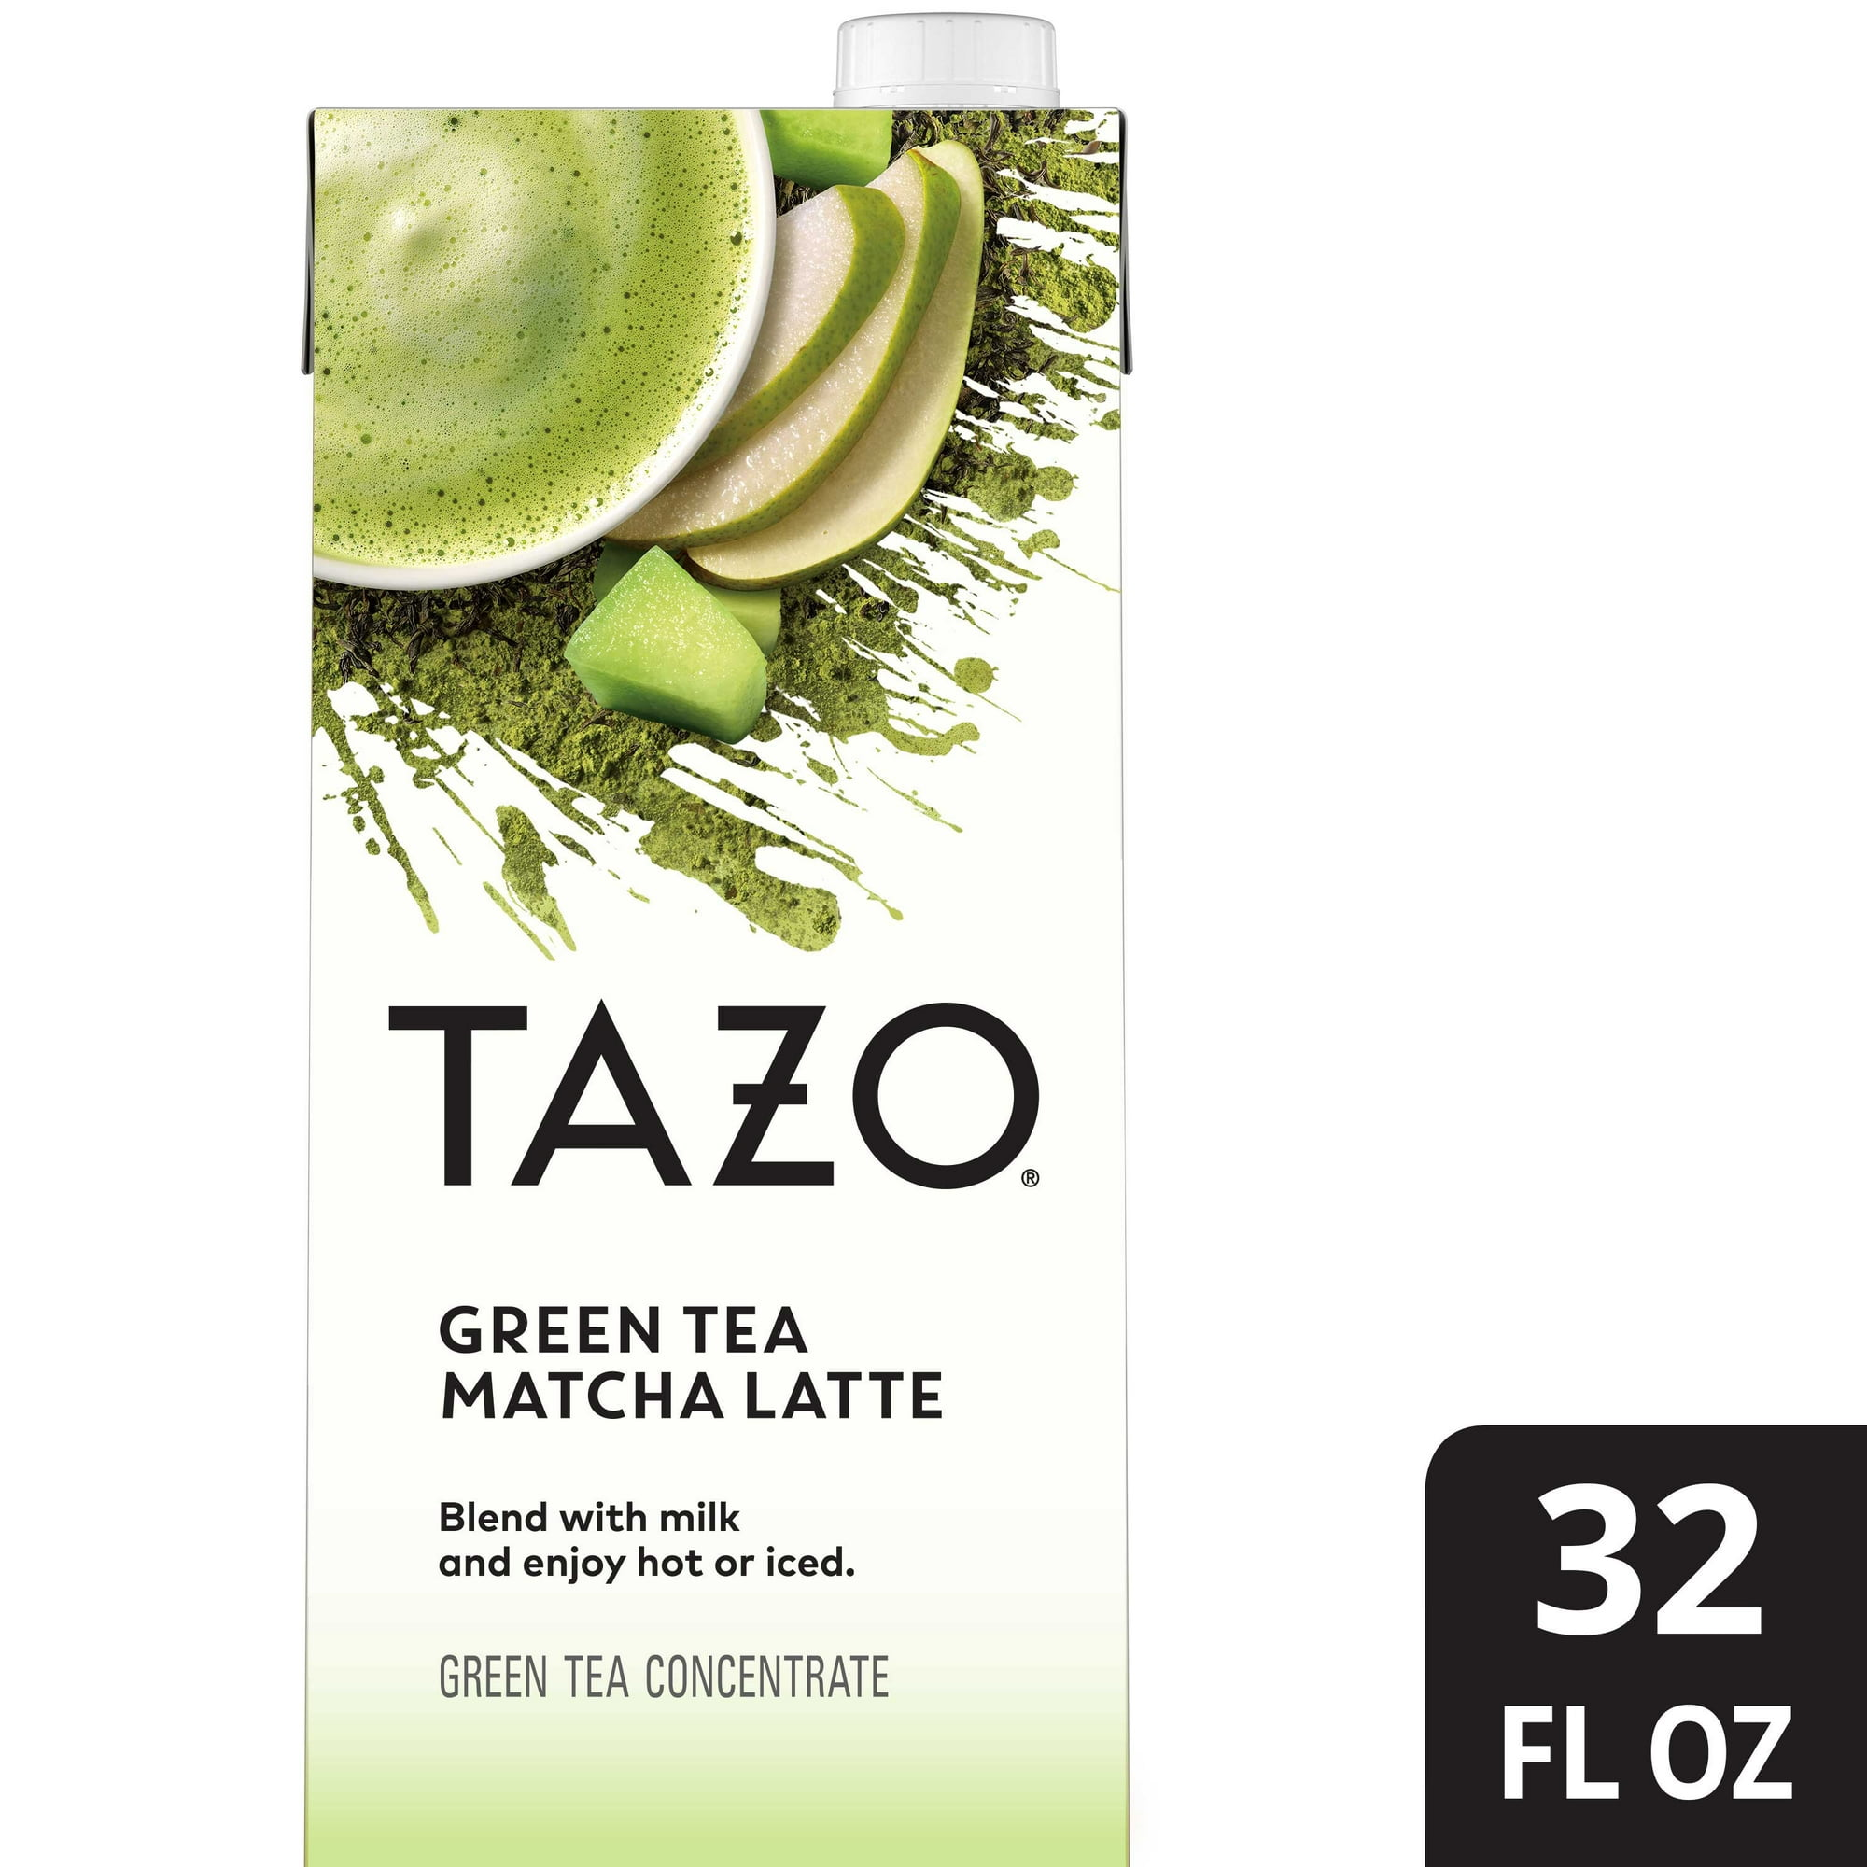
Tazo Green Tea Matcha Latte Concentrate

Slide 50
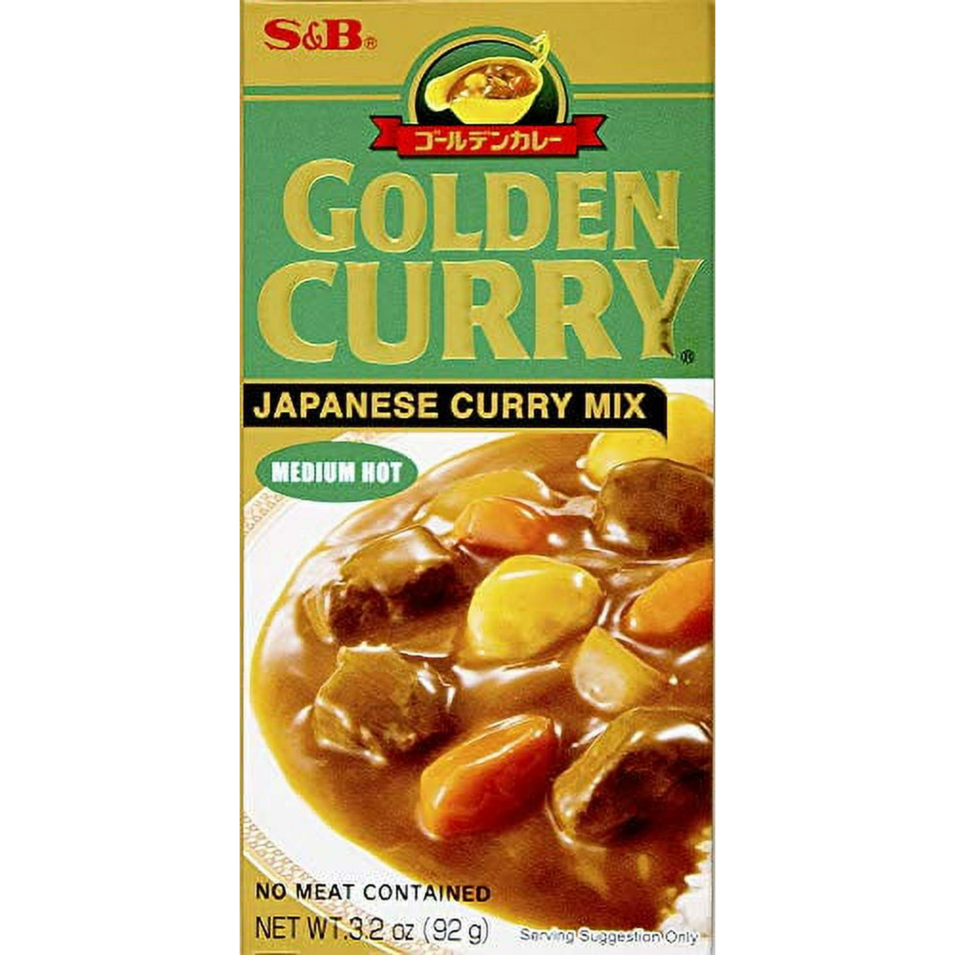
Golden Curry Japanese curry Mix

Slide 51

Equate Baby Powder

Slide 52

Native Body Wash

Slide 53

Arm & Hammer Baking Soda

Slide 54

Kodiak Cakes Power Cakes Flapjack Quick Mix

Slide 55

Bosco Chocolate Syrup

Slide 56

Hairitage Body Lotion

Slide 57

Lipton Kosher Soup Recipe Vegetable

Slide 58

Ritz Original Crackers

Slide 59

Quaker Instant Oatmeal

Slide 60

Nesquik Chocolate Powder

Slide 61

Sweet Baby Ray's Original Barbecue Sauce

Slide 62

Hain Pure Foods Sea Salt

Slide 63

Lay's Stax Potato Crisps

Slide 64

Soothing Body Wash

Slide 65

Bacon Grease

Slide 66

Snuggle Fabric Softener Sheets

Slide 67

Nesquik Strawberry Syrup

Slide 68

Crest Scope Liquid Gel Toothpaste

Slide 69

Native Deodorant

Slide 70

Shout Advanced Action Gel

Slide 71

Coco Real Cream of Coconut

Slide 72

Butter Original Spray

Slide 73

Mosquito Repellent Spritz

Slide 74

Heinz Mayomust Sauce

Slide 75

Method Men Gel Liquid Body Wash

Slide 76

Instant Cappuccino Mix

Slide 77

Osem Natural Soup Mix

Slide 78

Super Coffee Vanilla Creamer

Slide 79

Reynolds Cut-Rite Wax Paper

Slide 80

Great Value Whole Wheat Spaghetti

Slide 81

Hershey's Cocoa Powder

Slide 82

Lifeway Organic Whole Milk Peach Kefir

Slide 83

Body Proud Body Wash Cleanser

Slide 84

Elmer's School Glue

Slide 85

Nellie and Joe's Key West Lime Juice

Slide 86

Ken's Steak House Lite Honey Mustard Salad Dressing

Slide 87

Great Value Strawberry Syrup

Slide 88

Log Cabin All Natural Table Syrup

Slide 89

Hidden Valley Original Ranch

Slide 90

OFF Deep Woods Dry Mosquito Spray

Slide 91

Butter Tub

Slide 92

Organic Coconut Oil and Ghee

Slide 93

Kids Bubble Bath and Body Wash

Slide 94

Oats Mixed Berry Oatmeal

Slide 95

Hairitage Body Scrub

Slide 96

Honey Hot Barbecue Sauce

Slide 97

Skin Moisturizer

Slide 98

ARM and HAMMMER Liquid Laundry

Slide 99

Drano Max Gel Clog Remover

Slide 100

Table Tennis Racket

